Slide 1
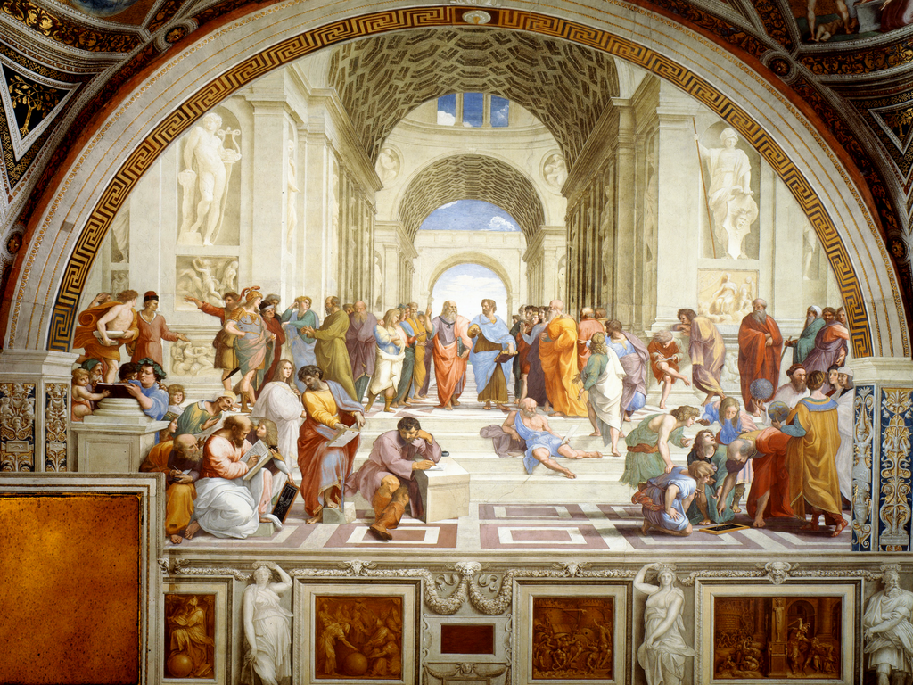
1. Get Real: An Introduction to Plato

Slide 2
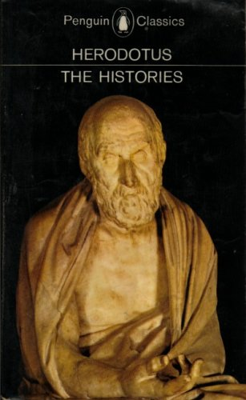
2. Herodotus c.495-425

Slide 3
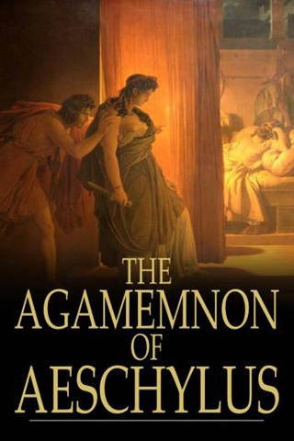
3. Aeschylus 525-456

Slide 4
4. Plato 427-347

Slide 5
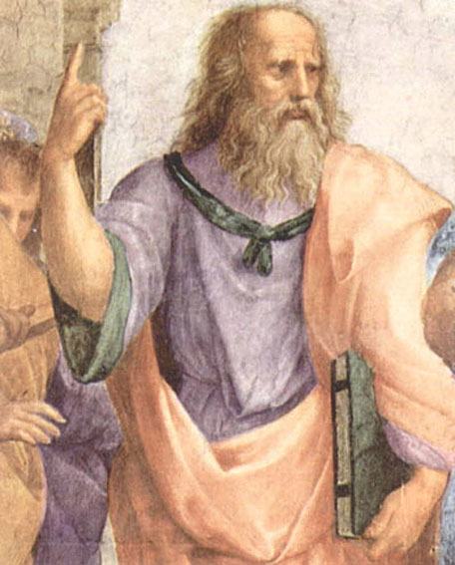
5. Plato is not being impolite

Slide 6
6. protagonist
The leader or principal person in a movement, cause or narrative

Slide 7
7. transcendent
going beyond ordinary limits; surpassing; exceeding.

Slide 8
8. Forms, Ideas, universals, absolutes, archetypes

Slide 9
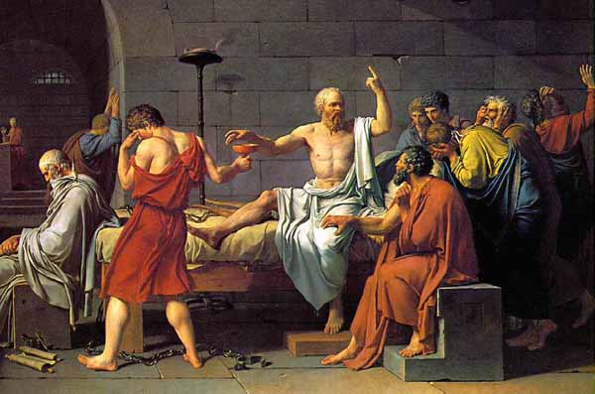
9. Socrates 469-399

Slide 10
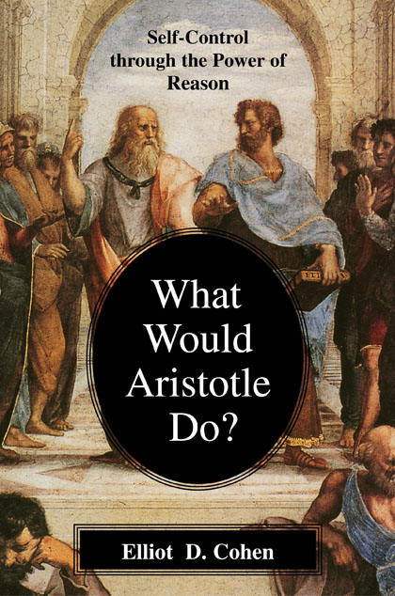
10. Aristotle 384-322

Slide 11
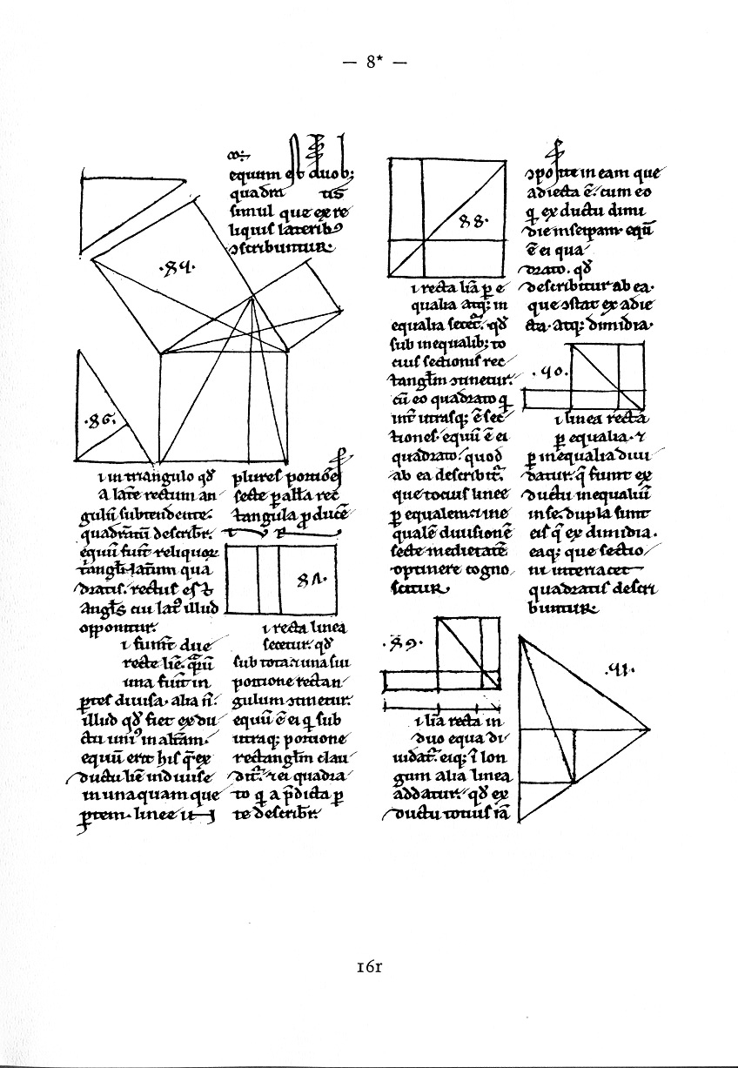
11. Pythagoras c.582-c.507

Slide 12

12. Hesiod 8th c. BC

Slide 13

13.Homer 8th c. BC

Slide 14

14. Sophocles 496-406

Slide 15
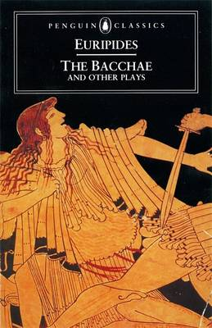
15. Euripides 480-406

Slide 16
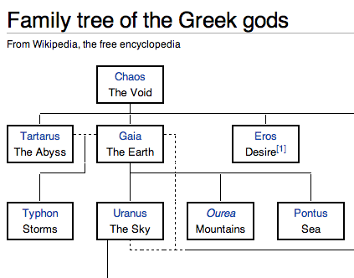
16.

Slide 17
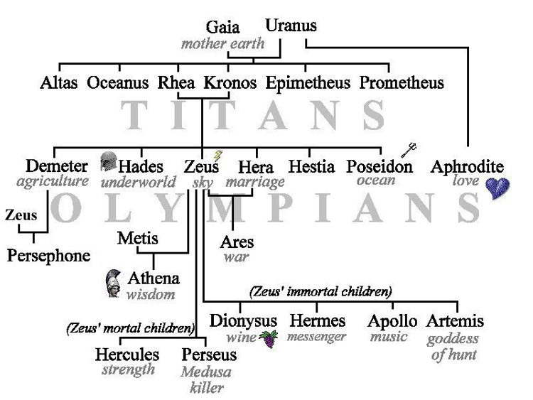
17.

Slide 18
18. Ontology
Theories of Being
What is real?

Slide 19
19. Epistemology
Theories of Knowledge
What can we know?

Slide 20
20.The Theory of Forms

Slide 21
21. nostalgia
a sentimental yearning for the happiness of a former place or time

Slide 22
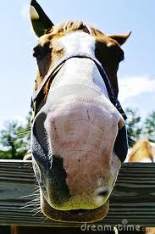
22. The Form of Beauty

Slide 23

23. Non-platonic horse I lost money on.

Slide 24
24.“After we came out of the church, we stood talking for sometime together of Bishop Berkeley’s ingenious sophistry to prove the non-existence of matter and that everything in the universe is merely ideal. I observed that though we are satisfied that his doctrine is not true, it is impossible to refute it. I shall never forget the alacrity with which Johnson answered, striking his foot with mighty force against a large stone, till he rebounded from it. ‘I refute it thus.’”
From Boswell’s ‘Life of Johnson’

Slide 25
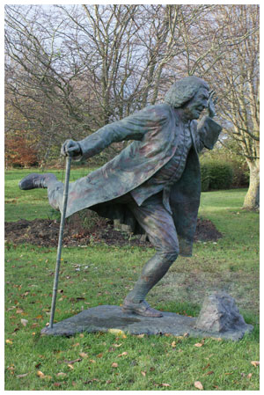
25. ‘I refute it thus!’

Slide 26

26. Jane Austen 1775-1817 AD

Slide 27
27. Idealism
any system or theory that maintains that the real is of the nature of thought or that the object of external perception consists of ideas.

Slide 28

28.

Slide 29
29. Realism
treatment of forms, colours, space, etc., in such a manner as to emphasise their correspondence to ordinary experience

Slide 30
30.Post modernism
There is no such thing as objectivity.
There is no "truth" to appeal to for understanding history and culture. There are no moral absolutes.
Texts, whether religious or philosophical or literary, do not have intrinsic meaning.
Ideas are cultural creations. Everything is relative.
We need to be deeply suspicious of all ideas given the way that ideas are used as tools to oppress and confine humans.

Slide 31
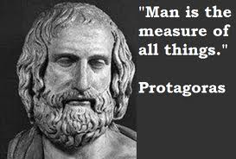
31. Sophists: Protagoras 490-420

Slide 32
32. pragmatism
action or policy dictated by consideration of the immediate practical consequences rather than by theory or dogma

Slide 33
33.
‘If that the heavens do not their visible spirits
Send quickly down to tame these vile offences,
It will come,
Humanity must perforce prey on itself,
Like monsters of the deep.’
Albany in Shakespeare’s King Lear IV,ii

Slide 34

34. Universal Declaration of Human Rights
United Nations General Assembly, Paris 10th Dec 1948

Slide 35

35. Karl Popper
1902-1994

Slide 36
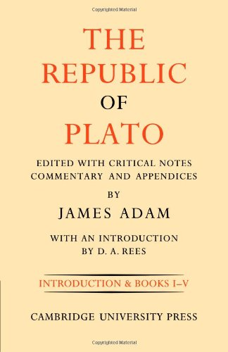
36. Plato’s The Republic

Slide 37
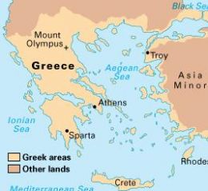
37. Antediluvian Sparta...

Slide 38

38. Stalin’s Russia

Slide 39
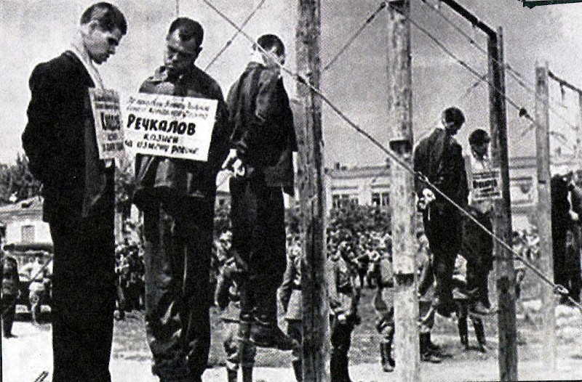
39.

Slide 40
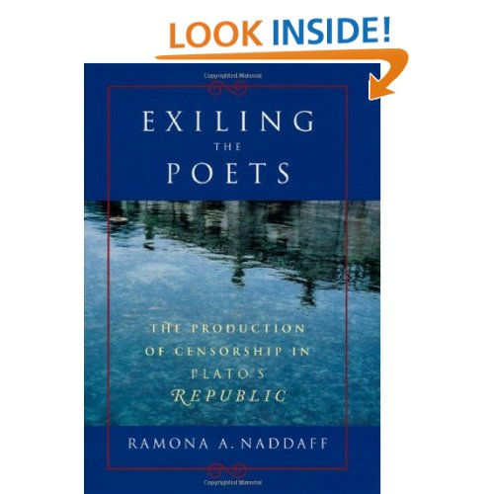
40.

Slide 41

41.

Slide 42
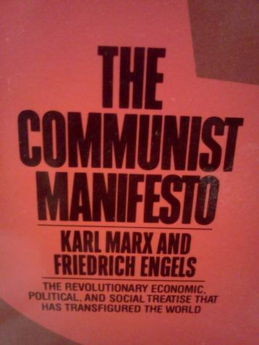
42.

Slide 43
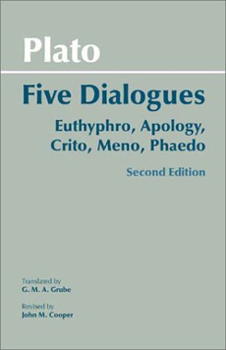
43.

Slide 44
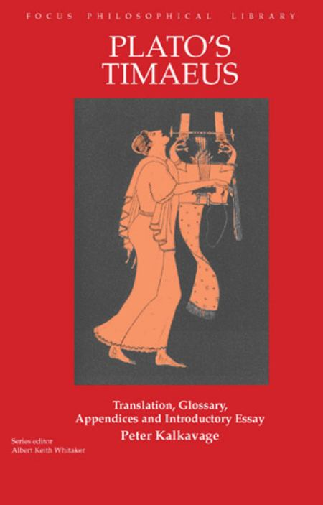
44.

Slide 45
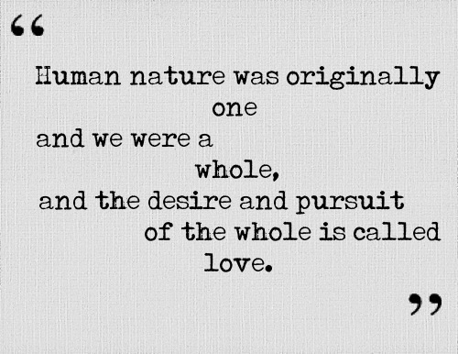
45. The Symposium:

Slide 46
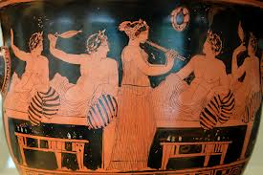
46.

Slide 47
47. dialectic
the art or practice of logical discussion as employed in investigating the truth of a theory or opinion.

Slide 48
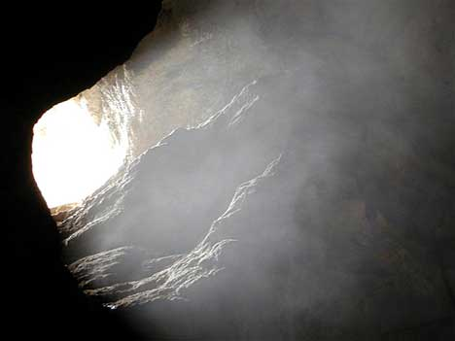
48. The Allegory of the Cave

Slide 49
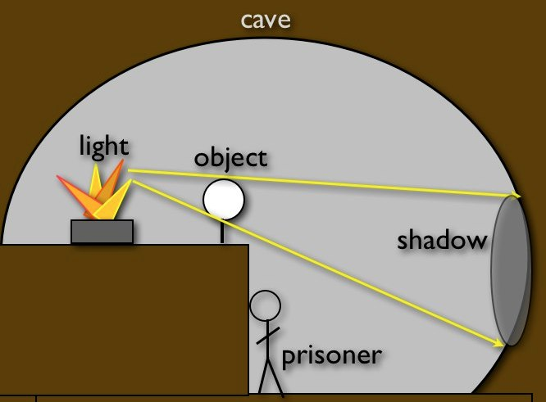
49.

Slide 50
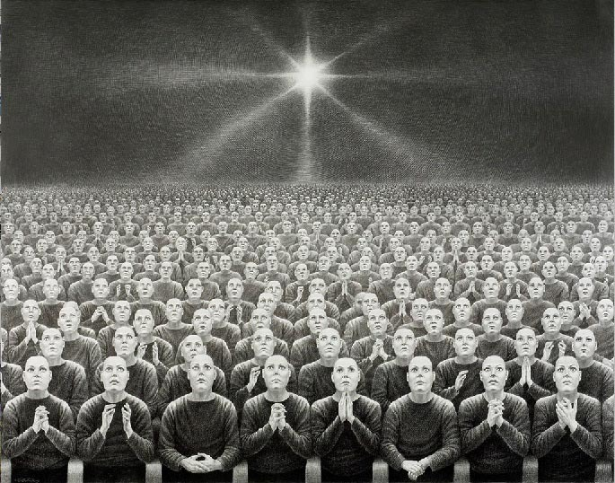
50.

Slide 51
51.
“Of all animals, the boy is the most unmanageable.”
- Plato

