Slide 1
The nature of knowledge
‘Information is acquired by being told, whereas knowledge can be acquired by thinking.’
Fritz Machlup, 1902-83

Slide 2
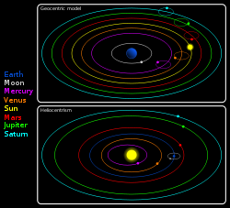
Knowledge as justified true belief
Truth
Belief
Is independent of...
Geocentric model
Heliocentric model
How do we know something is true? Can we ever be truly sure?
It is true ~ it is beyond reasonable doubt.

Slide 3
If you claim to know something, you must also believe it to be true.
As technology develops, will a computer ever KNOW things?
A calculator cannot know that 2+2=4
Vague belief
Well-supported belief
Belief beyond reasonable doubt
Tomatoes reduce heart disease
Moon landing in 1969 (convincing evidence)
Smith killed Jones (evidence)
See activity 2.2 p. 26

Slide 4
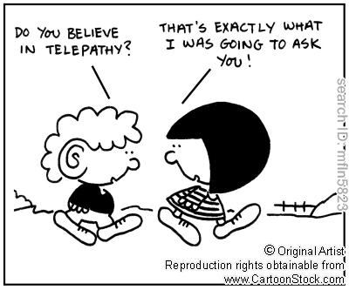
To claim you know something, your belief must be justified
Reason
‘I worked it out’
Language ‘someone told me’
Justification
Emotion
‘It’s intuitively obvious’
Perception
‘I saw it’
Reliable justification (depending on context: court room)
Unreliable justification (eg telepathy)

Slide 5
Levels of knowledge
Your understanding of what you claim to know can range from superficial to deep and sophisticated.
information
knowledge
Do you know what a zip is? Can you really explain accurately how it works?
Based on activity 2.3, (2) p.29: Can you find examples in your own life where you are able to recite things without fully understanding them?

Slide 6
Second-hand knowledge
How much could you know about the world if you never trusted anyone?
=Knowledge by authority
=Knowledge by testimony
What is the function of language in passing on second-hand knowledge? What are the dangers associated with this?
Main sources of second hand knowledge:
Cultural tradition, school, the internet, expert opinion, the media.
Can you think of any other sources?

Slide 7
Cultural Tradition
How does the culture you grew up in have an influence on the way you see the world?

Slide 8
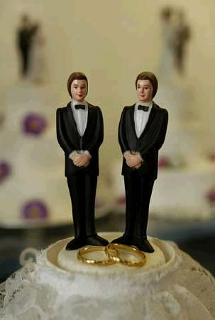
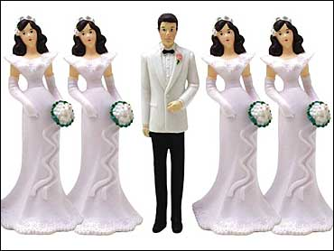
What is the most natural? Normal?
Gay marriage
Polygamy

Slide 9
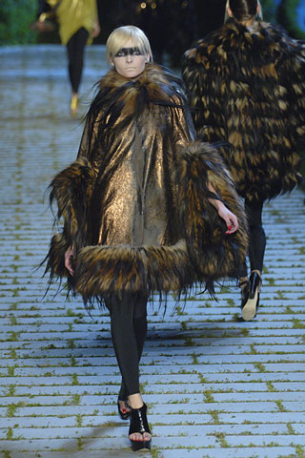
What is the most natural? Normal?
Padaung fashion, Thailand
Christian Dior, ‘Haute coûture’

Slide 10
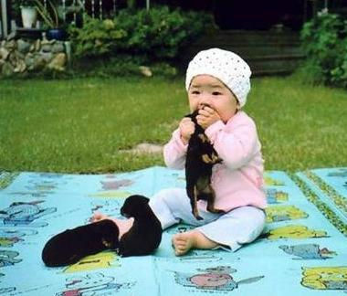
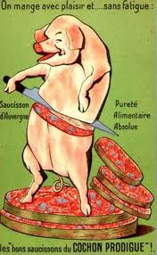
What is the most natural? Normal?
To eat dogs
To eat pigs

Slide 11
School
What’s the difference between education and indoctrination?
See act 2.6 (1). What opinions are teachers in your country expected to keep silent about and to what extent can this be justified?

Slide 12
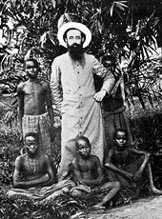
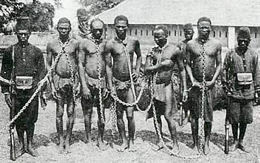
History lessons on colonisation in Congo
Exploitation? (my education)
Civilisation? (my dad’s education)

Slide 13
The internet
Is the internet a source of information or of disinformation?
See p.32 for Internet Urban Legends

Slide 14
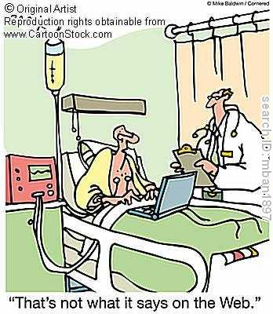
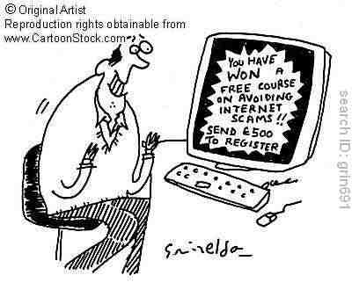
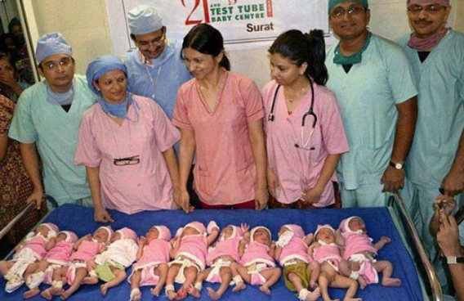
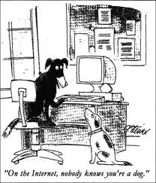
Did you ever google your flu symptoms and found out you were ‘terminally ill’?
Wild stories circulated about a woman who gave birth to 11 babies at once

Slide 15
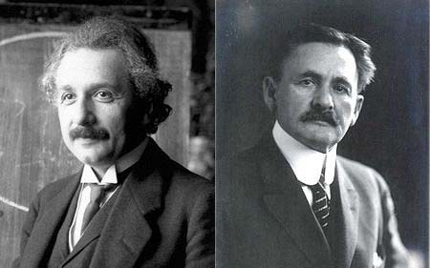
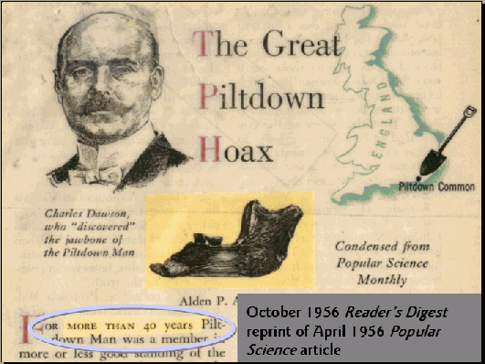
Expert opinion
Experts sometimes get it wrong.
See activity 2.8 p.34. How reliable is the expert opinion of the astrologer?

Slide 16
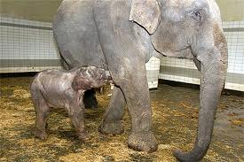
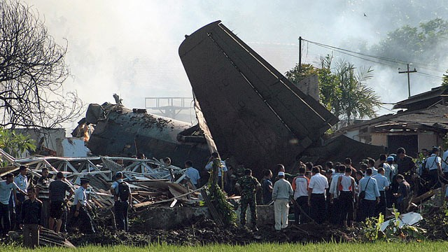
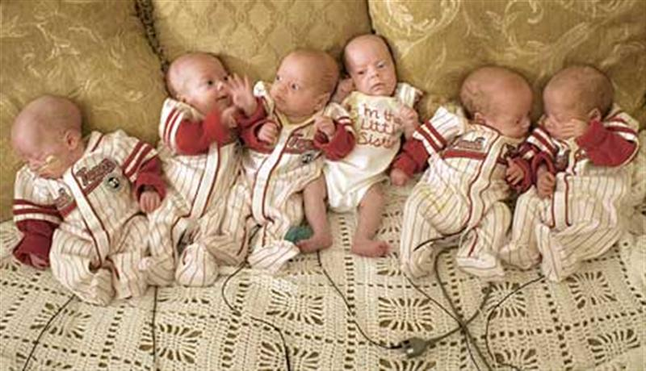
The news media
Activity: check out one ‘event’ which is reported in the media and compare their stories (preferably in different languages).
Bad news
Extroardinary news
Relevant news
What makes the news in your country? Why?
Indonesian plane crash, June 2012
Woman gives birth to sextuplets in the UK
Baby elephant born in Belgian zoo

Slide 17
Conclusion and key-points
Knowledge= justified true belief.
Truth is independent, believing something does not make it true
Knowledge=more than unorganised facts and more than belief as such
Lots of knowledge is gained second-hand, by the authority of other people
Detail and context help to gain understanding of an area of knowledge
Not all sources of knowledge can be trusted.
(danger of authority worship)
See p.39 for linking points

Slide 18
Key terms
Authority worship
Justified true belief
context
Expert opinion
Knowledge by authority/testimony
culture
information
Sufficient condition
News media
indoctrination
Thick concept
Second-hand knowledge
Primary knowledge
Urban knowledge

