Slide 1
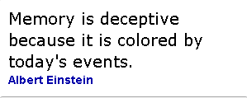
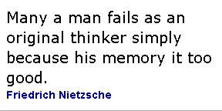
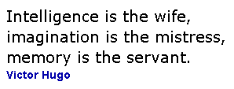
Memory
Which quote do you like best? Why?
Memory is the core of what we call reality…Almost every reality you ‘know’ at any given second is a mere ghost held in memory.
Howard Bloom
Notes:
Today we will look at memory as a way of knowing. We will particularly look at the concepts of memory, power, identity and control. To do so, we are going to look at a real life example for the arts: an extract of the book 1984. This is why we have invited an expert of the arts (an area of knowledge) to discuss this with you.

Slide 2
‘1984’: The Author
George Orwell, 1903-1950
Politically motivated writer (socialist)
As well as novels (Animal Farm) wrote numerous political motivated articles and non-fiction pieces.
Wrote 1984 in 1948.

Slide 3
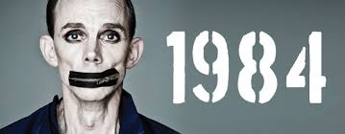
A brief context
Written in 1948, 3 years after the end of WWII.
World still in state of uncertainty after the traumas of war.
Huge divide emerging between Communist USSR and capitalist West. Beginning of the ‘Cold War’.
An important novel… for the alarm it sounds against the abusive nature of authoritarian governments, but even more so for its penetrating analysis of the psychology of power and the ways that manipulations of language and history can be used as mechanisms of control.

Slide 4
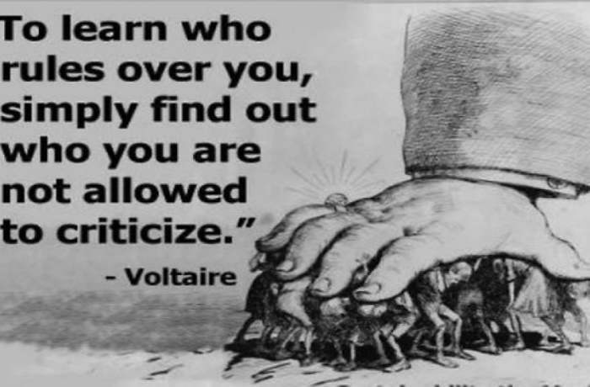
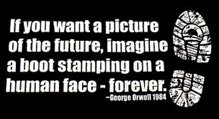
Setting
The novel is set in a future British society, years after a nuclear war has occurred.
Society is split into two groups - Party members and Proles.
Every aspect of life is controlled by the Outer Party (Big Brother) - individual freedom does not exist.
‘1984’ tells the story of Winston Smith’s individual rebellion against the oppressive totalitarian rule of Big Brother.

Slide 5
Winston is captured, tortured and ‘re-integrated’ by O’Brien, the novel’s only human representative of Big Brother. “Does Big Brother exist?" "Of course he exists. The Party exists. Big Brother is the embodiment of the Party." "Does he exist in the same way as I exist?" "You do not exist.”
Memory and ‘1984’

Slide 6
Memory & 1984
Read through the extract and discuss the ideas presented regarding memory (underlined).
What are Winston’s principle beliefs regarding individual reality and memory?
In what way do O’Brien’s principle beliefs contrast with Winston’s?
What links can you make between ideas presented in the extract and the quotations of Bloom, Einstein, etc.?

Slide 7
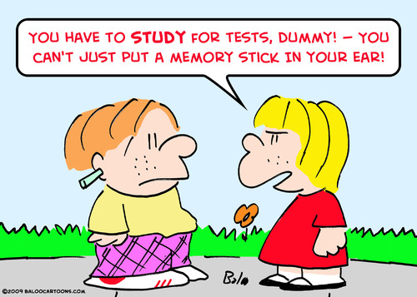
Where would we be without memory?
Notes:
Whilst keeping the extract in mind, we are now going to have a quick look at memory as such. We need memory in our daily lives: to pass tests, store information etc. It helps us to remain good social contacts and it (hopefully) prevents us from doing stupid things, such as hitting our head against a wall over and over again.

Slide 8
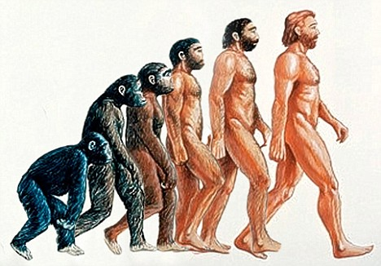
Notes:
Apart from individual memory, we also rely on collective memory. The memory of all that our ancestors have learned enables us to evolve as humans.

Slide 9
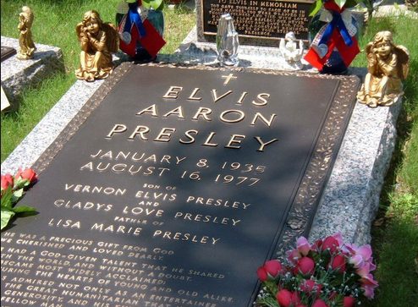
Notes:
On a personal emotional level, it is important to remember events and people. Many cultures remember the dead in a different way. The memory of Elvis is kept alive to such an extent, that some feel that the King still exists. Across the world, people also use keepsakes such as rings, photos, scrapbooks, engravings etc to remember big days such as weddings.

Slide 10
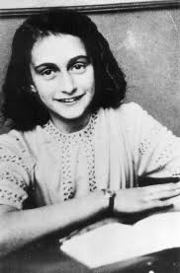
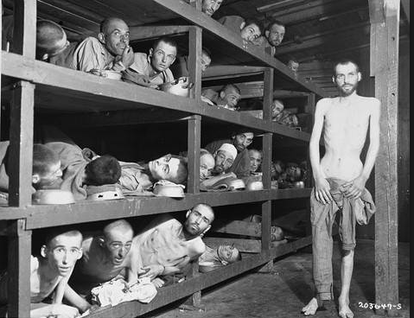
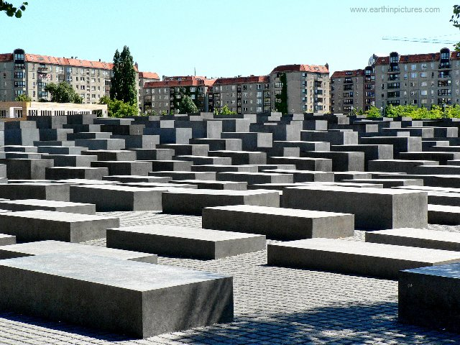
Notes:
Sometimes, it is historically and ethically important to remember big events from the past. The Holocaust memorial reminds us why we should remember the atrocities of genocides and will hopefully prevent people from committing the same atrocities in the immediate future. The Anne Frank exhibition also makes us remember what we are capable of as human beings. It shows how the single story of one individual can be create powerful collective memories. I think most people will agree that memory is very important. For the first time in 2015, the TOK course added memory as a way of knowing in its specification. Some people may argue that memory is not a way of knowing as such, but rather a storage place for knowledge. But, how would we know without memory?

Slide 11
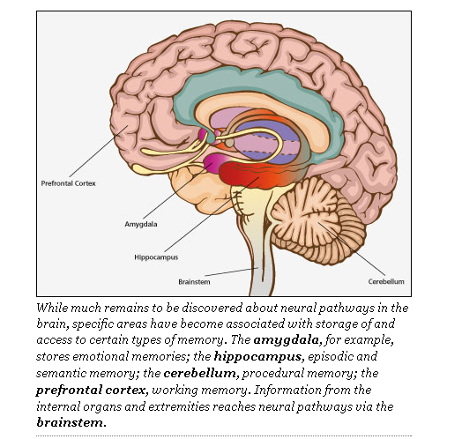
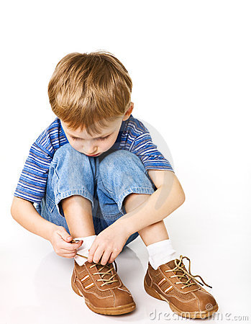
Procedural memory (skills)
Declarative memory (facts and events)
Semantic
(information)
Episodic
(experiences, autobiographical events)
Knowledge and memory of skills, encoded on subconscious and intuitive level. Long term, implicit memory.
Notes:
Psychologists differentiate between different types of memory. Psychologists make a difference between two types of memory: procedural memory (the knowledge of skills, which is encoded on the subconscious and intuitive level) and declarative memory (the memory of facts and events- either semantic memory, which is based on information or episodic memory, which is based on experiences). Both types of memory are highly important when we consider memory as a Way of Knowing. Each type of memory will raise different Knowledge Questions. In Tok we can also differentiate between what we remember as an individual and what we remember as a group, because we distinguish between personal and shared knowledge. Our individual memory and collective memory will give us knowledge in a different way.
Procedural memory is memory for the performance of particular types of action. Procedural memory guides the processes we perform and most frequently resides below the level of conscious awareness. When needed, procedural memories are automatically retrieved and utilized for the execution of the integrated procedures involved in both cognitive and motor skills; from tying shoes to flying an airplane to reading. Procedural memories are accessed and used without the need for conscious control or attention. Procedural memory is a type of long-term memory and, more specifically, a type of implicit memory. Procedural memory is created through "procedural learning" or, repeating a complex activity over and over again until all of the relevant neural systems work together to automatically produce the activity. Implicit procedural learning is essential to the development of any motor skill or cognitive activity.

Slide 12
Pair discussion (1984)
What would be the worst?
You could not make new memories?
Your individual memory clashed with the shared memory of your identity group?
What if?
All evidence of your past was erased?
You could not remember information/facts which you gathered.
You could not remember past experiences.
Notes:
We’ve looked at the importance of memory and the types of memories. Let’s now look at some implications on the topic of memories. Thinking of implications is important within the assessment for TOK.

Slide 13
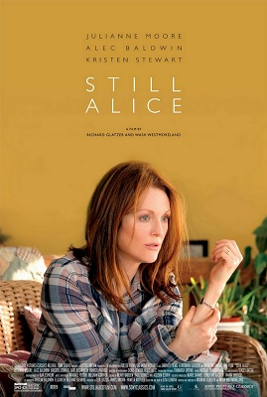
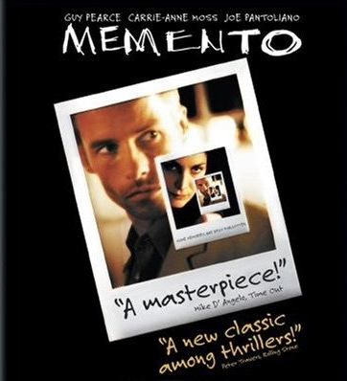
How do we know without memory?
Is memory a WOK?
The importance of memory can be highlighted by imagining the challenges that would be presented by losing our memory.
DISCUSSION:
What do you do to remember things?
Does your memory of these events change because of the ‘souvenirs’ you create?
What do you remember well? What do you tend to forget easily?
Notes:
The importance of memory can be highlighted by imagining the challenges that would be presented by losing our memory. Psychological and medical conditions which involve memory loss, such as Alzheimer's, highlight the importance of memory as a Way of Knowing. After I watched the thriller Memento, about a man who suffers from anterograde amnesia, I became fully aware of this fact. The main protagonist of the film is unable to store new explicit memories. In a time before I pads and I phones, he had to store his memories in a creative manner: through tattoos and Polaroid pictures. This memory impairment creates the perfect starting point for a thriller, yet it also highlights how we need memory as a Way of Knowing. DISCUSSION TASKS

Slide 14
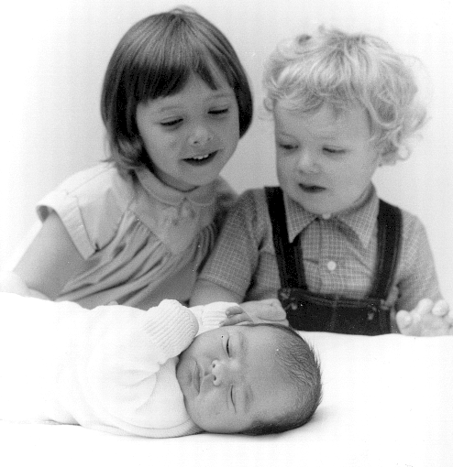
And if we forget?
TASK: Can you think of your most distant childhood memory?
Notes:
We do not remember everything. Sometimes this can be a good thing… We have all done some things we are not proud about and we have all seen things we’d rather forget. One of the more mysterious forms of amnesia is called childhood amnesia. To make you understand, try to think of your most distant childhood memory. On this photo, I am around 3.5 years old. I do remember the birth of my little brother, albeit in patchy detail (and more focused on the sweets we got –Belgian tradition- rather than the baby being born). My middle brother, who was 1.5 years will not remember the event and my baby brother most certainly not. TASK: Think about your earliest childhood memory. How confident are you that you remember the event itself rather than being told about the event? Do you think it’s possible you altered the memory of the event throughout the years? Or mixed up different parts of the event?

Slide 15
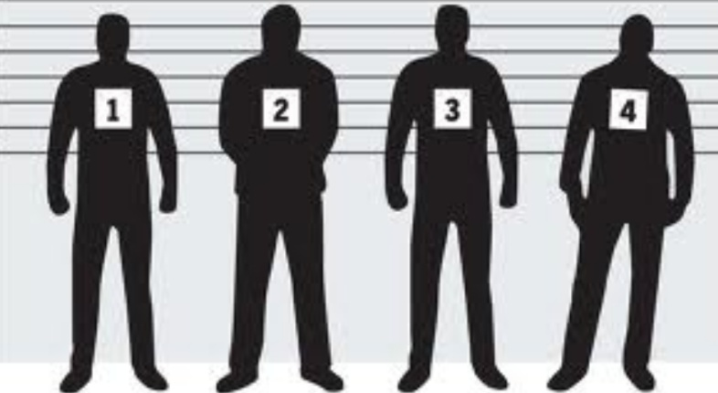
How reliable is our memory?
Notes:
In addition to the problem of forgetting memories completely (eg childhood amnesia, alzheimer’s), there is the issue of the unreliability of memory. If we rely on memory to store and acquire knowledge, it is important to have a reliable memory. But, this is certainly not always the case. Many of the examples I will use come from a TED talk by psychologist Loftus on the reliability of memory. The reliability of memory is very important in a legal context, where we will use eye witness testimony to decide what has happened.

Slide 16
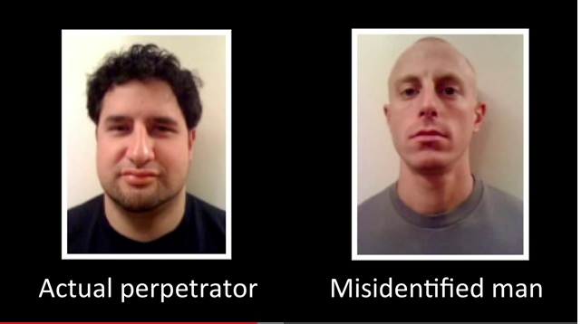
Elizabeth Loftus at TED (the fiction of memory):
Contamination of memory through misinformation
Notes:
Loftus starts off with a case in which a man had been falsely accused of rape (man on the right picture) and he got sentenced based on eye witness testimony. The victim of the rape managed to mistake him for the man on the left hand side, even though the physical resemblance is very poor. According to Loftus, there is a statistically very high incidence of contamination of memory in legal cases which rely on memory and eye witness testimony (even though the man on the right was proven to be innocent and he was legally cleared, his life was ruined and he committed suicide).

Slide 17
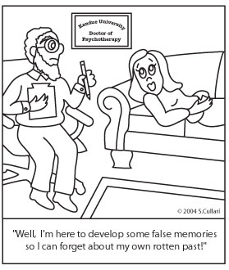
FALSE MEMORIES
Notes:
The legal cases were people were falsely accused based on false memories of eye witness testimonies drove Loftus to explore the possibilities of planting false memories. Your TOK textbook explores this issue in more detail and if you study psychology, you may be familiar with Loftus’s research. She is a controversial figure in the field of psychology because of the ethical implications of her research.

Slide 18
Success rate for planting false memories
Lost in shopping mall: 25 %
Nearly drowned: 50%
Attacked by a dog:50%
You witnessed demonic possession
Notes:
Loftus researched how the use of suggestion, leading questions, someone else (family member) telling you that something had happened and imagination inflation (let imagination run wild) can alter people’s memories. The results were quite amazing:……………………….. Imagine the control parents and authority figures have over you. Scary!

Slide 19
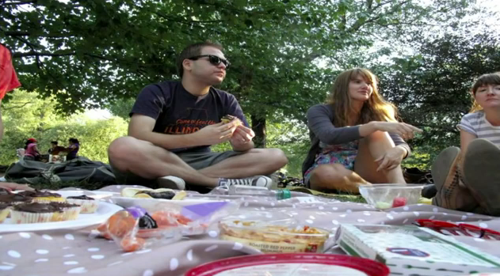
How false memories change your behaviours
Disgust
Or appetite?
Strongly disagree- agree
Discussion: The ethical implications of memory experiments?
Would you implant false memories in your children to make them eat vegetables?
Is there any situation in which we could justify planting false memories?
Could we justify planting false memories from a utilitarian point of view?
Notes:
Loftus’s research may seem rather controversial from an ethical point of view. She did get into trouble legally because of the type of research she did, as she explains in her TED talk. She does, however, strongly feel that the ethical advantages of the implications outweigh the disadvantages. (DISCUSSIONS– choose the sign in ‘strongly disagree…..strongly agree’ continuum that fits you best and stand next to it.)

Slide 20
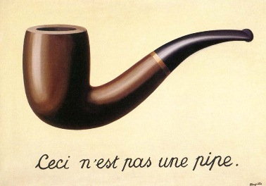
CIA interest in leading ‘memory psychologists’ during the Cold War era: Change memory to change behaviour
CASE STUDY: Tabula Rasa therapies by experimental psychiatrist Dr Cameron (1901-67)
For full documentary: See Adam Curtis: The living dead, episode 2, 19.25mins – 23mins.
website: www.sohowdoweknow.weebly.com)
Notes:
As research shows, it is remarkably easy to manipulate memories. This can give you power because once we alter or erase someone’s memory we can try to control the other and even alter people’s behaviour. An interesting real life case study is the Tabula Rasa therapies which were used by experimental psychiatrist Dr Cameron. He attempted to erase people’s memory (tabula rasa) so patients would be transformed into new human beings, freed from their troubled past. AT the time of the cold war, the CIA was particularly interested in such therapies, as they presented politically powerful tools. I will now show you a fragment of a patient who has been through such therapy. If you are interested in the entire documentary, have a look on the website.

Slide 21
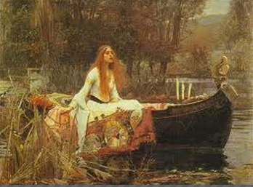
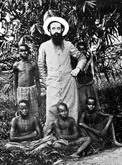
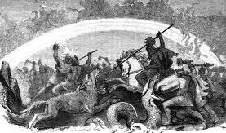
The abuse of memory in the world
Link to AOK
Pre-Raphaelite art
Our memory of colonisation
See Curtis’s ‘The Living Dead’ epsiode 1 (website)
The Aryan Myth
Discussion: can you find other real-life examples where memory is/has been abused around the world?
Notes:
Research on false memories highlights the importance of critically evaluating where memory has been abused and is still abused throughout the world. Many dictatorships, for example, draw on mythical memories which never existed. The Aryan myth with a nostalgia for a past which was never there, is a good example. Propaganda in North Korea creates and glorifies false memories. The colonial history of Belgium, but also the UK and other European nations is often an airbrushed, false memory. Pre-Raphaelite art may just be art, but it had a function to recreate a false medieval memory which heavily influenced our perception of the past. We will now go back to the extract of 1984 to see how we can apply what we have just learned to a real life example of the arts.

Slide 22
Memory & 1984
How might you use your new knowledge of memory to help you assess the capacity of Big Brother to shape personal knowledge?
(reliability of memory, false memories, erasing memories, abuse of memory)

Slide 23
PLENARY →FORUM memory and the arts: 1984
What questions does (the extract of) 1984 raise in terms of the strengths and weaknesses of memory as a tool to gather and shape personal as well as shared knowledge?
Notes:
You have answered many questions in relation to memory and the extract of 1984. As a plenary homework activity, you will need to think of your own questions in response to the real life situation (the extract) in relation to memory as a way of knowing.
(report grades).
Next week: BIS space day, the week after: bring completed notes on Anne Frank exhibition as you will be preparing a group presentation on this topic.

