Slide 1
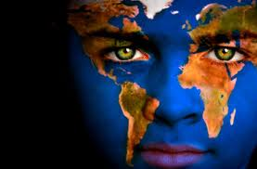
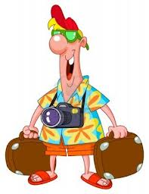
Researching indigenous cultures...
Etics- perspective an outsider has of the area.
Emics - perspective of somebody native to the area.

Slide 2
Research into culture needs to consider...
Reflexivity of the researcher
Ethics
Stereotyping
Protection of knowledge and ownership?
Ethnocentrism- the tendency to perceive the world from your own cultural/ethnic group. A consequence of this is that explanations may only work for certain cultural groups.
Caution of generalising data.
Translation of data.

Slide 3
Psychology of
“Cultural knowledge is best understood in its own terms and within its own frames of reference”.
Discuss
Maasai definition of marriage/love.
Notes:
Yvette Conway shows examples from a human scientist’s point of view. Link with Psychology and Culture in IB and the use of methodology in the human sciences.
Possible link to art and maths as AOK. How do we know we love? On what basis do we define beauty/attraction ...

Slide 4
Universal/similar (etic) or
Culture specific/different (emic)?
Time?
Aggression?
Emotion?
Attraction?
Gender roles?
Depression?
Happiness?

Slide 5
How different are we?
Western Science and Indigenous Knowledge are not polar opposites, common similarities exist in reference to:
Environmental awareness
Organic produce
Interconnectedness of living things- ecology

Slide 6
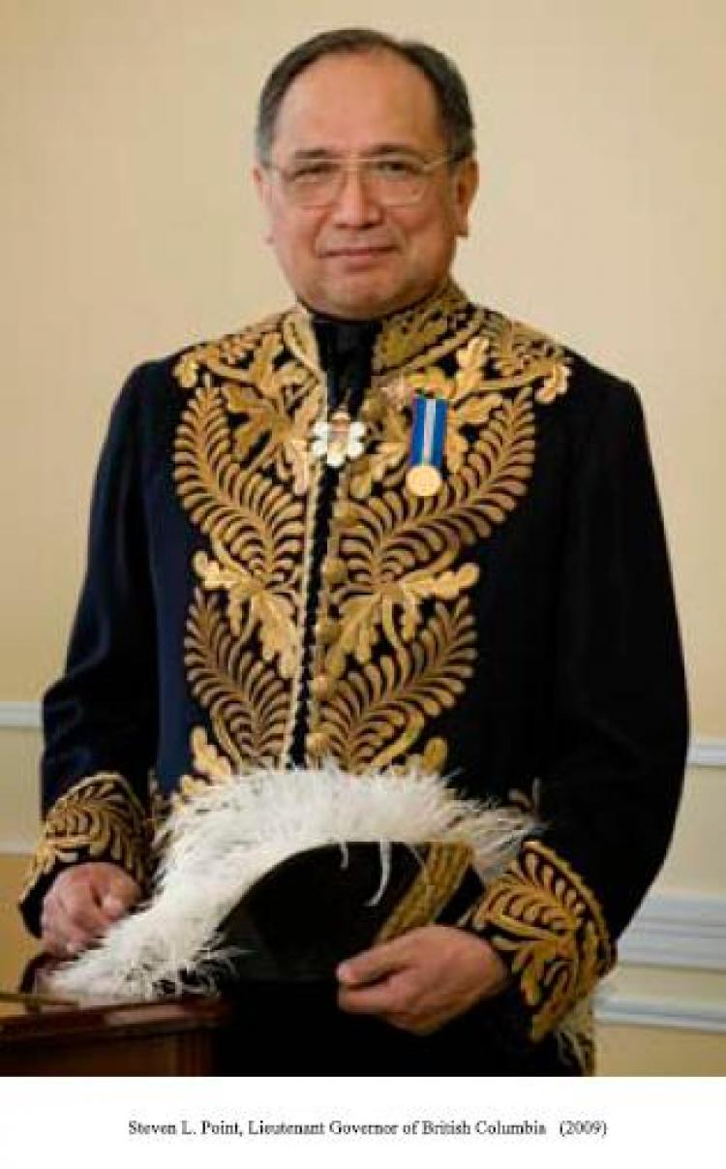
Stephen L.Point
Skowkale First Nation, Canada:
“Our values and our systems are not European.
However, the more I study Europeans and the more I learn about my own history, the more I find that in fact we are the same…
if you look long and hard enough, you will find that there are probably more similarities than there are differences between us”

Slide 7
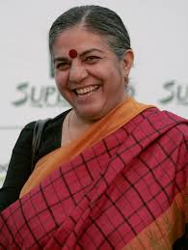
Vandana Shiva
“We’ve moved from wisdom to knowledge,
and now we’re moving from knowledge to
information, and that information is so partial-
that we’re creating incomplete human beings.”
To what extent do you agree with the above statement?

Slide 8
Further research
Extended Essay?
CAS?
TOK presentation/essay?
Notes:
Guide students to the website and show possibilities of this AOK within the IB programme. Emphasize local projects such as the Borneo Project and their importance (link to Earth Day, CAS, EE…)

Slide 9
Videos
Notes:
Bruce Parry: Tribe BBC/ Survival International (underline importance of the latter organisation and show link on website).

