Slide 1
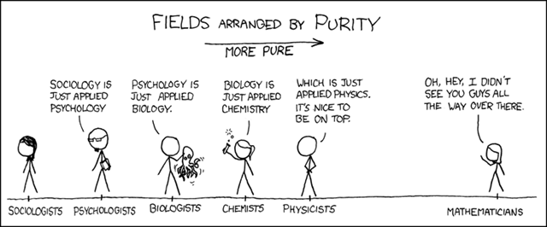
Psychology as a Natural Science
“A branch of science that deals with the natural world”

Slide 2
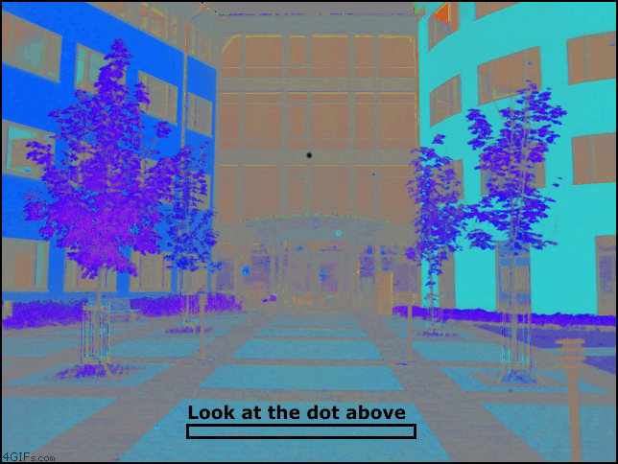

Slide 3
Psychology as a Natural Science
“A branch of science that deals with the natural world”

Slide 4
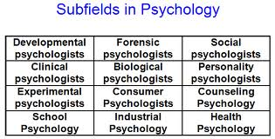
Human? Natural? Both?

Slide 5
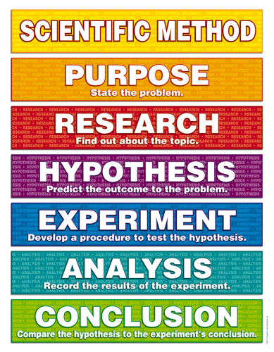
What is Science?
Relevant WoKs…
Reason
Sense perception

Slide 6
Science and non-science
This is the same for the ‘boundaries’ between natural and human sciences…

Slide 7
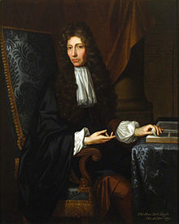
Scientific method... control freaks
Robert Boyle
In a typical experiment, Boyle would note the place in which the experiment was carried out, the wind characteristics, the position of the Sun and Moon, and the barometer reading, all just in case they proved to be relevant.

Slide 8
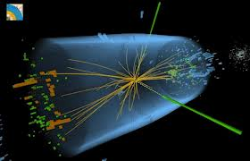
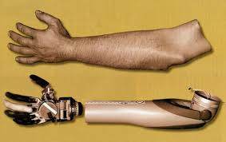
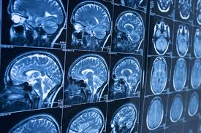
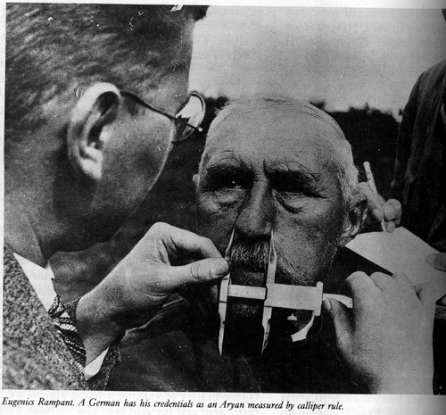
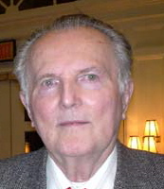
Knowledge Framework – Scope and applications
HUGE impact on society and culture… but this works the other way too. ‘Science’ has a funny habit of finding evidence to support society’s prejudices.

Slide 9
Concepts and language
Many shared concepts and language in natural science (e.g. reductionism, empiricism etc).
Each science has its own, often quite intimidating, terminology as well. E.g…
“Neural correlates, neural instantiations, cortical localisations” all = ‘bits of the brain’

Slide 10
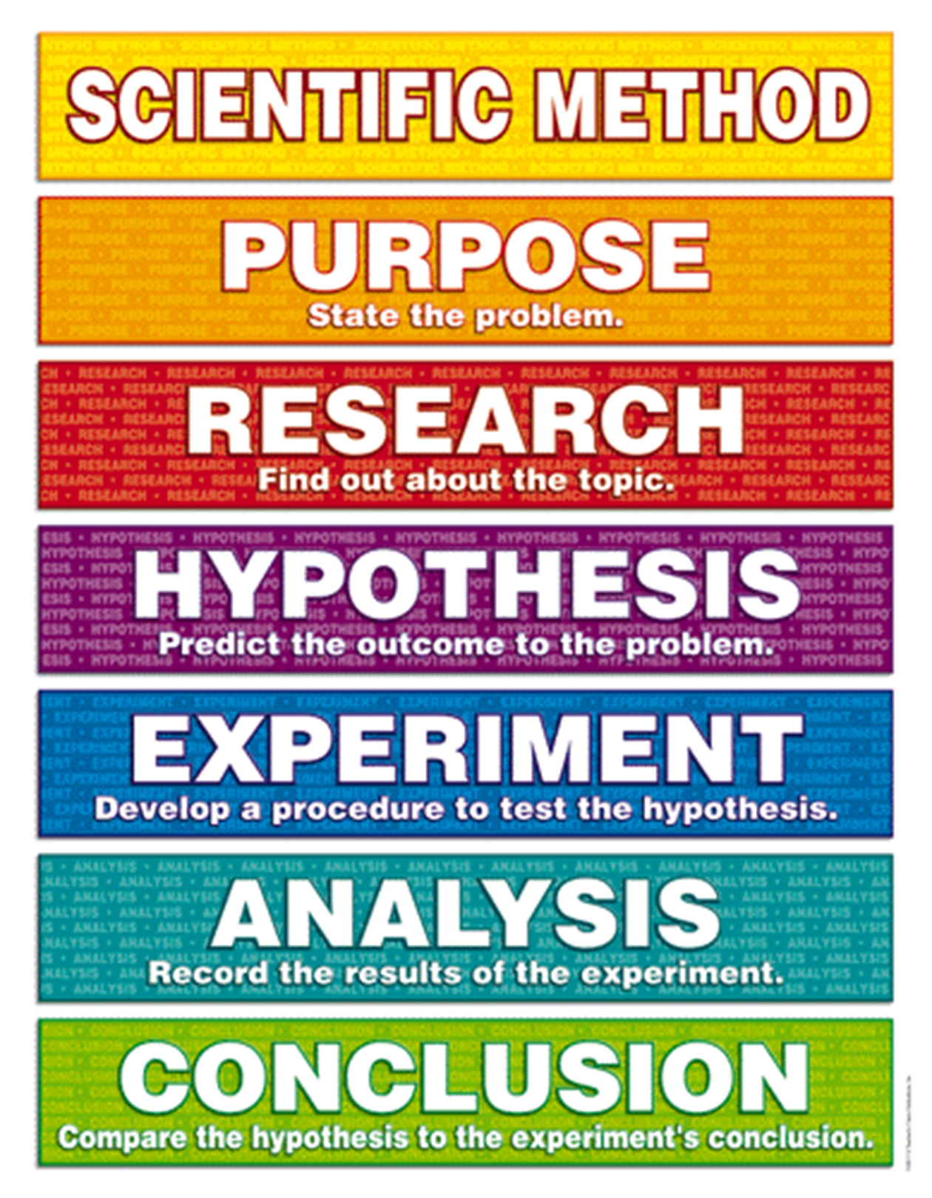
Methodology

Slide 11
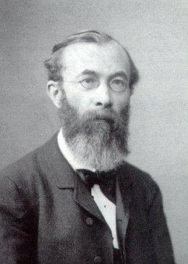
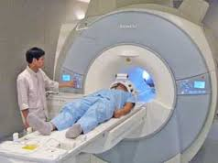
Historical development
The graduate students [in his lab] were made to swallow a stomach tube in the morning and keep it in place throughout the day. Apparently, many of them vomited at first …, before they gradually got used to it. In between their lectures and other activities they would report to the lab where hot water would be poured down the tube, and the subjects would introspect on the sensations they were experiencing. The process would be repeated with iced water.
Let’s try some introspection ourselves…
Compare this to today’s ‘natural’ psychology…

Slide 12
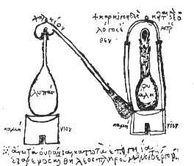
‘Science’ in the past...
Much less rigorous standards than today

