Slide 1
What is Art?

Slide 2
Does it depend on the purpose of art? Or on the skill involved in producing it? Or in the way it is used/ perceived by society?

Slide 3
How many of the following criteria are important
for something to be considered art?

Slide 4
Art must be intended as art
Arts are a way of expressing emotion
(We engage in art forms that generate an emotional response)
Art imitates nature or the world
(It takes great skill to paint a realistic scene
or is this only imitation? )
Art conveys truth about the world

Slide 5
Art teaches us what is right and heightens moral awareness
Art has to be beautiful or interesting…
Art requires technical skill
Art requires creativity and uniqueness
Art offers insight into the human condition… (Other disciplines give us knowledge but art broadens our emotional and intellectual boundaries)

Slide 6
Choose whether each one is: "definitely art", "maybe art", or "definitely not art.“

Slide 7
Give reasons for your choices.

Slide 8
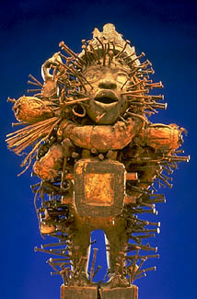
Africa, Zaire, Kongo (KON-go) Nail Figure (nkisi nkondi) (en-KEE-see en-KAHN-dee), 19th century Wood, vegetable fibres, and metal H. 15_ inches

Slide 9
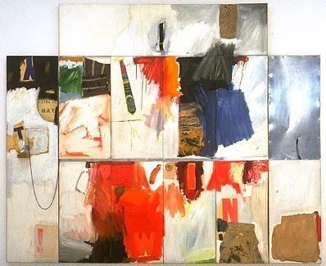
Robert Rauschenberg Trophy II (for Teeny and Marcel Duchamp), 1960 oil, charcoal, paper, fabric, metal on canvas, drinking glass (not original), metal chain, spoon 90 x 118 in.

Slide 10
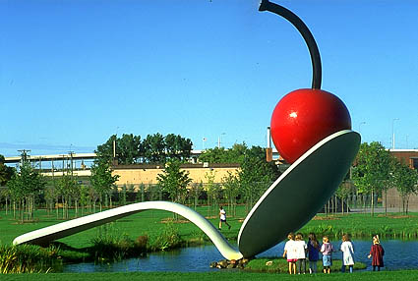
Claes Oldenburg and Coosje van Bruggen Spoonbridge and Cherry, 1985-1988 aluminium, stainless steel, paint 354 x 618 x 162 in.

Slide 11
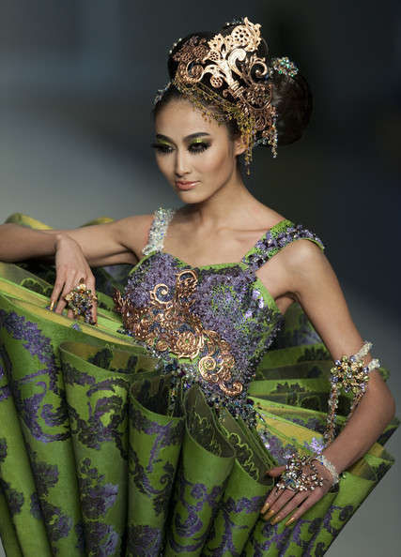
Guo Pei fashion designer

Slide 12
Humans have been creating art since prehistoric times. Each culture and historic time seems to have its own definition of what art is. Each culture creates its own ideals for how art should look.

Slide 13
Artists have often created works that raise questions about art itself. "What is art?" is not a simple question with only one correct answer.

Slide 14
The answer to the question, "What is art?" is not the same for all cultures.

Slide 15
The idea of special objects made as "fine art" is not common to all. In some cultures, what Westerners have traditionally called "art" represent principles that guide every thought and action.

Slide 16
Aesthetic traditions are visible in everything a culture produces, including functional objects. (Aesthetic--The philosophical study that explores questions about "what is art?" or "what is beauty?“)

Slide 17
Read and discuss the background information about each piece.

Slide 18
Africa, Zaire, Kongo Nail Figure
This figure was created as a functional object that served a civic purpose: to maintain the well-being of a Kongo village. This sculpture served as a type of contract, offering clues about the civil and judicial systems of the village.
This sculpture, Popularly known as nail figures, were used for protecting the village, curing illnesses, settling disputes, sealing agreements, and destroying enemies.
Generally carved in the shape of human beings, minkondi were sacred objects. Each of the nails driven into the figure represents the taking of an oath, the witnessing of an agreement, or some other occasion when the power of the figure was invoked.
The figure stands in a pose of challenge and authority, with its left hand resting on its hip, and its right arm raised to hold a weapon (which is missing). A mirror covers the figure's stomach. The eyes are also made of mirrors. They reflected the faces of those who stood before the figure, showing that the spirit was keeping watch on their every move.

Slide 19
Trophy II (for Teeny and Marcel Duchamp) is a multi paneled combined painting and assemblage created in honour of Marcel Duchamp and his wife, Teeny.
Rauschenberg created five "trophies" dedicated to artists he admired.
We can try to decode his work and explain the meaning behind it.
It may be possible that the panel on the left represents Teeny (see the "T" and "Y") and the panel on the right represents Duchamp. The aluminium on the right might refer to Duchamp's interest in painting on glass. The centre panel may comment on how competitive American culture can be; notice the letters "W", "I", "N", a baseball game, and a moonscape. The latter is most likely a referral to the United States' "race" with the Soviet Union to explore space
Robert Rauschenberg Trophy II (for Teeny and Marcel Duchamp), 1960 oil, charcoal, paper, fabric, metal on canvas, drinking glass (not original), metal chain, spoon

Slide 20
Claes Oldenburg and Coosje van Bruggen Spoonbridge and Cherry, 1985-1988
Spoonbridge and Cherry was commissioned for the Walker Art Centre in 1985.
This work is one of two fountain sculptures created by Oldenburg and his wife, Coosje van Bruggen.
For the Minneapolis Sculpture Garden, the two artists considered a design connecting Minnesota's Native American or Scandinavian heritages by creating a Viking ship prow or canoe pulled up on the shore of the pond.
They finally chose the spoon and cherry design, which was closely connected with Oldenburg's use of common objects for the central theme in his monumental art.
Oldenburg has used a spoon as a motif or theme in drawings or studies since the early 1960s.
Spoonbridge and Cherry has become a landmark for Minneapolis and this whimsical sculpture is a favourite among visitors to the Walker Art Centre

Slide 21
Guo Pei
Chinese opera theatrics gone Avant Garde is one way to describe Guo Pei’s collection.
The fashion designer from China presents an interesting mix of colours, textures and silhouettes that result in a weird collection.
Clothing covers and protects our bodies from harsh elements such as wind, rain, sun, and cold weather. It can also serve as decoration for the body. Are we using clothes to fashion a runway that we ourselves are on? What constitutes art and can it be practical clothing?

Slide 22
Did the artworks seem more important or meaningful after you read about the art history?

Slide 23
Did you change your opinions? Why or why not?

Slide 24
How can we distinguish good art from bad?
Was it intended as art?
Is it original and creative?
Is it beautiful? – if there are objective standards of beauty…
Did it require skill? – did the artist do anything special?
Does it invoke emotion – Does it make us feel something?
Does it imitate nature?
Does it teach us something? – morally? Socially?
Does it give us insight into the human condition?
Does it contain truth?
What does society think? Experts? The public? Other artists??? – does it have any authority as Art?

Slide 25
Where is the art in this?
Where is the:
Emotion?
Skill?
Beauty?
Truth?
Humanity?
The Physical Impossibility of Death in the Mind of Someone Living by Damien Hirst
Or is it art only because Hirst and the establishment say it is?

Slide 26
Is graffiti an art form?
Emotion?
Skill?
Beauty?
Truth?
Humanity?
Or just mindless vandalism?

Slide 27
Should street caricature sketchers be treated as artists?
Which criteria or purposes does this meet?
Skill?
Beauty?
Truth?
Humanity?
Authority?
Or is it just a craft?

Slide 28
Conclusion: What is Art?
Does it need all of these to be art?
Or just some of them?
Are some more important than others?

Slide 29
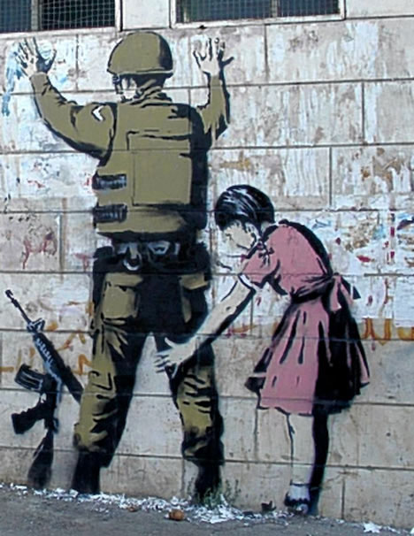
Additional Banksy work

Slide 30
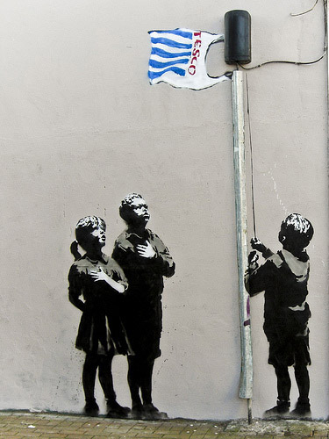

Slide 31
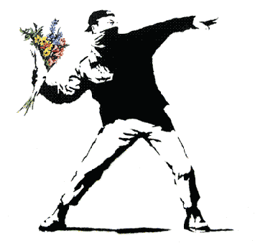

Slide 32
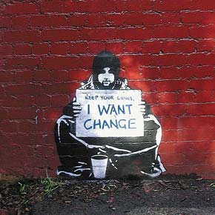

Slide 33
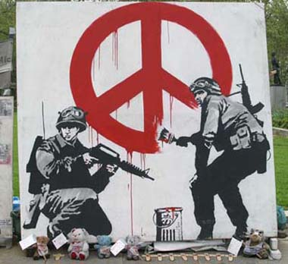

Slide 34
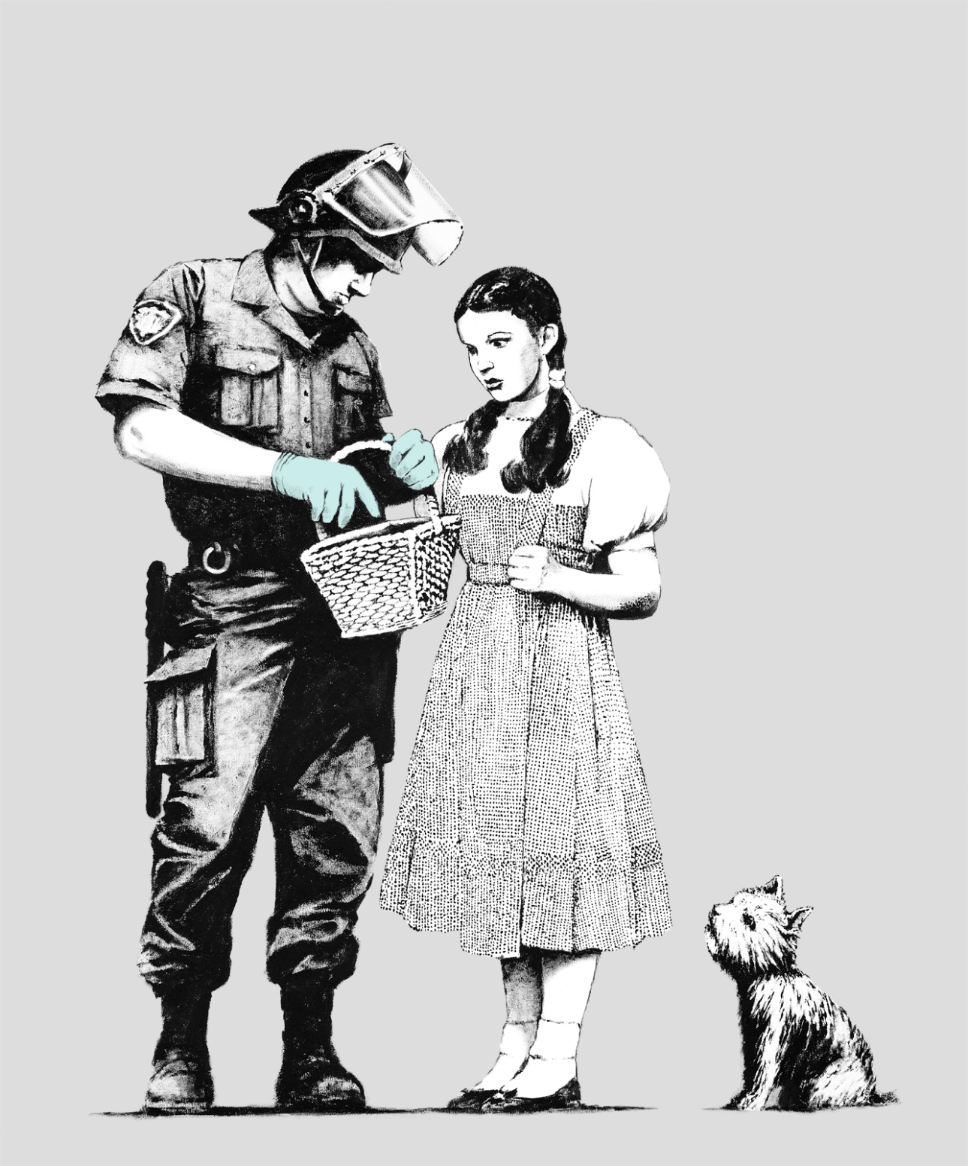

Slide 35
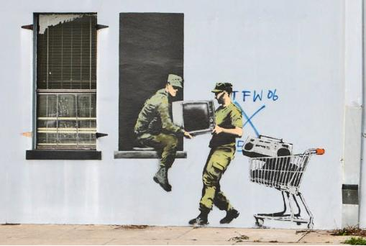

Slide 36
