Slide 1
The Arts
‘Art is meant to disturb, science reassures’.
Georges Braque, 1882-1963.

Slide 2
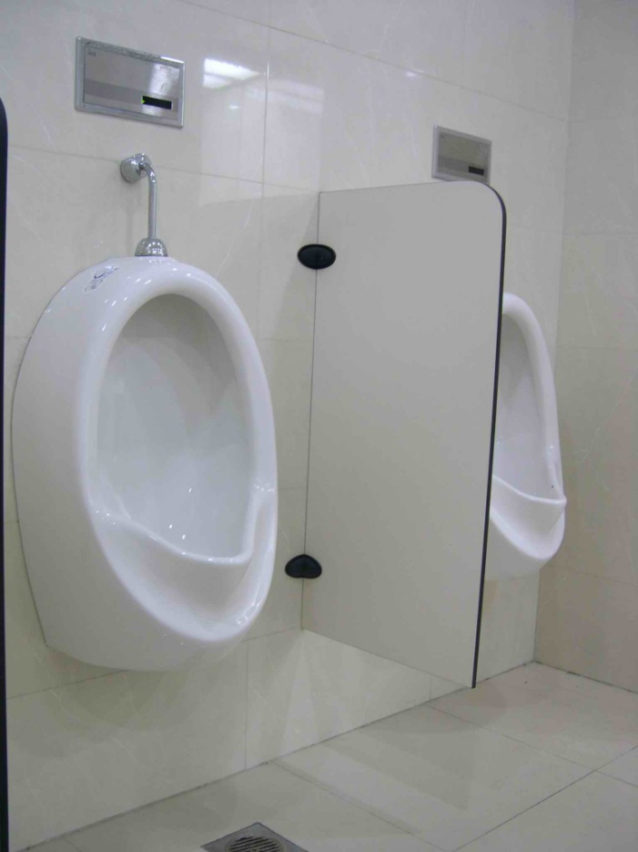
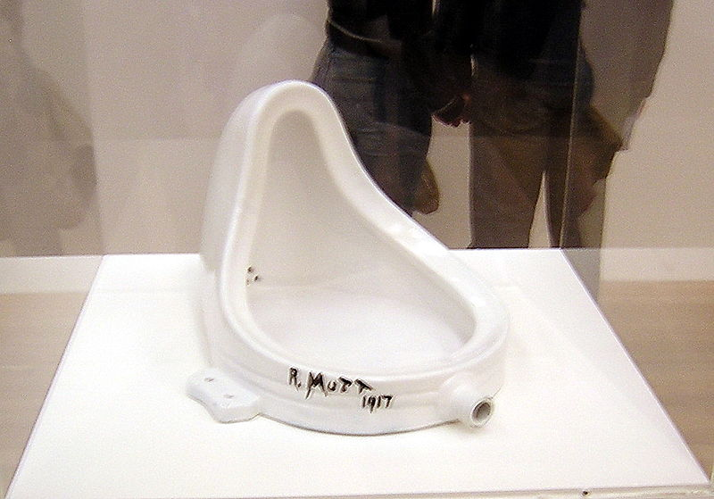
What is art?

Slide 3
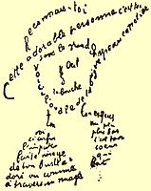
What is art?
Shall I compare thee to a summer's day? Thou art more lovely and more temperate: Rough winds do shake the darling buds of May, And summer's lease hath all too short a date: Sometime too hot the eye of heaven shines, And often is his gold complexion dimmed, And every fair from fair sometime declines, By chance, or nature's changing course untrimmed: But thy eternal summer shall not fade, Nor lose possession of that fair thou ow'st, Nor shall death brag thou wander'st in his shade,
When in eternal lines to time thou grow'st, So long as men can breathe, or eyes can see, So long lives this, and this gives life to thee

Slide 4
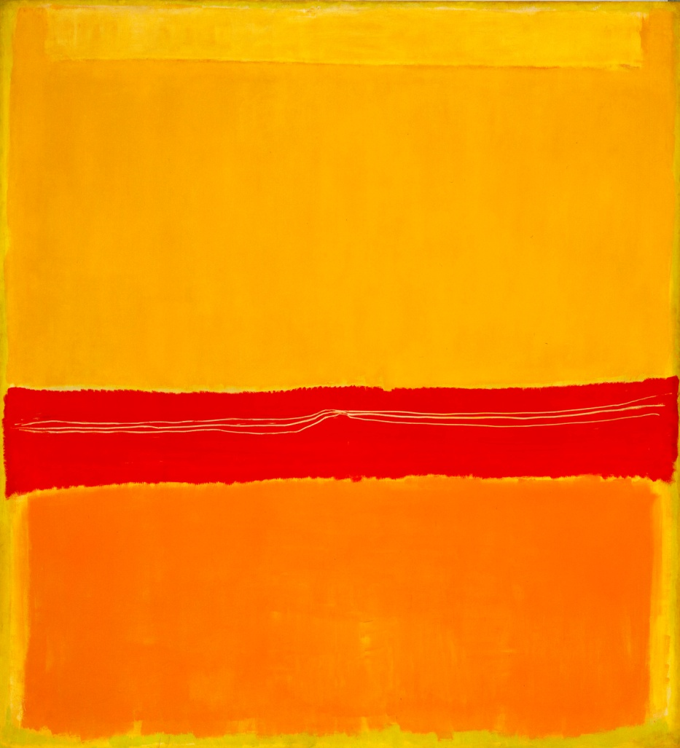
What is art?

Slide 5
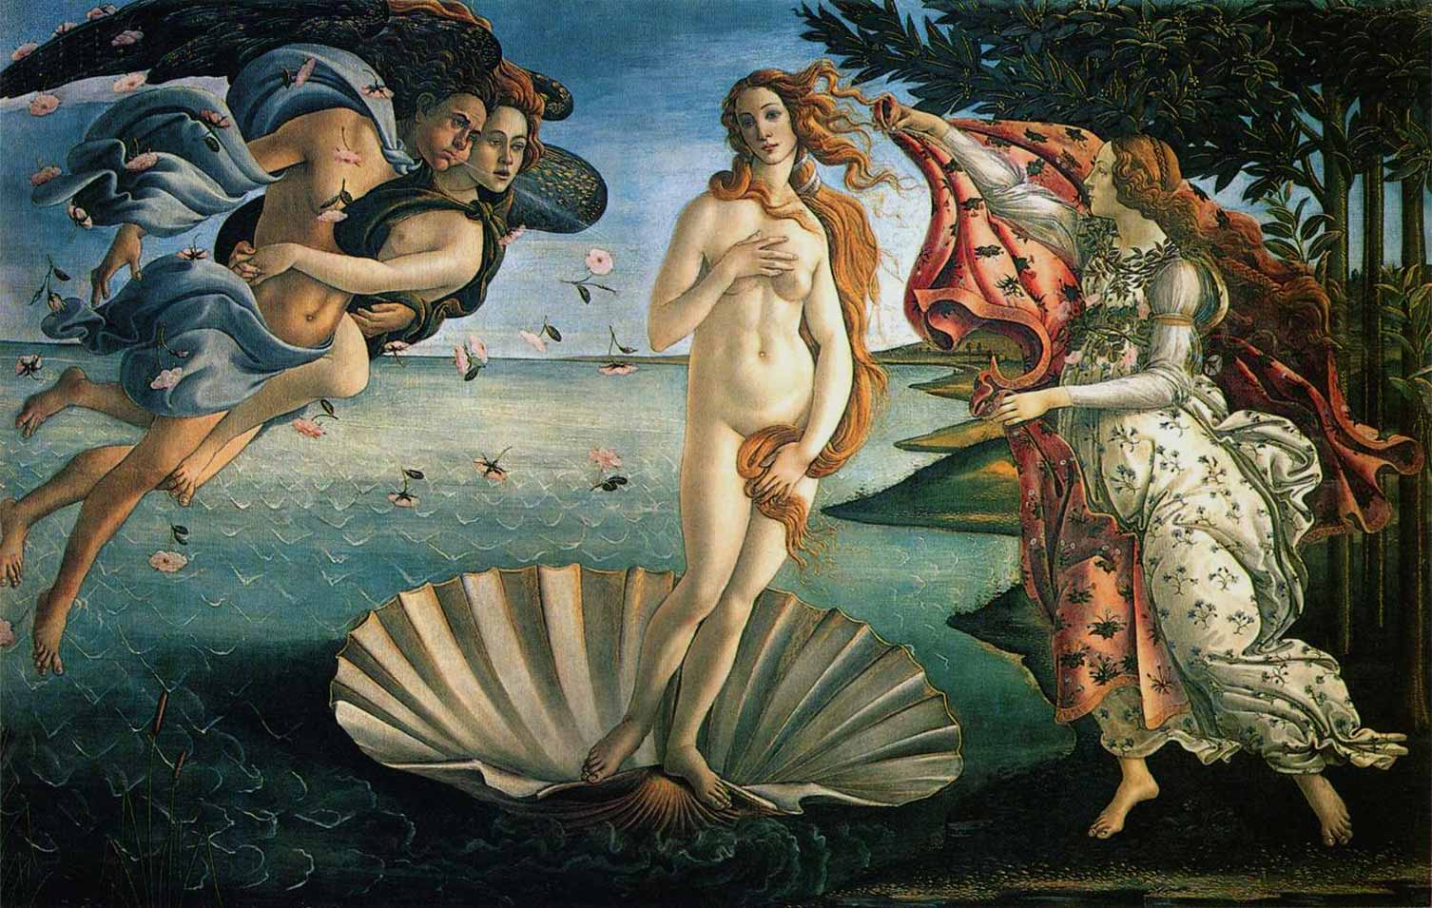
What is art?

Slide 6
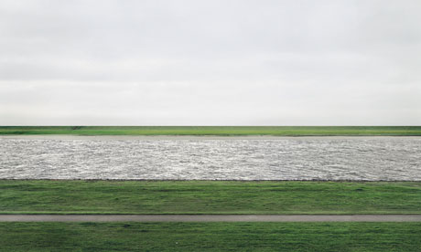
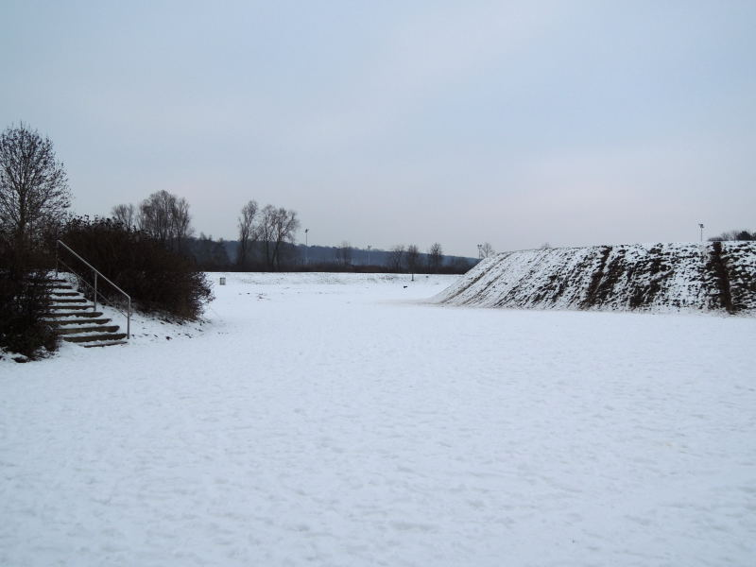
What is art?

Slide 7
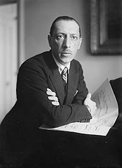
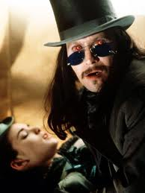
What is art?
http://www.youtube.com/watch?v=5tGA6bpscj8
http://www.youtube.com/watch?v=MCirK6psNoU

Slide 8
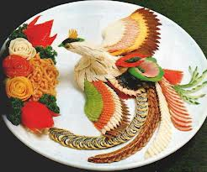
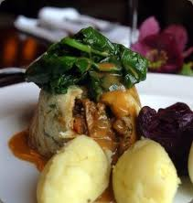
What is art?

Slide 9
Convince me it’s art!
Group work/par work: find an object in the classroom/your schoolbag and convince your teacher it’s art. The winner gets a chocolate prize.
Crazy? Then check out how much (monetary) value has been placed on the following works of art:

Slide 10
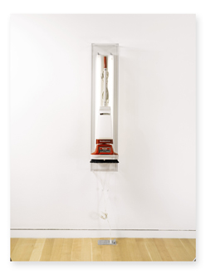
Jeff Koons
New Hoover Deluxe Shampoo Polisher
1980-86
Est. $ 1/1.5 million
Sold for $2,168,000
Jeff Koons proves that if he proclaims a vacuum cleaner as art, then it is what it is. His New Hoover Deluxe Shampoo Polisher sold for 2.2 million. A tip for our working class art rebels who want to fake it, eBay’s buy it now bid price is $109, just don’t expect the art experts to approve.

Slide 11
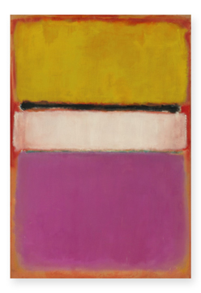
Mark Rothko
White Center (Yellow, Pink and Lavender on Rose)
signed and dated 1950 on the reverse
oil on canvas
81 x 55 ½ in.
205.8 x 141 cm.
Est. in the region of $40 million
Sold for: $72,840,000
RECORD FOR THE ARTIST AT AUCTION
RECORD FOR CONTEMPORARY WORK AT AUCTION
The prime moment we were all waiting for announced itself with the audience’s roaring applaud at the final price of Mark Rothko’s White Center (yellow, pink and lavender on rose), closing at $72.8 million by an anonymous phone buyer competing with at least 5 other unrelenting buyers.

Slide 12
So what is art?
‘Art is what you can get away with.’
Andy Warhol, 1928.
‘Life imitates art more than art imitates life.’
Oscar Wilde, 1854-1900

Slide 13
‘The essential function of art is moral.’
D.H. Lawrence, 1885-1930
‘Art is a lie that makes us realize the truth- at least the truth that is given us to understand.’
Pablo Picasso, 1881-1973

Slide 14
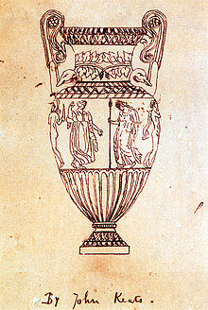
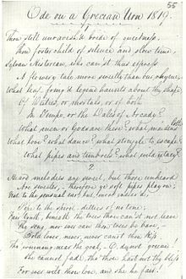
Is Art an aesthetic, illustrative or representational area of knowledge? If so, what implications does this have for art as a source of knowledge? Which way of knowing is the most dominant within illustrative art?
Beauty is truth, truth beauty," – that is all
Ye know on earth, and all ye need to know.

Slide 15
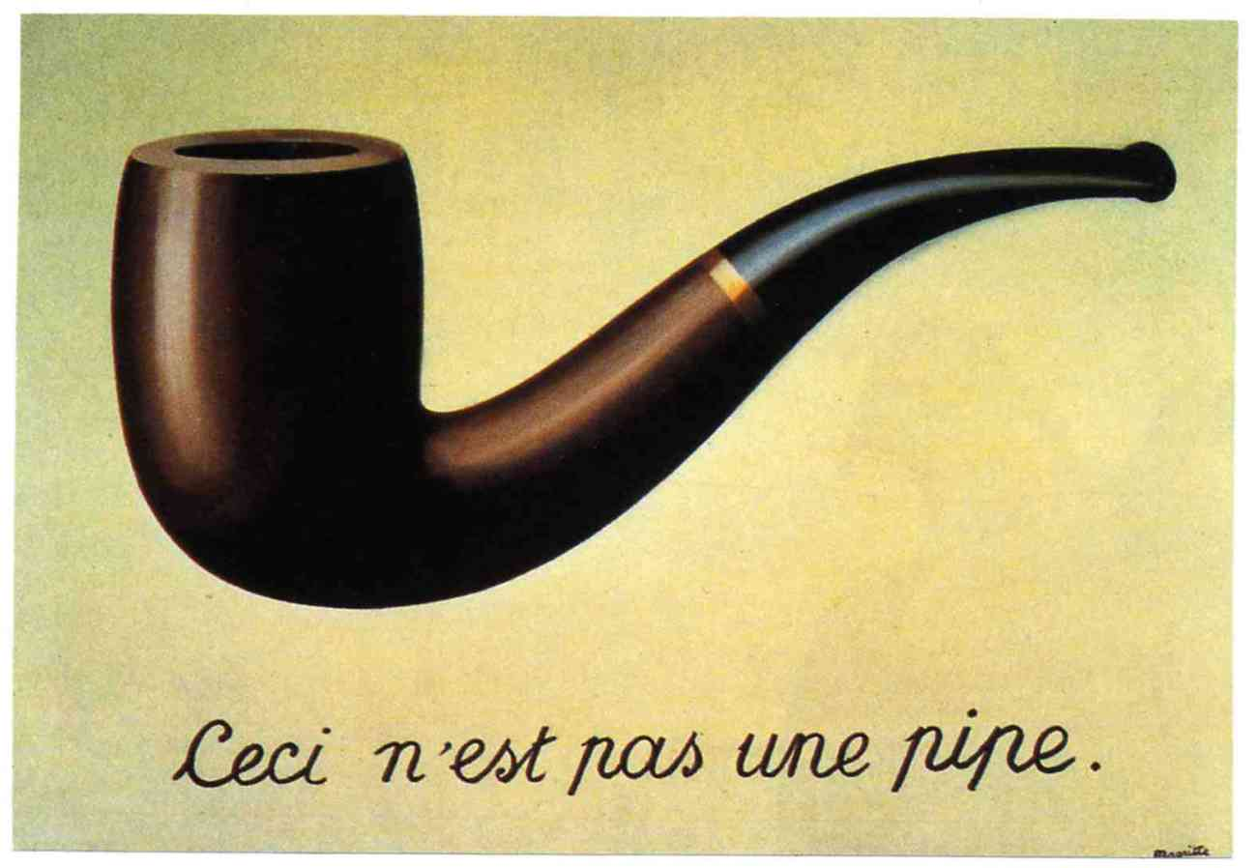
Or is Art a semantic experience for you? If so, what implications does this have for art as an area of knowledge? What is the role of the observer/audience as a knower within the realm of conceptual/semantic art? Which ways of knowing are more dominant?

Slide 16
Perception: To what extent do the arts help us see the world with new eyes? Can art exist without sense perception?
Reason: What role does reason play in artistic creation/appreciation?
The arts
Language: How do poets help to keep language alive? Is it possible to fully appreciate any work of art without language?
Emotion: Is art the language of emotions?

Slide 17
Religion: How is artistic creation similar to and different from divine creation?
Mathematics: What is the connection between music and mathematics?
Is it possible to calculate beauty?
Language: How doe poets help to keep language alive? Is it possible to fully appreciate any work of art without language?
The arts
Ethics: To what extent do the arts civilise people?
History: How much can we learn about the past from the history of art?
Natural sciences: What roles does creative imagination play in the sciences?

Slide 18
Knowledge issues
What kind of truths are the arts capable of expressing?
To what extent are the insights available from the appreciation of a work of art dependent upon the intentions of an artist?
What could be meant by artistic truth?

Slide 19
What might be meant by a ‘lie’ in the context of an artwork?
To what extent are the limits of art defined by morality?
Do the arts allow us to discover truths that are difficult to express in straightforward language?

