Slide 1
Ways of knowing: Reason
Thanks to Richard van de Lagemaat, Theory of Knowledge for the IB Diploma, Cambridge University Press
‘Two extravagances: to exclude reason, to admit only reason.’
Blaise Pascal, 1623-62

Slide 2
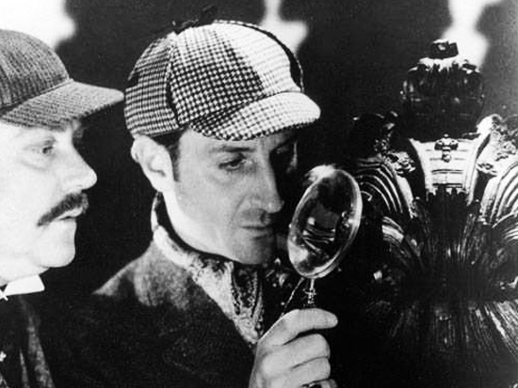
Sherlock Holmes’s deductive reasoning
Watchdogs bark at strangers
The watchdog did not bark at the thief
Therefore the thief was not a stranger.

Slide 3
DEDUCTIVE REASONING
INDUCTIVE REASONING
INFORMAL REASONING

Slide 4
DEDUCTIVE REASONING
DE= from DUCERE= lead
Reasoning that leads from something
Deductive reasoning is reasoning that moves from the general to the particular. For example, you know that all human beings are mortal (general) and that you are a human being (particular), therefore you can deduct that you are mortal.

Slide 5
Syllogisms
A kind of deductive reasoning which contains:
-Two premises and a conclusion
-three terms, each of which occur twice
-Quantifiers, such as ‘all’, ‘some’ or ‘no’
All humans are mortal
John is a human.
Therefore John is mortal
All A are B
C is an A.
Therefore C is B

Slide 6
To determine whether an ARGUMENT is valid, it helps to rewrite the premises and the conclusion ‘mathematically’ (with A, B and C).
An ARGUMENT can be valid (logical), even though the premises may be false.
All panters are pink
Che Guevara is a panter
Therefore, Che Guevara is pink.
All panters (A) are pink (B)
Che Guevara (C) is a panter (A)
Therefore, Che Guevara (C) is pink (B).
The ARGEMENT is valid, logically, but the conclusion as such is false, because Che Guevara is obviously not pink (neither is he a panter).

Slide 7
http://www.youtube.com/watch?v=B2WWeWUBhKU&list=PLB8A5292FC68E2D77&index=1&feature=plpp_video
Just because an argument is (logically) valid, the conclusion is not necessarily true. Both the premises must be true and the argument must be valid.
In everyday life people often use incomplete arguments, called ENTHYMEMES. They often feel that certain premises are obvious and do not state the premises when they construct an argument.
See activity 5.5 p. 119

Slide 8
(Correct) deductive reasoning is important for the preservation of truth. It prevents people from making logical mistakes and from using incomplete arguments (enthymemes).
However, they are not the source of truth. To know that your premises are true, you cannot use deductive reasoning, but you must use your experience.

Slide 9
INDUCTIVE REASONING
IN= towards DUCERE= lead
Reasoning that leads towards something
The issue of hasty generalisations!
Inductive reasoning is reasoning that moves from the particular to the general. For example, historically every human being before you has died and you have never heard of a human being who has not died, therefore you can deduct that humans are mortal.
Discuss the limitations of inductive reasoning and do activities 5.9 and 5.10 on p.122.

Slide 10
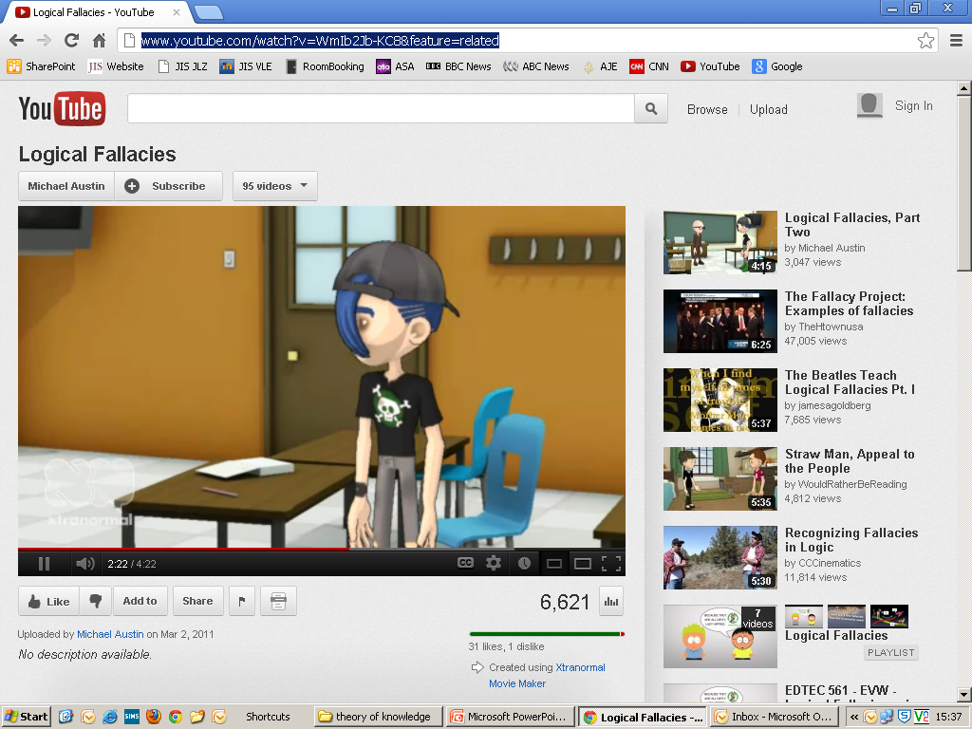
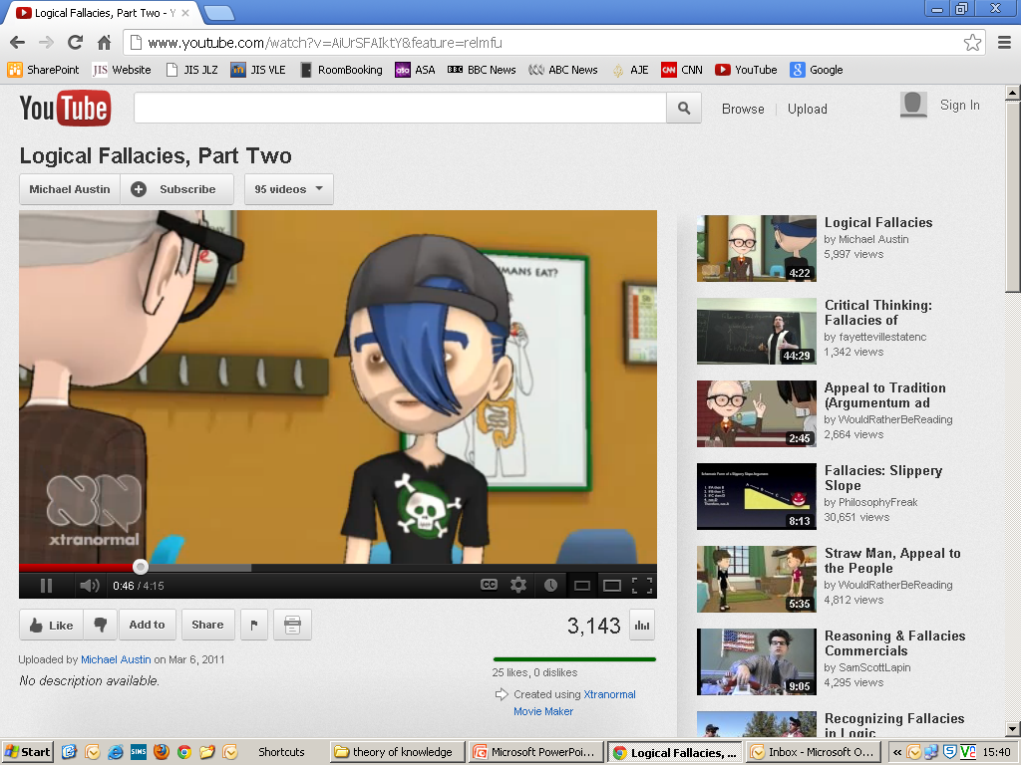
Logical fallacies
http://www.youtube.com/watch?v=WmIb2Jb-KC8&feature=related
http://www.youtube.com/watch?v=AiUrSFAIktY&feature=relmfu

Slide 11
Informal reasoning
http://www.youtube.com/playlist?list=PL48296651F7CF74CB&feature=plcp
Human beings are prone to improper reasoning. Apart from invalid syllogisms and hasty generalisations, you will probably find many examples in your daily life of the following fallacies.
Post hoc ergo propter hoc
Argument ad hominem
Special pleading (double standards)
Circular reasoning
False analogy
Argument ad ignorantiam
Loaded questions
Equivocation
False dilemma

Slide 12
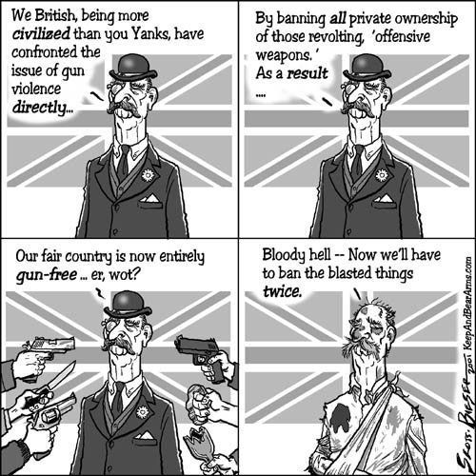
Post hoc ergo propter hoc
It happened after, so it must be caused by.
Strict gun control laws were introduced in Texas, the crime rate has risen. This shows that gun control does nothing to reduce crime.

Slide 13
Argument ad hominem
Attacking the arguer, not the argument
You are so stupid, your argument couldn’t possibly be true.

Slide 14
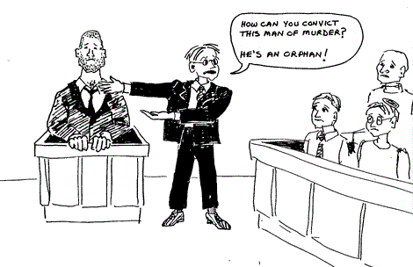
Using double standards to excuse an individual or a group
Special pleading
I agree that everyone should pay their taxes. But since I’m short of money this year and want to take my family on a much needed holiday, it’s OK if I don’t declare my income.

Slide 15
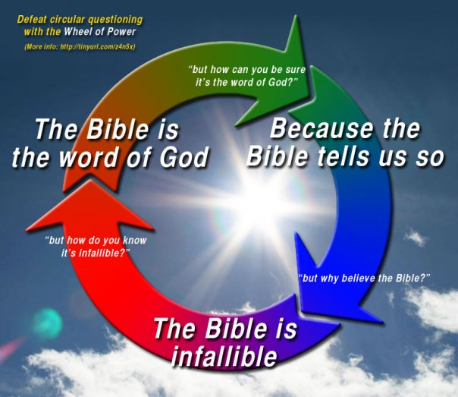
Circular reasoning
Assuming the truth of what you are supposed to be proving
God exists because the Bible says so. The Bible is inspired. Therefore, we know that God exists.

Slide 16
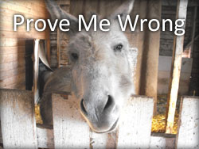
Argument ad ignorantiam
Claiming something is true because it cannot be proved to be false.
Since no one has been able to prove that we are alone in the universe, we must conclude that alien life-forms exist.

Slide 17
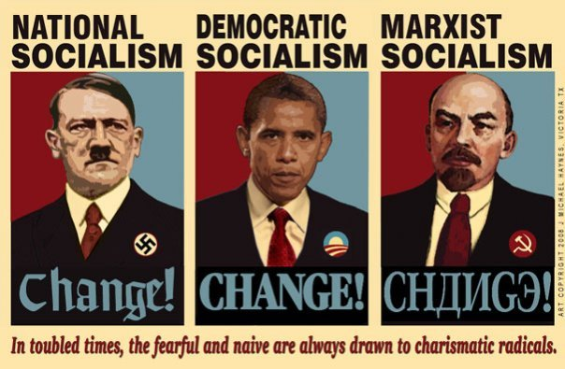
False analogy
Assuming that because two things are alike in some respects they are alike in other respects

Slide 18
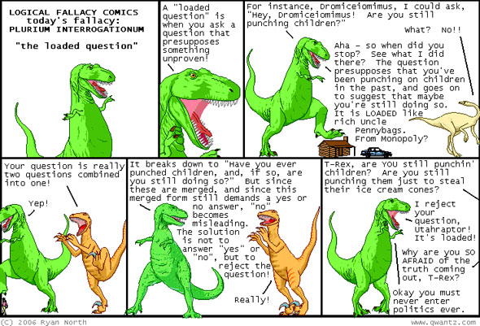
Begging the question
Assuming an answer in the way the question is phrased.
Loaded questions/
statements
A question/
statement which has a built-in assumption.
Do you always cheat in exams?
The headmaster did not come to school drunk today.

Slide 19
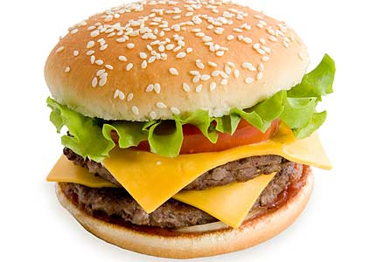
Equivocation
Using language ambiguously. A word is used in two different senses within one argument
A hamburger is better than nothing.
Nothing is better than good health.
Therefore a hamburger is better than good health.

Slide 20
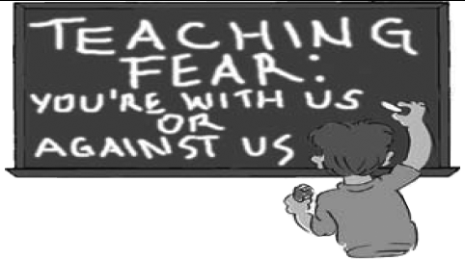
Excluding the middle
Considering only the two extremes in a range of possibilities (making the other side look worse than it actually is)
False dilemma or false dichotomy
Exaggerated either/or. Assuming that only two black and white alternatives exist.
Extension: check out Cixous’s feminist critique of patriarchal binary thought
In the fight against terrorism you are either with us or without us.

Slide 21
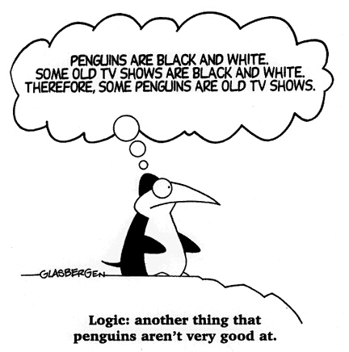
http://en.wikipedia.org/wiki/Non_sequitur_(logic)
Non sequitur
Assumes a logical link between separate points.
Syllogistical fallacies
The fallacy of the undistributed middle takes the following form:
All Zs are Bs.
Y is a B.
Therefore, Y is a Z.
Any argument that takes the following form is a non sequitur (affirming the consequent)
If A is true, then B is true.
B is true.
Therefore, A is true.
Men are human.
Mary is human.
Therefore, Mary is a man.
If Jackson is a human (A) then Jackson is a mammal. (B)
Jackson is a mammal. (B)
Therefore, Jackson is a human. (A)
http://pactiss.org/2008/05/29/penguin-logic/

Slide 22
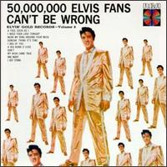
Argument ad populum
Everyone says it’s true.
Google gives more hits when this spelling is applied, therefore this has to be the correct spelling
In a court of law, the jury vote by majority; therefore they will always make the correct decision

Slide 23
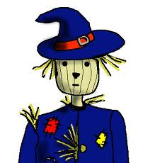
http://www.youtube.com/watch?v=v5vzCmURh7o
Straw man
Caricaturing a position to make it easier to attack.
A: Sunny days are good.
B: If all days were sunny, we'd never have rain, and without rain, we'd have famine and death

Slide 24
The statistics prove that....
Observational selection: counting the hits and forgetting the misses (eg phone rings, thinking about you)
Correlation/causation bias
Statistics
Statistics of small numbers (wrong inductive reasoning)
Misunderstanding the nature of statistics (eg Eisenhauwer’s astonishment that half of the Americans were below average intelligence)

Slide 25
Significance bias (eg conspiracy theories: significant people must have significant deaths)
Convention bias (or tradition trap)
(eg projection map, cardinal directions, 12 hour cloclk etc)
Media bias (selection, editing, photoshop)
BIAS
Correlation/causation bias
(Statistical errors/churches and prostitutes)
Selection Bias: (eg 75% of women would swap their husband for Kylie Minogue’s wardrobe– readers of my website– the readers who filled in the questionnaire)
Confirmation Bias: (eg the Chinese horoscope)

Slide 26
Lateral thinking
http://brainden.com/logic-puzzles.htm
A Man in an Elevator
A man who lives on the tenth floor takes the elevator down to the first floor every morning and goes to work. In the evening, when he comes back; on a rainy day, or if there are other people in the elevator, he goes to his floor directly. Otherwise, he goes to the seventh floor and walks up three flights of stairs to his apartment. Can you explain why? (This is one of the more popular and most celebrated of all lateral thinking logic puzzles. It is a true classic. Although there are many possible solutions that fit the conditions, only the canonical answer is truly satisfying.)
Bulbs
There are three switches downstairs. Each corresponds to one of the three light bulbs in the attic. You can turn the switches on and off and leave them in any position. How would you identify which switch corresponds to which light bulb, if you are only allowed one trip upstairs?

Slide 27
Keep the first bulb switched on for a few minutes. It gets warm, right? So all you have to do then is ... switch it off, switch another one on, walk into the room with bulbs, touch them and tell which one was switched on as the first one (the warm one) and the others can be easily identified .
The man is of short stature. He can't reach the upper elevator buttons, but he can ask people to push them for him. He can also push them with his umbrella.
What are the advantages and disadvantages of lateral thinking?

Slide 28
Reason and knowledge
What possibilities for knowledge are created by reason? What are the advantages of being able to reason about something rather than, say, feeling something, dreaming about something, wishing something to be the case?
Does all knowledge require some kind of a rational basis?
If knowledge claims cannot be rationally defended, should they be renounced? Is the answer to this question dependent on the area of knowledge of the claim?

Slide 29
Can reason on its own, independent of sense perception, emotion and languages, ever give is knowledge? Or are reason and language inseparable in the quest for construction and justification of knowledge?
What constitutes a good argument? What is the value of learning to distinguish valid and invalid arguments?

Slide 30
Strengths and weaknesses of reason
What are the advantages of discriminating between valid and invalid arguments, good and bad reasons, more or less persuasive reasoning, both for the individual knower and society?
Why are informal fallacies often plausible and convincing? When, where and by whom are they formulated? Are there circumstances under which the use of informal fallacies can be justified, for example, in public advertising campaigns for a good cause?
How can beliefs affect our capacity to reason well and to recognise valid arguments? Can they affect a person’s capacity to distinguish between fallacy, good argument and rationalisation? What is the difference between a rational argument and a rationalisation?

Slide 31
What, if any, are the advantages of expressing arguments in symbolic terms? Are the ambiguity and vagueness of conventional language eliminated by this formulation?
Are there some parts of human life or experience where reason has no real function?
http://www.youtube.com/user/PhilosophyFreak

Slide 32
Linking questions
How does the role of reason compare with the roles of other ways of knowing? Why might some people think that reason is superior, and what consequences does holding this position have for the knowledge pursued and the methods considered appropriate in the pursuit?
Attempts have been made to identify universal, self-evident and incontrovertible laws of logic, such as the law of identity (eg an apple is an apple) or the law of non-contradiction (eg nothing can be an apple and also a non-apple). Are these actually laws in the scientific sense of term, or are they axioms? How do logical axioms compare with axioms in mathematics, and with the underlying beliefs we take for granted in other areas of knowledge?
What is the role of reason in ethical principles and their justification? Is reason more important to acting morally than other ways of knowing?

