Slide 1
Knowledge in Mathematics

Slide 2
What is Mathematics?
Notes:
What is Mathematics, What does the term mean, what are its limits, how do you define it, discuss and feedback.

Slide 3
Defining Maths
The abstract science of number, quantity, and space
a science of logical reasoning
systematized knowledge, and/or strategic reasoning based on accepted rules
an art which studies patterns for predictive purposes
a specialized language which deals with form, size, and quantity
Notes:
All complex disciplines are difficult to define but here are some partial definitions to help us understand. Notice that mathematics can be viewed as an art, a science and a language

Slide 4
Knowledge in Mathematics
Structure and Nature of Mathematical Knowledge and the concept of proof
Mathematical Modelling, Maths and the Real World
Statistics and Data Processing
Limitation of Mathematics

Slide 5
The Structure and Nature of Mathematics
Notes:
Any area of mathematics and there are many is a self contained system of related concepts, structures and ideas. These are built up systematically starting from axioms (assumed truths) and through logical reasoning new understanding is derived through the development of new rules, relationships or truths. These process continues indefinitely, and some ideas or relationships generate whole new branches of mathematics or whole new sciences. Theorems are things deemed important, Lemmas are less so and corrolarrys tend to be side results. To contribute a Theorem to mathematical knowledge is the aim of most university professors and alike however it is not enough to have an idea that something is true to be considered mathematical knowledge it must be true. If it is not yet proved then it is called a conjecture.

Slide 6
Theorem and Conjecture
Pythagoras’ Theorem
“In a right angled triangle the square of the hypotenuse is equal to the sum of the squares of the other two sides”
Goldbach’s Conjecture:
it seems that every number that is greater than 2 is the sum of three primes”
Notes:
The difference between these two is that the first one has never been proved to be true for all numbers, whereas the second has been show to be true for all right angled triangles.

Slide 7
What is Proof?
Notes:
So how do you prove that something is true? What form can take proof, What do we mean by proof, discuss and feedback.

Slide 8
"I'll do anything to prove my innocence" -Amanda Knox
Notes:
In Mathematics proof has to be more than in a court of law, in a court of law you only need to prove beyond reasonable doubt. In Mathematics proof requires absolute irefutable certainty.

Slide 9
The Structure and Nature of Mathematics
Notes:
So Mathematics is this system where logic and reasoning, can be used to generate knowledge and understanding. However any mathematical system is only as good as the axioms it is based on, So what are axioms?

Slide 10
Notes:
Here is an example to help draw out the idea. What colour is this screen? Blue or Green, Well how do you decide, what does it mean to be blue or green, colour is a spectrum of wavelengths and at some point blue become green, someone has to define that point before that happens there we can never be sure. (in truth this colour is the line it is exactly half way between blue and green so it is neither and both?

Slide 11
An Axiom
a self-evident truth that requires no proof.
a universally accepted principle or rule.
a proposition that is assumed without proof for the sake of studying its’ consequences
Notes:
An Axiom is something we assume to be true, It is usually something that is hard to deny but not always.

Slide 12
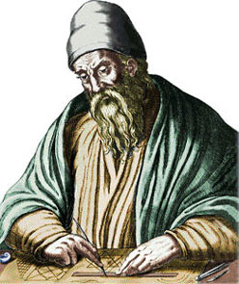
Notes:
One of he most famous pieces of mathematics based on axioms is this one, by this man, Euclid, show the book. In this book Euclid defined all two dimensional geometry based on five axioms, so things like, circle theorem, angles on parallel lines, angles in polygons, angles in triangles, constructions, all from only five axioms. In fact it has since been proved that none of the five axioms can be proved from any of the other four and it is not possible to construct 2D geometry with fewer that five axioms

Slide 13
Euclid’s Axioms (Postulates)
You can draw a straight line between any two points
It is possible to produce extend a finite line segment into a straight line
It is possible to construct a circle of given radius and centre
All right angles are equal to one another
If two lines intersect a third in such a way that the sum of the inner angles on one side is less than two right angles, then the two lines inevitably must intersect each other on that side if extended far enough
Notes:
Euclids’ first four axioms are obvious self evident truths, the fifth is slightly different.

Slide 14
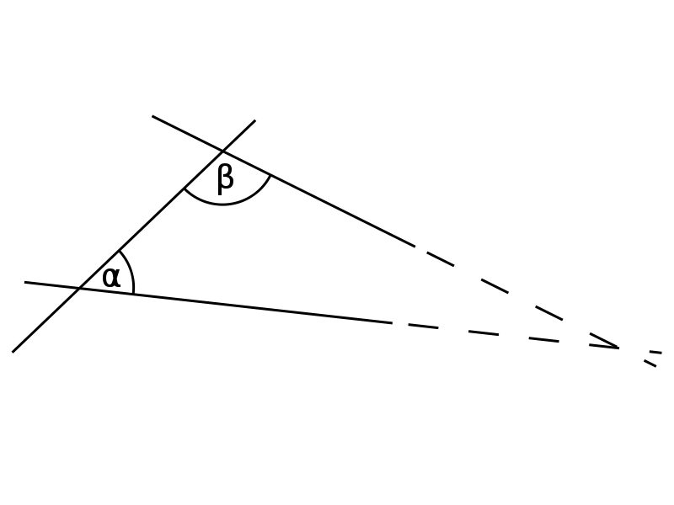
5. Parallel Postulate
Notes:
Explain that parallel postulate.

Slide 15
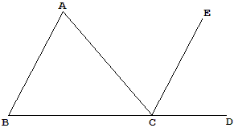
AB is parallel to CE
BCD form a straight line.
Already have the theorems that alternate and corresponding angles are equal.
Notes:
An example of a Euclidean proof talk through. Not the generality

Slide 16
What about algebra
Prove that the sum of three consecutive integers is always equal to 3 times the middle number
N+(N+1)+(N+2)
=3N+3
=3(N+1)
Notes:
Now algebraic proofs like this one have the same property, the axioms here are the fundamental laws of arithmetic such and this argument includes theorems about brackets, multiplication .

Slide 17
Not Just Shapes and Numbers
Notes:
Logical Reasoning and proof are not limited to only addressing mathematical concepts they can be about anything, here is one for you to try.

Slide 18
Three Pins
Form a triangle with three small pins. Each pin has two ends. One is blunt, the other is pointed. The blunt end is known as the head, the pointed one is the tail. At a vertex of the triangle where two pins meet, they may meet either head to head, or head to tail, or tail to tail. Prove that with three pins forming a triangle, either all vertex configurations are the same, or all vertex configurations are different.
Notes:
This can be approached by a method called proof by exhaustion, you can try all possible combination in the first corner (HH TT HT and show that the other corners given the same result (demo or student demo)

Slide 19
The Structure and Nature of Mathematics
Notes:
So Mathematics is this system where logic and reasoning, can be used to generate knowledge and understanding. However any mathematical system is only as good as the axioms it is based on, So what is logic and reasoning?

Slide 20
What is Logical Reasoning?
http://www.youtube.com/watch?v=2dgmgub8mHw
Notes:
Logic is essentially a series of self consistent rules that govern whether a argument is valid. Although logic is a vast subject in its own right it can be explained simply by the words IF THEN, AND, OR and NOT. If this is true then this happens. Event A and Event B occur. IF A is TRUE then B Is Not True, logical reasoning is the basis of almost all mathematics (fuzzy logic) and computing as well.

Slide 21
Post Office Burglary
Notes:
You will probably find that you already have quite good logic, Here a puzzle for you to try to solve, use a pen and paper?

Slide 22
Post Office Burglary
Notes:
Notice the IF... THEN not etc in these are the logical constructs used in your arguments, although it is such a part of our normal decision making process (cause and effect) that we hardly notice we are doing it.

Slide 23
Proof by contradiction
1. Assume the opposite of what you want to proof
2. Construct a logical argument
3.Generate a contradictory statement
4. The contradiction implies your assumption must be wrong.
Notes:
Sometimes we can proof things by looking for a breakdown in logic, following this structure. A contradiction is a breakdown in logic where an arguement leads to something that is obviously false.

Slide 24
Prove that there are an infinite number of primes
Assume there are a finite number call them
P_{1,} P₂,P₃,...............P_{N}
(So P₁=2 and P_{N} is the largest prime)
Consider the number
P1xP2xP₃,...............xP_{N}+1.
No number P₁ to P_{N} can be a factor of this number hence it must be prime.
This contradicts the initial assumption
So the initial assumption must be incorrect
Notes:
This is a well know proof by contradiction that illustrates the concept. Talk through it.

Slide 25
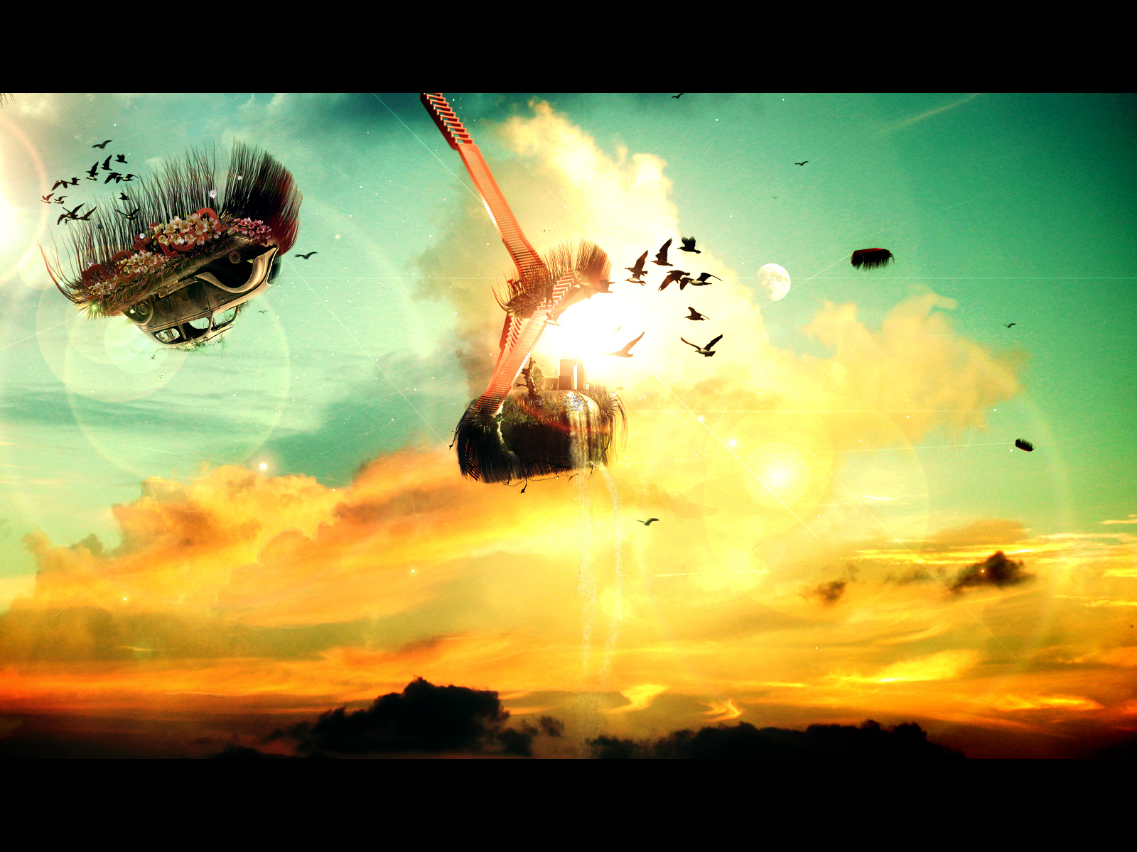
Where is the art?
Notes:
So we have this structure of mathematics with axioms and logic combining to generate new understanding however this is perhaps a bit dull. This is because we are missing the spark. When Mathematics is presented to you in class or in a book it can seem dry and fixed, but it worth remembering that somewhere someone has created these ideas and that require something more than computation or the ability to follow rules. Mathematical proof often required imagination and creativity to generate a result. The ability to visualise or imagine a situation is a skill that enables mathematical knowledge to develop.

Slide 26
One Dimensional Ants
Ants on a stick may only march left or right, all with the same constant speed. They never stop, short of falling off the stick. When two ants bump into each other they bounce and reverse their directions.
Assume 25 ants were randomly dropped on a 1 meter stick and move with constant speed of 1 m/sec. 25 ants create real commotion marching this way and that way, bouncing off each other, and occasionally falling off the stick.
Is this certain that eventually all the ants will fall off the stick?
If so, in the worst case scenario, how long it may take for the stick to become ant free?
Notes:
Here is a problem to think about in your pairs. Take suggestions for what happens, Now I am going to show you a proof to this problem that only requires a little imagination and no numbers or algebra.

Slide 27
One Dimensional Ants
Imagine that each ant carries a flag. Let's stipulate that when they bump into each other, in addition to reversing their directions, they exchange the flags. The usefulness of the introduction of the flags stems from the following observations:
There are no flagless ants as there are no antless flags, implying that a stick is ant free if and when it is flag free, and vice versa.The flags never change their (individual) directions and each moves with the given constant speed towards the end of the stick at which it is doomed to fall off.
Since within 100 seconds each flag will have fallen off the stick, 100 seconds is the longest for the stick to become flag (and hence ant) free.
Notes:
If you consider for a moment how certain you are that this result is right. Now contrast that with how you felt a few minutes ago. A small piece of imagination and visualisation has achieved new knowledge. No one has told you the answer, but a spark of creativity combined with a reasoned approach has generated new knowledge. That is the process of mathematics, if you spend some time in the maths office you will see that it is moments like that that make us smile.

Slide 28
Automatic Theorem Proving?
Notes:
This system continues to exist and be developed but one of the debated ideas in mathematics is this one, some modern proofs rely on computation power, but it raises an interesting TOK debate, if we cannot prove it without a computer, how do we really know it is true, (we can repeat and check and become more confident, however are we really certain?)

Slide 29
Proof
Mathematical Proof must have a starting point something that is assumed to be true (axioms)
Mathematical Proof follows logical structure and reasoning
There are many different approaches, each proof can be unique sometimes requiring imagination, visualisation and creative
The process of logical reasoning and proof can generate new knowledge and understanding purely through thinking
Notes:
Talk through summarise.

Slide 30
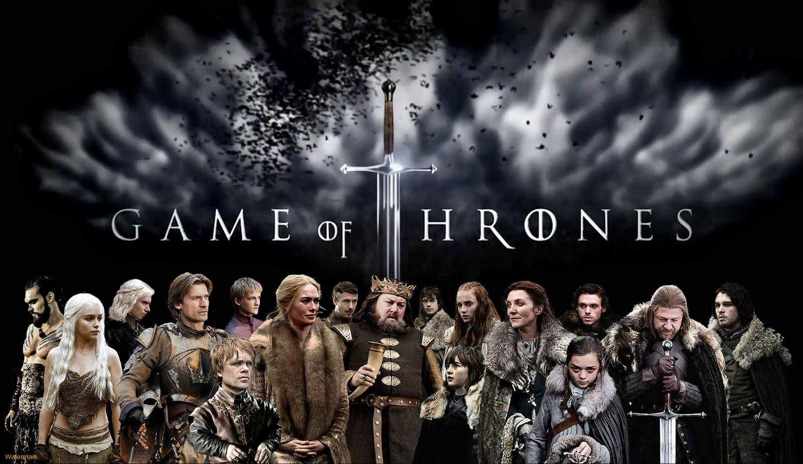
Notes:
So what... I can imagine a system and make it behave following simple logic and reasoning and this enable me to be certain about how it behaves.

Slide 31
Can you think of any examples where mathematical knowledge has value in the Real World?
Notes:
So what, we have this idea that we can create a system based on logic and reasoning and spend an infinite amount of time constructing knowledge about our imaginary system. (Think, Pair, Share). Students to discuss this question.

Slide 32
Mathematical Modelling
Notes:
So what did you come up with? Mathematics is studied primarily because of its long history of giving us insights into events in the real world. We call this modelling. We can start from some known truths about the world and use them and reasoning to generate a model of what really happens. This in many ways helps us to predict the future and solve problems. Let’s consider a few examples.

Slide 33
I. Every object in a state of uniform motion tends to remain in that state of motion unless an external force is applied to it.
II. The relationship between an object's mass m, its acceleration a, and the applied force F is F = ma
III. For every action there is an equal and opposite reaction
Notes:
If consider some simple physical axioms about the world. Such as these (what are they) Physics is in essence a mathematical model of the physical world (a small side branch of mathematics) The application of these simple axioms and some logical reasoning provides a model and a set of equations predicting how objects are going to move and interact, this model has been so successful in predicting what will happen that it has radically changed our world

Slide 34
Notes:
An application of this model has built all modern machinery, started the industrial revolution, built cars aeroplanes, and put man on the moon. And that is only one small branch of maths (physics)

Slide 35
What if.............?
00,01,10,100,101,110,111,1000,1001,1010,...
IF..THEN, AND, OR, NOT,+,-,x,÷

Slide 36
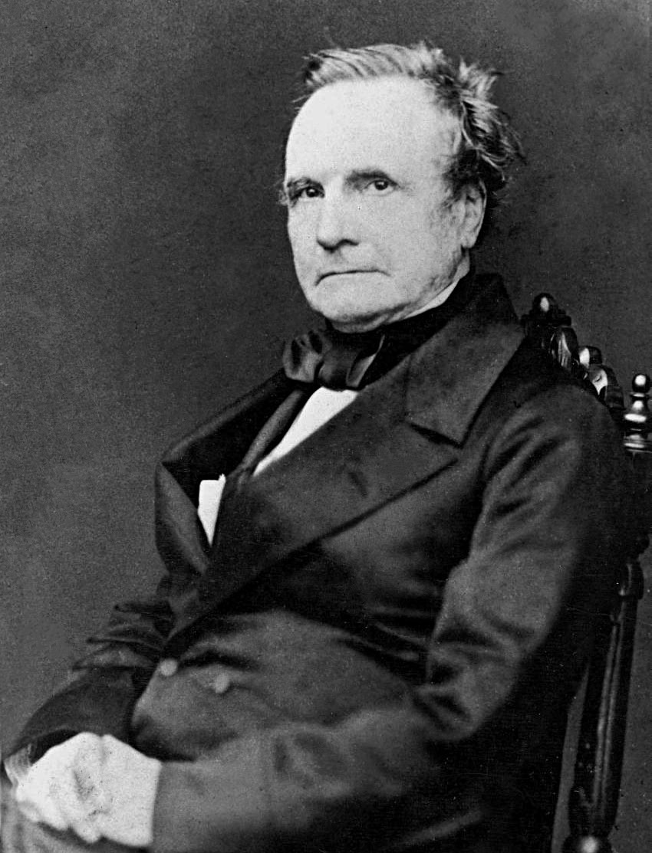
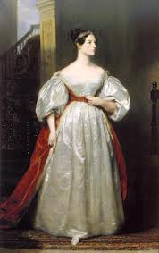
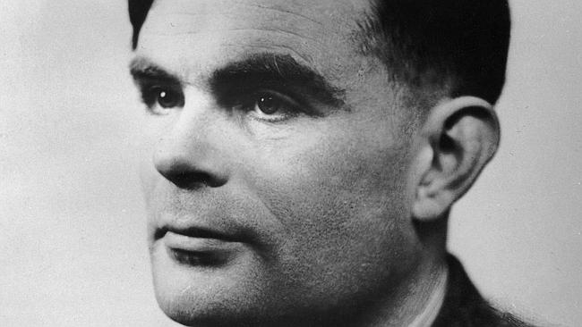
Notes:
Another branch of Mathematical modelling has generated computing (yes if you study computing then again another small part of mathematics) Charles Babbage designed a machine to make automatic computations, Ada Lovelace wrote the first program to run on such a machine in the 1800s, note the imagination here, she wrote computer programs before there were computers, only mathematics has this capacity. The man at the bottom Alan Turing imagined a machine that could perform any logic calculation (IF AND etc) and then proved what kind of programs it ( and all computers) could run and more importantly what kind it couldn’t long before any computer was built. Again the power of imagination to create new knowledge and understanding is there.

Slide 37
Limitations of Mathematical Modelling
Can Logic and Mathematical Reasoning predict everything?
Can you think of any areas where this approach does not work effectively?
Notes:
So Mathematical modelling is a pretty powerful idea but does it always work. Question students.

Slide 38
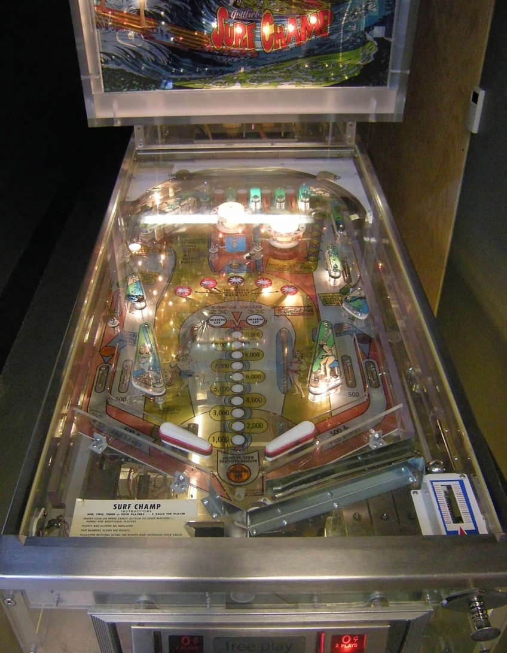
Determinism
Notes:
In fact mathematics has already addressed this too, if a system behaves in a ratio logical way, like a machine where its initial conditions can be used to predict what happens in the future, then it is called a deterministic system. If we do the same thing in the same way we get the same result, so logic and reasoning work quite well(newtonian mechanics and computation are good examples of these). It can be incredibly complex (lie pin ball or flying to the moon) Large scale physics behaves like this as do all machines hence they apply. But not all systems are like this.

Slide 39
Chaos
Notes:
Not everything behaves this way though, in some systems a small change in initial conditions can make a large difference in out come. Imagine I have two colour of plasticine, I give half to you and the we both combine the two colours in the same way, minute variations in our movements and body temperature can make the finished produces to look very different.

Slide 40
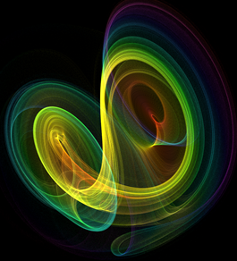
Chaos
Notes:
Chaotic Systems resist logical reasoning as they appear to have unpredictable effects, especially over a long period of time. Mathematicians have tried to model this idea and have had significant success however it is does not help us make predictions as the only prediction is that things will diverge from the expected. The picture on the left is a piece of art made by someone randomly mixing colours, the one on the right is a plot of the lorenz attractor in 3D, which you can think of a bit like a graph.

Slide 41
Chaos and the Weather
Notes:
Weather prediction works in this way, when you get the weather predicts on the TV, a computer program is run hundred of thousands of times with varying starting conditions and then the weather predicted is the most frequently occuring outcome, but it is not always right. ..... 1987 Hurricane,
In the rennaisance and the following years thinkers believed that the universe was entirely deterministic and as such the aims was to establish all the laws of nature and then we would know everything, however we now know that there is a little more to it than that.

Slide 42
What about you, what are the big questions in your life? Can Mathematics help?
Notes:
So some systems behave chaotically making logical reasoning a difficult tool to use and some systems have resisted analysis and modelling so have not as yet been identified as being chaotic.
What about people, if we consider people and human activity then we need to contend with freewill to what extent does mathematics help us understand the world in that manner. What are the big questions in your life and can mathematics help you? Can you think of any questions that mathematics is not able to answer?

Slide 43
How can we eliminate world poverty?
How can we ensure world peace?
How can we reduce child mortality?
What will make me happy?
How can I find true love?
What should I do with my life?
How can I get rich?
Notes:
We have seen however that mathematical knowledge and logic can be applied to the world in many way to help us develop further knowledge and understanding, but there are some questions that are resistant to this approach.

Slide 44
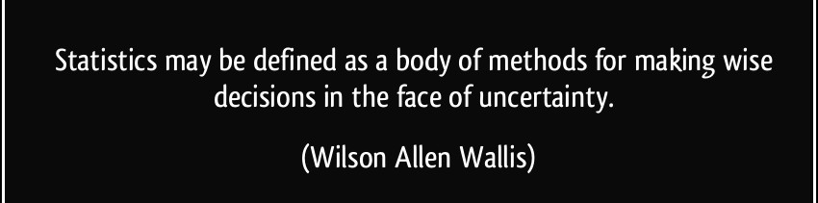
Statistics
Notes:
Another branch of Mathematics, Statistics can help us to try and make sense of some of these ideas. IF Mathematics is the science of certainty then statistics is the opposite

Slide 45
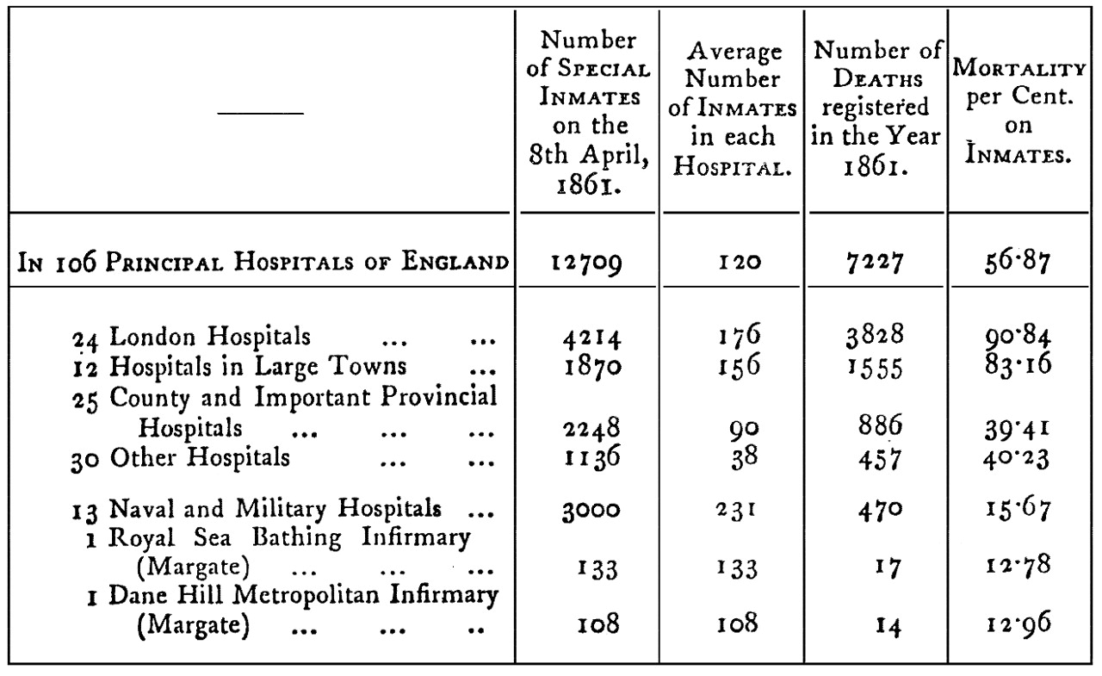
The power of visual representation
Notes:
I have already mentioned that proof requires an element of imagination and some depth and statistics can be the same way. When I say statistics we think of something like this, a list of numbers that require some processing. However statistics is really about making sense of numerical data and giving lists of numbers meaning.

Slide 46
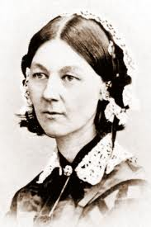
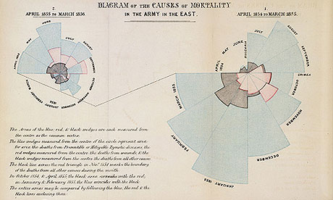
Notes:
This lady did just that, Any ideas who it is, this is Florence Nightingale, famous as a nurse, however what actually made her stand out was statistics. She had a table like we just saw of deaths in the crimean war and use a revolution idea to demonstrate how to reduce them. She show her data visually, .....explain the graph. Notice how by showing the same information in a more creative way we have more information than before.

Slide 47
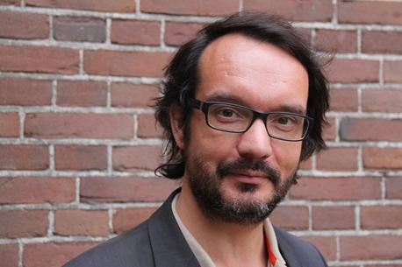
David McCandless
http://www.youtube.com/watch?v=5Zg-C8AAIGg
Notes:
I want to show you a short clip of David Mccandless to help illustrate this point a little more. 6:09=7:43

Slide 48
http://www.informationisbeautiful.net/visualizations/billion-dollar-o-gram-2013/
Notes:
So Florence Nightingale and David Mccandless use pictures to represent information and that promotes understanding and knowledge, can you see the parallel with the approach to proof.

Slide 49
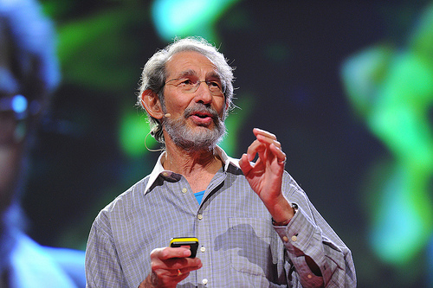
BIG DATA and Computational Statistics
Notes:
Statistics is more than just graphs though, it is a raft of tools based on the same logical foundation of mathematics used to make predictions and draw patterns from large quantities of data.
In recent ideas this ability to process information and use it in this manner has been transformed and this area is called Bbig data, which is Big data is the term for a collection of data sets so large and complex that it becomes difficult to process using on-hand database management tools. The approach relies primarily on mathematical algorithms in the form of computer programs. Geoffrey West has used this technique to identify the underlying reason the world is moving increasingly towards urban lifestyle (geography) and Hans Rosling at the gapminder foundation has used it to interpret history and social development.

Slide 50
Maths or Languages?
Notes:
Google translate uses this method to convert from language to another, by search the internet for sources in more than one language it uses a statistical technique to work out what words mean, as the sources become greater and the algoritmn is better poor Ms Gulinck here may be out of the job.

Slide 51
What can Statistics and Mathematics not tell us about the world?
Is there a negative consequence for trying to interpret the world in this manner?
Notes:
Take a moment to discuss what we have so far, what can stats not tell us about the world. Are there any limits, what kind of questions can it not answer?

Slide 52
Notes:
The last question here is interesting, what impact does our reliance on mathematics and statistics have on our view and understanding of the world. David Boyle wrote this wonderful book addressing this very issue. He argued that by attempting to measure everything we distort the nature of the world. If we take the big questions like, what do you want from life, many people in the world might say they want to be happy. However how do to begin to measure that, but we can easily measure something like, how rich you are and thus our goal is shifted from happiness to wealth, which we begin to associate with each other and I would suggest incorrectly.
.

Slide 53
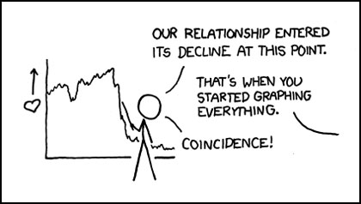
Notes:
Perhaps it is wrong to try and measure everything,

Slide 54
Summary
Mathematical Reasoning is based on axioms (assumed truths) and a self consistent logic
Human Creativity can enhance the Mathematical Process and add new knowledge
The process of Mathematical Reasoning allows us to gain more knowledge and understanding about the world and helps use achieve things which would not be possible without it
Statistics is a tool for dealing with ‘awkward’ concepts that elude other mathematical techniques
Trying to analyse the world in this manner can have unintended consequences (distort our thinking).
Notes:
So in summary, Mathematics is a system....... At its centre is the human imagination and creativity and it encourages a thought process that allows us to imagine new knowledge (unique) this seeming abstract self contained system empowers us to make predictions and creations that have transformed the world.

Slide 55
Is it possible to cut two opposite corner squares off a chess board and to cover the remaining squares with dominoes?
Notes:
Mathematics is a unique subject in many ways as it is about ideas and imagination and how relationships, it is about structures and patterns and predictions. most of all it is about beauty, studies of the brains of mathematicians have shown that proof and elegant mathematical ideas have the same effect on the brain as a beautiful picture or piece of music, with that in mind I will leave you with this puzzle to think about, if you cannot find an elegant solution you will feel frustrated and confused, but when you see the solution it will make your smile. Mathematics is essentially about ideas and this makes it applicable to all other areas of study.

