Slide 1
Ways of knowing: language
Thanks to Richard van de Lagemaat, Theory of Knowledge for the IB Diploma, Cambridge University Press
‘Thought is not merely expressed in words; it comes into existence through them.’
L. Vygotsky, 1896-1934

Slide 2
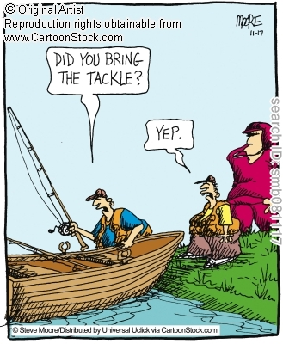
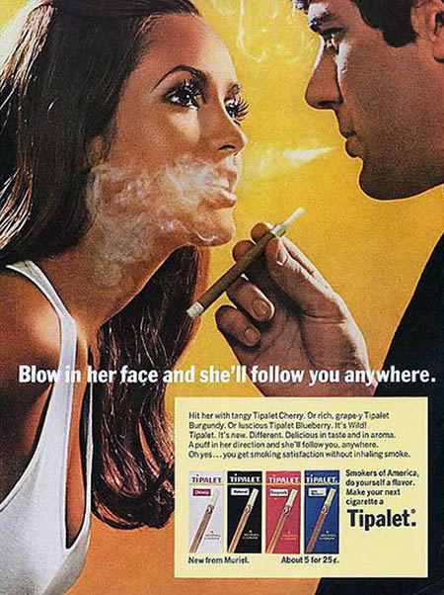
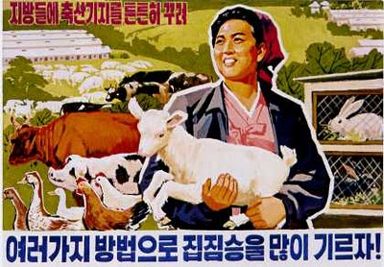
How much would you know of the world if you had no language or means of communicating with other people?
But...
Language and miscommunication
Language and manipulation

Slide 3
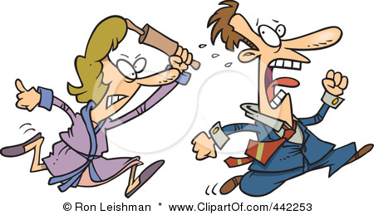
Language is rule-governed
John hits Mary
Mary hits John

Slide 4
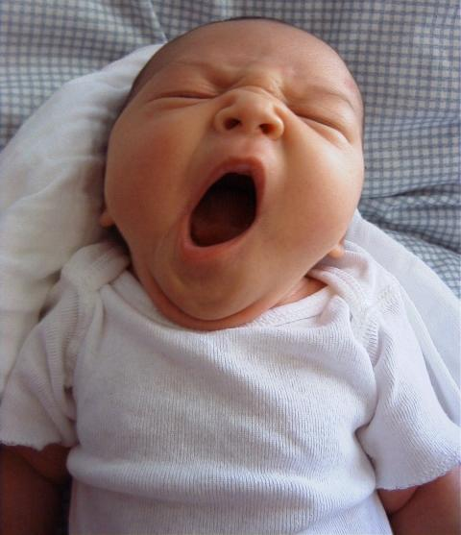
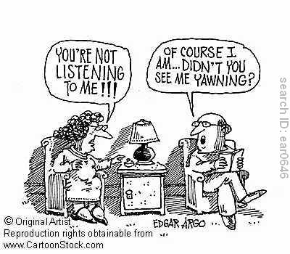
Language is intended
When does yawning become language?
Yawn contagion
9 mins
http://www.ted.com/talks/frans_de_waal_do_animals_have_morals.html

Slide 5
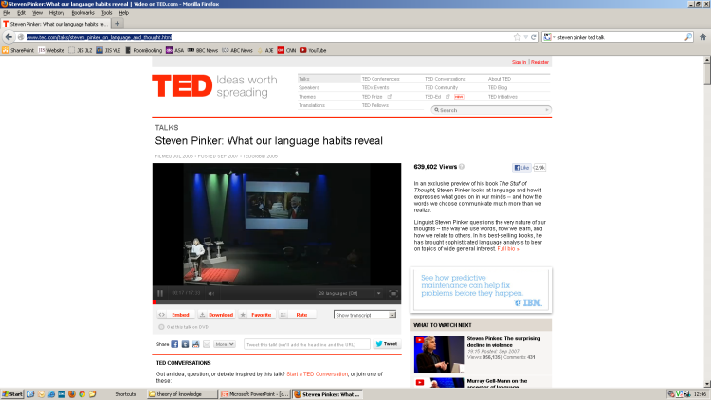
Language is creative and open-ended
Words which have entered the English language: obscene (Shakespeare), Kindergarten (German), ...
Sentence combinations:
Snows | wise | shelter | Cow | When
dusk | at | The | Seeks | It
http://www.ted.com/talks/lang/en/susan_savage_rumbaugh_on_apes_that_write.html
Do you think animals have language?
http://www.ted.com/talks/steven_pinker_on_language_and_thought.html

Slide 6
Is sign language a language according to the three criteria (rule-governed, intended and creative and open-ended)?
Would it be possible to develop a scent language?

Slide 7
The problem of meaning
See activity 3.5 p. 51
Meaning is important in our search for knowledge because you must know what a sentence means before you can decide whether it is true or false.
Words are often ambiguous and open to a variety of interpretations

Slide 8
Definition theory: consult a dictionary for a definition
Dictionary definitions- sometimes vague and imprecise.
Always reliant on other words (language)
How would you explain, to a blind person what the word ‘red’ means? What does this suggest about the limitations of definitions?

Slide 9
Denotation theory: a meaningful word (as opposed to a meaningless word) stands for something.
What does ‘wisdom’ stand for?
Sometimes not possible for a word to clearly stand for a thing.
What does the word ‘Socrates’ stand for?
Did the word ‘Socrates’ become meaningless once Socrates died?

Slide 10
What, do you think, is this painting of Magritte all about?

Slide 11
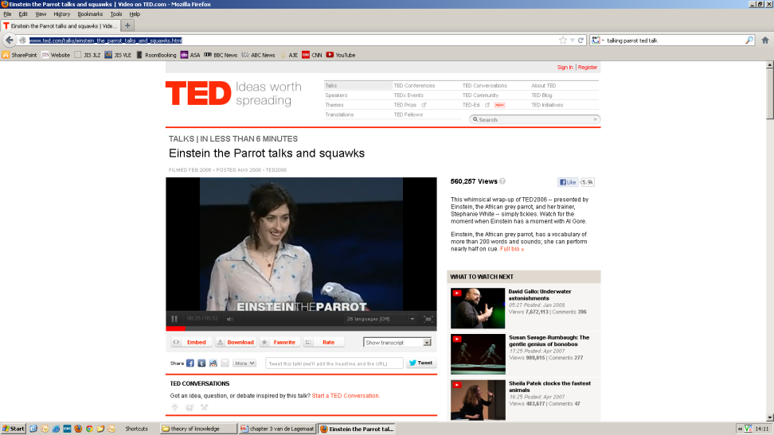
Image theory: the meaning of the word is the mental image it stands for
http://www.ted.com/talks/einstein_the_parrot_talks_and_squawks.html
According to the image theory, does ‘Einstein’, know what he says? Why not?

Slide 12
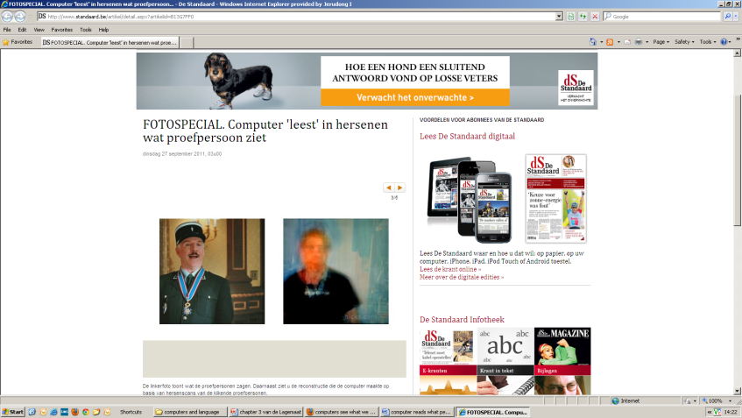
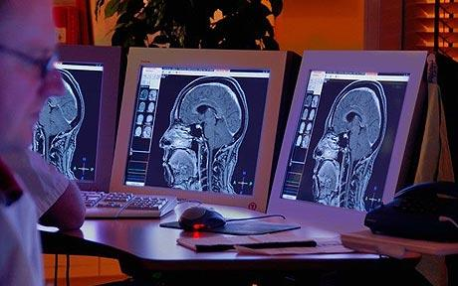
If meanings are in the mind, we can never be sure that someone else understands the meaning of a word in the same way we do, as we can never get into another person’s mind and find out what is going on. (p. 54)
http://www.standaard.be/artikel/detail.aspx?artikelid=B13G7FF0
What are the implications of the advances in neuroscience and technologies for (a possible rejuvenation of) the ‘image theory’?
Computers that can read minds are being developed by Intel. Photo: ALAMY

Slide 13
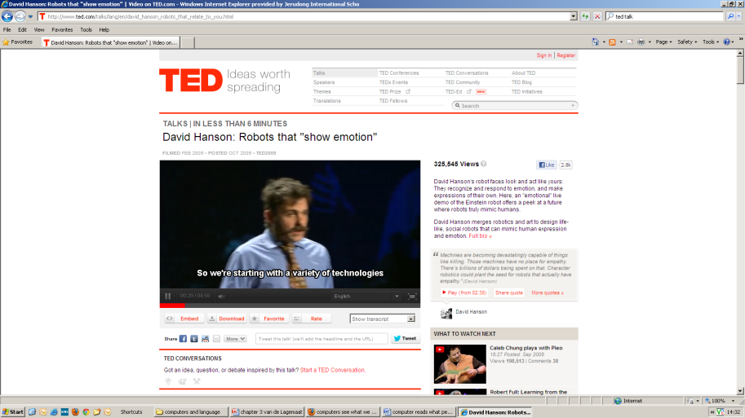
Meaning as know-how
You know the meaning of a word when you know how to use it correctly.
Do you think a robot could use and respond appropriately to language? What difference, if any, would it make in real life if this were the case?
5 min
talk
http://www.ted.com/talks/lang/en/david_hanson_robots_that_relate_to_you.html

Slide 14
Problematic meaning
Vagueness (see activity 3.9 p. 55)
Ambiguity (see activity 3.10 p.56)
Secondary meaning (see activity 3.11 p.57)

Slide 15
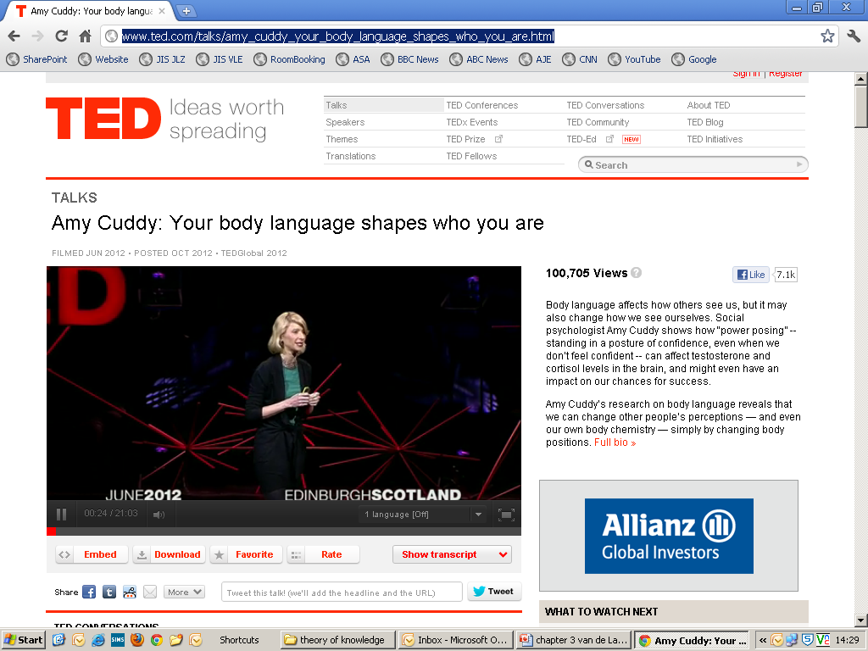
Body language
http://www.ted.com/talks/amy_cuddy_your_body_language_shapes_who_you_are.html
Watch only to ‘anecdote’

