Slide 1
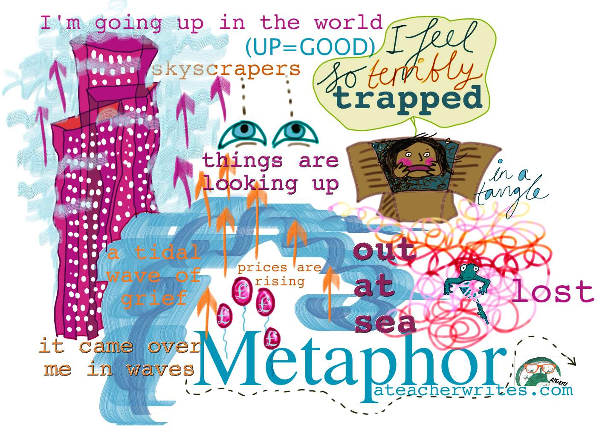
How Metaphors Rule Your Life
Notes:
Going to try to not use a metaphor

Slide 2
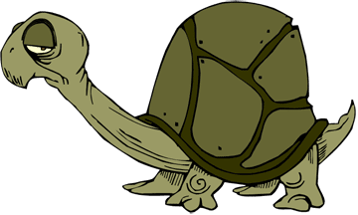
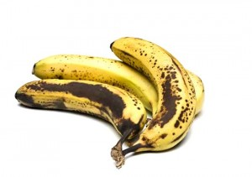
What is a metaphor?
Bob is a ray of sunshine.
Bob is a tortoise.
Bob is a ripe banana. (Bruce Fraser’s study)
Notes:
Metaphors might be something you associate with English lessons, things to include in your descriptive writing in order to have a particular effect on the reader. First thing that comes to mind for most of us is probably what we would call an active metaphor – something we can make deductions from without it bearing any literal relation to the context in which it is said, however we do require some context. E.g Bob as a ripe banana = Soft, oversexed, is yellow, is nice, is harmless, is good now but rotten soon, is crazy, is available, is sensitive, is easy to hurt, stands out to be picked on. Context might depend on age/culture. Difference between metaphor and idiom (type of metaphor but don’t make sense when directly translated).

Slide 3
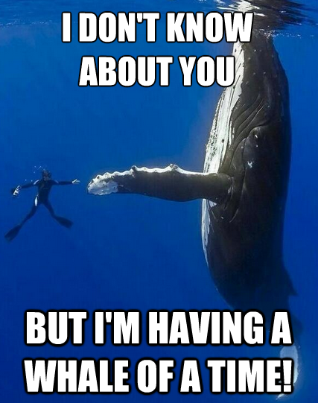
When does a metaphor become an idiom?
Bob is having a whale of a time.
Bob is broke.
Bob geht mir auf den Keks.
Notes:
Difference between metaphor and idiom (type of metaphor but don’t make sense when directly translated). So some metaphors are language specific.

Slide 4
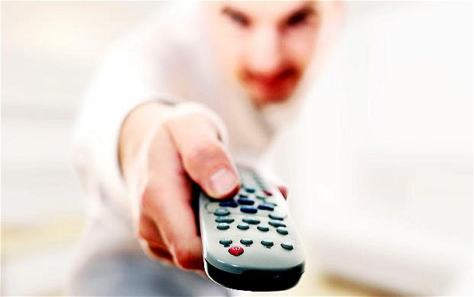
When do we start to use metaphors?
73% accuracy in identifying and understanding non literal statements from the age of 7
(Kaplan, Winner and Rosenblatt, 1987)
Start to create, use and understand metaphors much earlier:
Open your eyes.
Open the TV.
(Rumelhart)
Can I go to the toilet please?
Notes:
Start to create metaphors much earlier as long as it involves domains of which child has knowledge (2-3 years old). Rumelhart’s example shows how children can extend concepts to new ideas/new experiences which is what is needed to access metaphors.

Slide 5
How many metaphors can you find in the following passage?
Your homework this weekend is to put aside as much time as you can to revise for Monday’s test. I hope I can get across to you how important this is. Imagine that your brains are sponges, soaking up ideas as you study.
Some of you have worked hard all term, but some of you really need to literally pull your socks up and realise that hard work now will open doors for you in the future. Imagine yourself ten years from now. How do you want you life to be? Place a clear image of it your mind. Keep this in mind when you feeling like being lazy.
Notes:
Metaphors (including idioms) – as many as you can see.

Slide 6
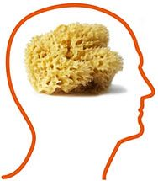
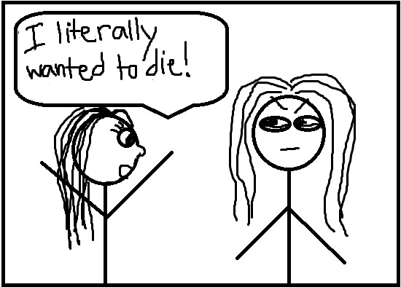
Your homework this weekend is to put aside as much time as you can to revise for Monday’s test. I hope I can get across to you how important this is. Imagine that your brains are sponges, soaking up ideas as you study.
Some of you have worked hard all term, but some of you really need to literally pull your socks up and realise that hard work now will open doors for you in the future. Imagine yourself ten years from now. How do you want you life to be? Place a clear image of it your mind. Keep this in mind when you feeling like being lazy.
Notes:
You probably spotted the more obvious, some active and some frozen metaphors, but there are others in here which are metaphorical rather than literal that we use without thinking. LITERALLY dictionary definition now includes informal use = used for emphasis even if something isn’t actually true. Has literally now become a metaphor because it has a non-literal meaning? The mind boggles...

Slide 7
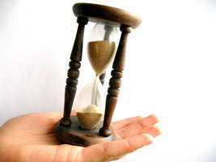
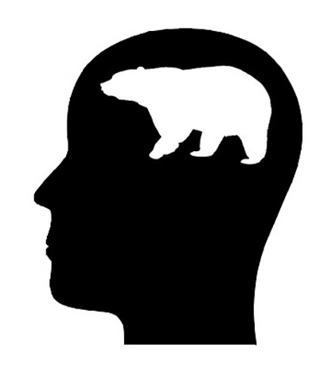
Your homework this weekend is to put aside as much time as you can to revise for Monday’s test. I hope I can get across to you how important this is. Imagine that your brains are sponges, soaking up ideas as you study.
Some of you have worked hard all term, but some of you really need to literally pull your socks up and realise that hard work now will open doors for you in the future. Imagine yourself ten years from now. How do you want you life to be? Place a clear image of it your mind. Keep this in mind when you feeling like being lazy.
Notes:
What about the subtle metaphors here? Intro concept of active and dead metaphors. What about the use of the word ‘literally’? Just been added to the OED with a non-literal meaning (just to confuse you some more).

Slide 8
How do / should we use metaphor?
Logical positivist theory: literal language is most truthful
= metaphors are part of rhetoric and have no place in science
Relativist theory: language shapes our thinking;
most of our ordinary conceptual system is metaphor
= metaphors are how we make sense of the world
Notes:
Aristotle saw the value of metaphor but thought metaphors should be primarily ornamental. May wish to consider which side you agree with most. But I hope to show you some of the points made via the second theory (relativist) and will demonstrate how metaphors are an integral part of how we think and speak. Our concepts structure what we perceive, how we get around in the world, and how we relate to other people. Our conceptual system thus plays a central role in defining our everyday realities. I will even argue that metaphors apply in the world of science and are essential to the way we think and express new ideas!

Slide 9
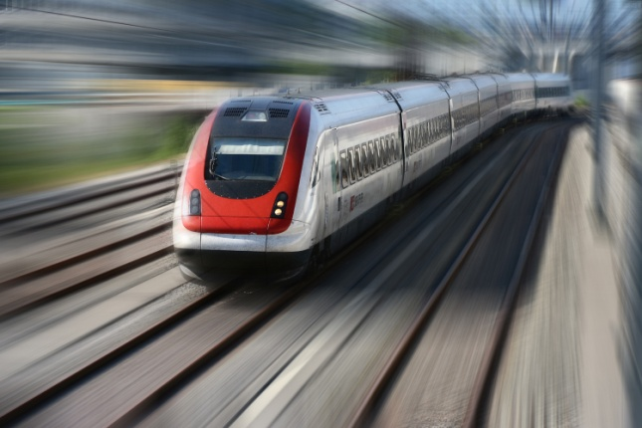
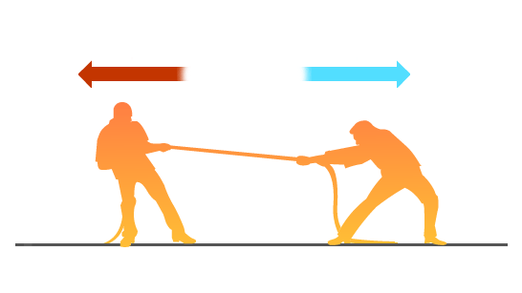
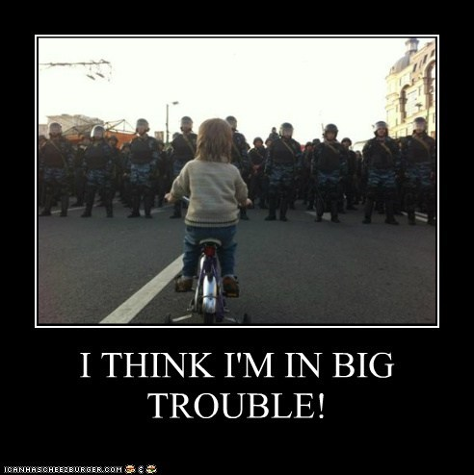
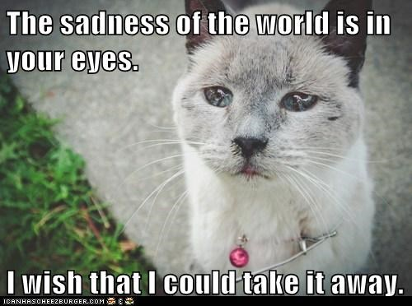
(Lakoff)
Space, motion and force
States are locations
Causes are forces
Changes are movements
Notes:
Here are some general theories from Lakoff: that all our conceptual systems must be based on those which exist/can be expressed via our visual systems – where things are and how things move. Lakoff argues that our use of metaphor for abstract concepts makes good biological sense.

Slide 10
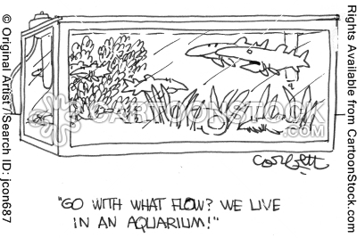
We use what is concrete to understand the abstract
“pour out sorrow”
“it’s been floating around”
“absorb those ideas”
“go with the flow”
“all in the same boat”

Slide 11
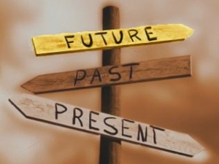
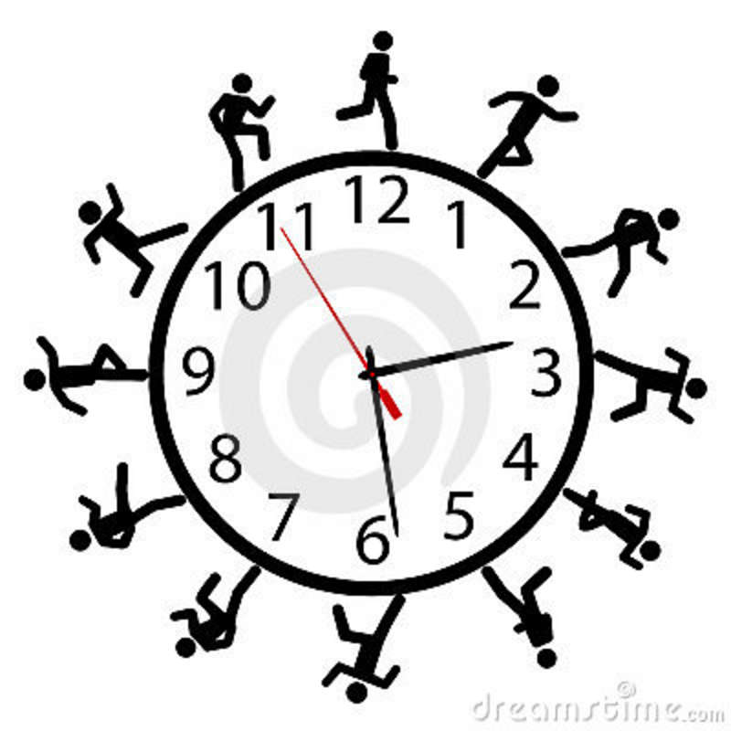
We deal with the abstract in a concrete way
Time as a measurable location/space:
at 8o’clock um 8 Uhr throughout the year arrive on time looking forward to the holidays
put the past behind you
Notes:
We deal with the abstract in a concrete way because it is the only way we know how. Order of past, present and future is culture dependent: in some cultures the future is in front, whereas others it is behind us. We will go back to time as metaphor a little bit later as I’m sure you can think of more instances where the concept of time is explored using metaphor.

Slide 12
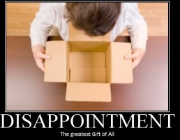
‘conduit metaphor’ (Reddy)
ideas = objects
words = containers
I gave you that idea.
The meaning is right there in the words.
His words carry little meaning.
Your words seem hollow.
Notes:
If you have ever exclaimed that you couldn’t put your feelings into words, you have used a metaphor. The conduit metaphor (Reddy) is a complex one which structures how we talk about and understand language. The speaker puts ideas (objects) into words (containers) and sends them (along a conduit) to a bearer who takes the objects out of the containers.

Slide 13
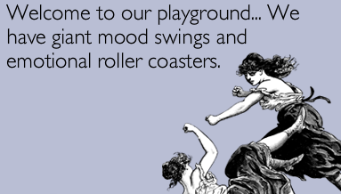
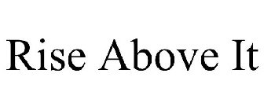
happy = up
sad = down
rational = up
emotional = down
High- level discussion
Notes:
Feelings themselves are probably the most abstract and subjective concepts we have to deal with, so again we decide to deal with them in metaphor. Happy is feeling up or high, sad is feeling low or feeling down. Physical basis: drooping posture typically goes along with sadness and depression, erect posture with a positive emotional state. Similarly, rational is up and emotional is down: we view ourselves as being in control over animals, plants etc. and it is the ability to reason which makes us human, which is why it is given more status and prestige than the more animalistic, emotional side of us (which is uncontrollable and therefore less sophisticated).

Slide 14
Do we use metaphors as a coping mechanism?
simultaneous mapping
movement from one another realm? lifetime = a day
place to another
to “pass away”
Notes:
In the same way that we may use metaphor to explain our feelings, we may also use them to control or reflect our feelings in other ways. The way we talk about death is a good example of this. Dylan Thomas’ famous poem instructs the addressee not to ‘go gentle into that good night’. Here we have an example of what we would call simulatenous mapping, where death is a departure – where we LEAVE one place to go to another and lifetime is a day where death is night. This is reflected in terms like ‘passed away’ or ‘passed over’ which are frequently used as less harsh alternatives to the statement that somebody died. It encourages us to visualise death as a movement from one place to another rather than as somebody ceasing to exist. Depending on how you view this there could be religious connotations to this metaphor, if death is indeed a movement, albeit not physical, into another realm or another world.

Slide 15
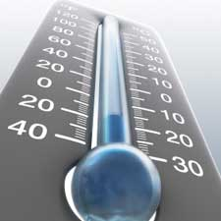
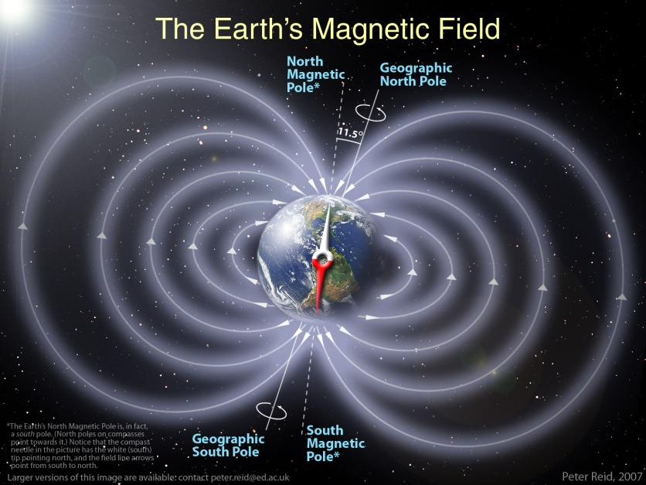
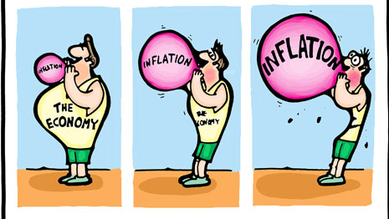
Even science and economics are not safe from the metaphor!
Notes:
But it’s not just when we try to express feelings and make sense of experiences that we use metaphor. Even pragmatic, cold-hearted scientists and economists can’t avoid them! When we talk about prices going up or soaring we do not mean it literally. The line on a graph may move in a an upward direction, but the price itself is not an entity which can move itself. With a drop in temperature, the mercury in the thermometer may physically move downwards and therefore drop, but the temperature itself does not physically do that. Perhaps we could link our association here with cold and a downward movement with the concept of a ‘cold’ person and feeling down... The magnetic field metaphor is one that we don’t think twice about but it is reminiscent of a football field where losing or gaining a particular player can have an impact on everyone else still on the field (Lakoff and Johnston) We are talking about a web or a field of interactions.

Slide 16
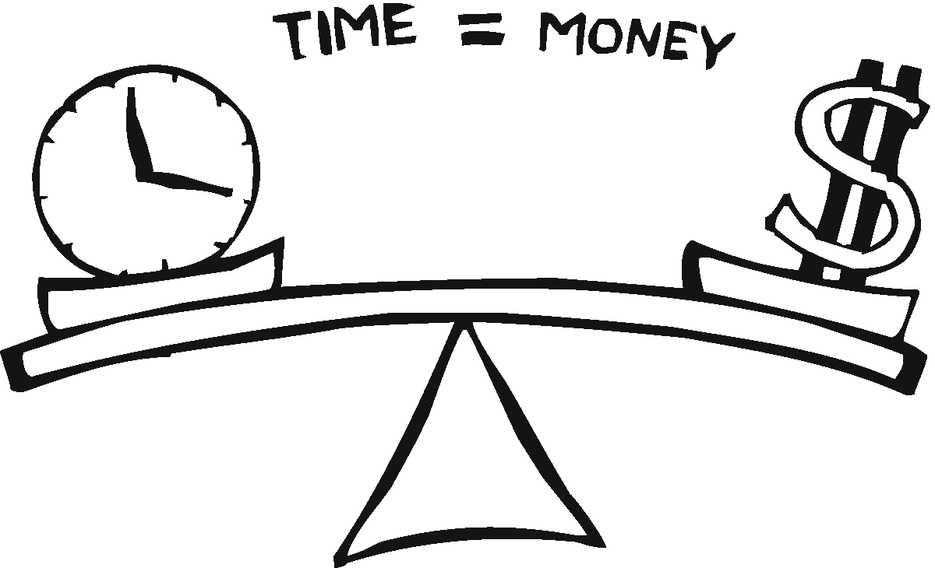
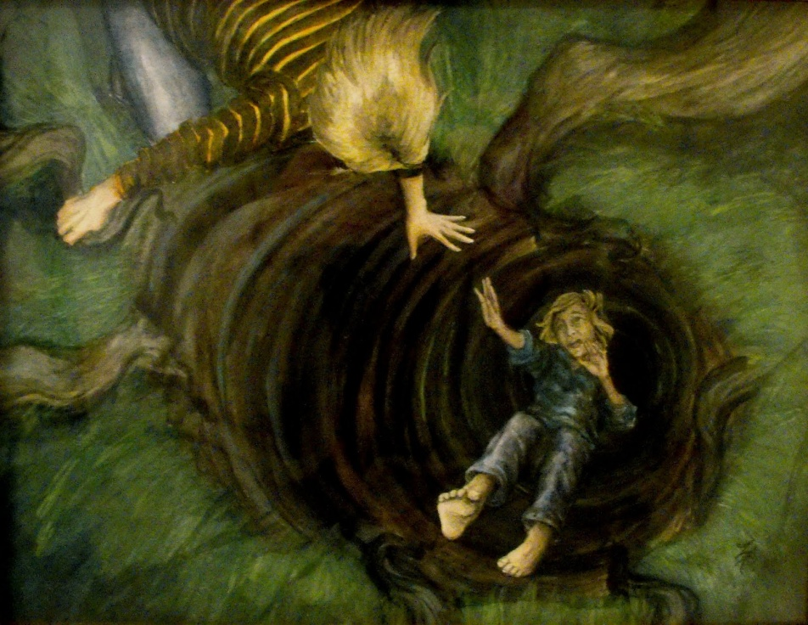
Does metaphor determine or reflect cultural values?
This gadget will save you hours.
How do you spend your time?
I've invested a lot of time in it.
Is that worth your while?
He's living on borrowed time.
You don't use your time profitably.
Thank you for your time.
Time = valuable commodity and a limited resource
The course of true love never did run smooth.
This relationship isn’t going anywhere; we may have to go our separate ways.
Lakoff
State of love = unexpected, involuntary, dangerous?
Notes:
If we talk about things differently, do we view them differently? What comes first, the idea or the expression for that idea? What we really mean when we say time is money is that time is costly in terms of foregone incomes. Time in our culture is a valuable commodity. It is a limited resource that we use to accomplish our goals.
There are languages, and therefore cultures, where time is none of these things. Falling in love is a dead metaphor which suggests a downward movement, to link it to Lakoff’s theory of space, motion and forces as being the three concrete concepts which we can visualise and therefore apply to abstract concepts. The connotations of this are interesting: what are we falling into? What comes at the end of the fall? Does it imply that the state of being in love is something that is hard to get out of if you fell into it? Something unexpected? Freud might make something else of it. Does this metaphor shape our understanding of what it is to fall in love? Again, varies from language to language. Lakoff points out the extended metaphor of love as a journey with stages and expectations that need to be met.

Slide 17
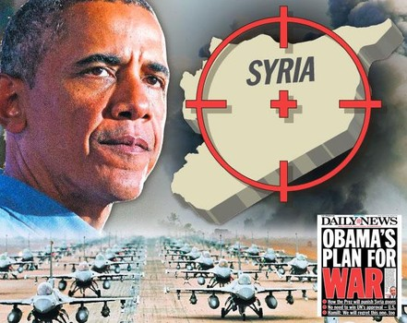
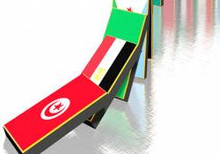
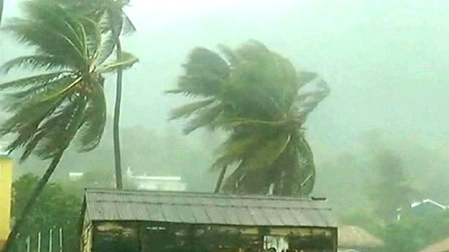
Schön: What are the ‘facts’ highlighted in a metaphor?
Does metaphor determine how we act?
‘domino effect’; ‘contagious’
out-of-control ‘storm’
military strikes, not bombs
(Susan Bakewell, 2013)
(Geary, 2011)
Notes:
We could argue that metaphor determines how we act and how we perceive our behaviour and actions. Schoen talks about the use of metaphors in a social context and what he dubs the ‘facts’ of a metaphor. He asks us to examine which aspects of something are favoured in order to highlight them. Military strikes not bombs= carefully aimed knock-out punches or lightning bolts versus injuries, explosions, mess.
Bombs imply a down and outward movement, with things pounded to bits. Strikes imply an into and through movement. Middle East uprisings, the talk of the protests being either ‘contagious’ or part of some sort of ‘domino effect’ has the effect of diminishing the agency of those involved (Geary). economic crisis as a ‘storm’ is to convey the sense that it is out of control, a naturalised process that we have to try to weather, rather than something that we can influence .

Slide 18
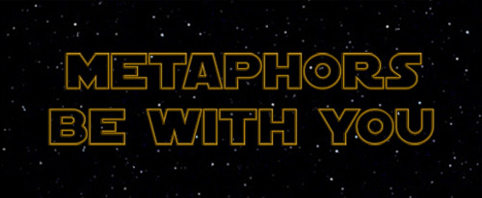
create something new / new way of seeing the world
enjoyment of puzzle solving
(Jerry L. Morgan)
reflect our cultural values
there is no literal expression for exactly what we mean
to reveal the ‘truth’ about something (or what we would like the truth to be)
Plato: A man cannot enquire either about that which he knows or about that which he does not know; for if he knows, he has no need to enquire; and if not, he cannot; for he does not know the very subject about which he is to enquire.
social etiquette
Notes:
So why use metaphors? If you would like a list of further reading, I can send you a list of relevant articles and books. Sorry if over the next few days you now can’t look at anything without identifying the dead metaphors! Metaphors be with you, whether you like it or not!

Slide 19
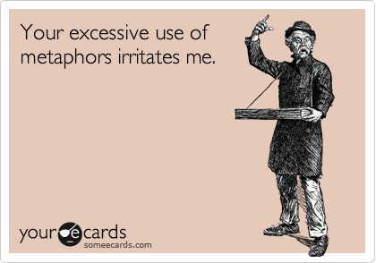
Bibliography/further reading
Metaphor and Thought, edited Andrew Ortony, 1979.
Metaphors We Live By, George Lakoff and Mark Johnson, 1980.
I is an Other: The Secret Life of Metaphor and How It Shapes the Way We See the World, James Geary, 2011.
‘With the Future Behind Them: Convergent Evidence From Aymara Language and Gesture in the Crosslinguistic Comparison of Spatial Construals of Time’, Rafael E. Núñeza and Eve Sweetser, Cognitive Science 30 (2006), pp.1–49.
‘How we’re herded by language’, http://www.theguardian.com/commentisfree/2013/sep/06/herded-language-metaphor-war: Susan Bakewell, 2013.

