Slide 1
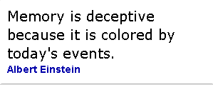
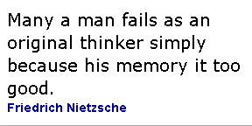
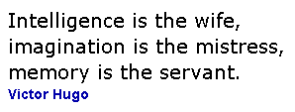
Memory

Slide 2
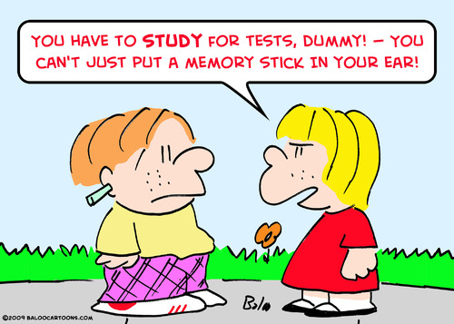
Where would we be without memory?
Notes:
We need memory in our daily lives: to pass tests, store information etc. It helps us to remain good social contacts and it (hopefully) prevents us from doing stupid things, such as hitting our head against a wall over and over again.

Slide 3
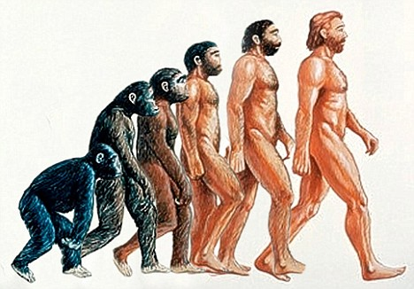
Notes:
Apart from individual memory, we also rely on collective memory. The memory of all that our ancestors have learned enables us to evolve as humans.

Slide 4
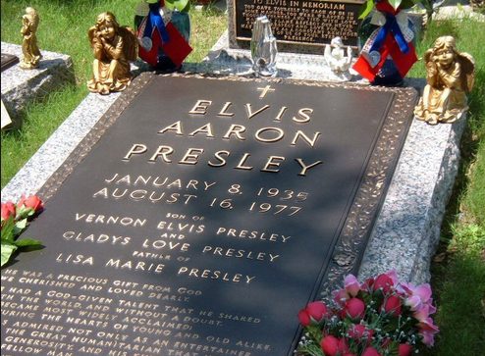
Notes:
On a personal emotional level, it is important to remember events and people. Many cultures remember the dead in a different way. The memory of Elvis is kept alive to such an extent, that some feel that the King still exists. Across the world, people also use keepsakes such as rings, photos, scrapbooks, engravings etc to remember big days such as weddings.

Slide 5
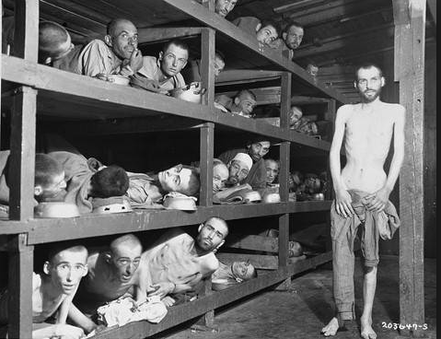
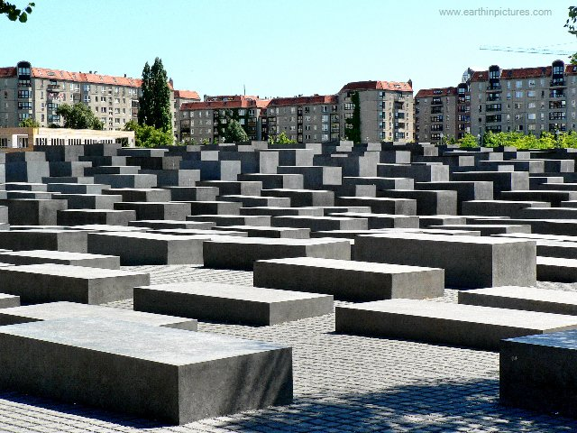
Notes:
Sometimes, it is historically and ethically important to remember big events from the past. The Holocaust memorial reminds us why we should remember the atrocities of genocides and will hopefully prevent people from committing the same atrocities in the immediate future. I think most people will agree that memory is very important. For the first time, the TOK course has now added memory as a way of knowing in its specification. Some people may argue that memory is not a way of knowing as such, but rather a storage place for knowledge. But, how would we know without memory?

Slide 6
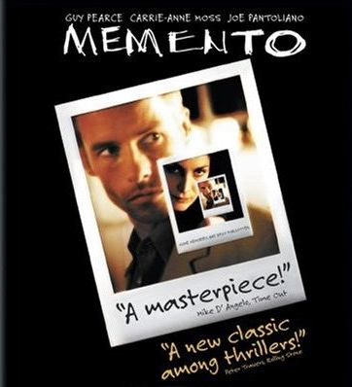
How do we know without memory?
Is memory a WOK?
The importance of memory can be highlighted by imagining the challenges that would be presented by losing our memory.
DISCUSSION: What do you do to remember things? Does your memory of these events change because of the ‘souvenirs’ you create?
What do you remember well? What do you tend to forget easily?
Notes:
So, even though some people may claim that memory is not a way of knowing as such, the importance of memory can be highlighted by imagining the challenges that would be presented by losing our memory. Psychological and medical conditions which involve memory loss, such as Alzheimer's, highlight the importance of memory as a Way of Knowing. After I watched the thriller Memento, about a man who suffers from anterograde amnesia, I became fully aware of this fact. The main protagonist of the film is unable to store new explicit memories. In a time before I pads and I phones, he had to store his memories in a creative manner: through tattoos and Polaroid pictures. This memory impairment creates the perfect starting point for a thriller, yet it also highlights how we need memory as a Way of Knowing. DISCUSSION TASKS (blue box)

Slide 7
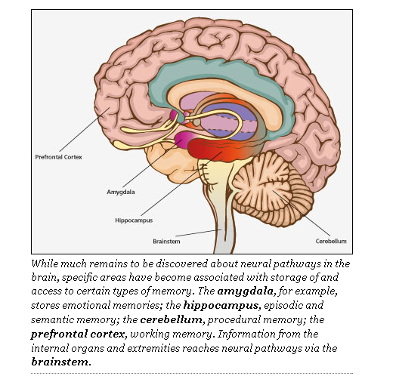
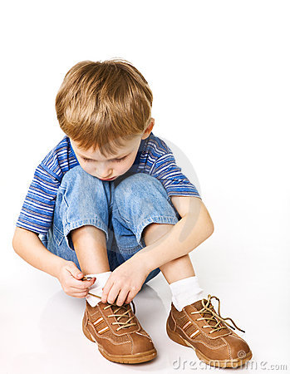
Procedural knowledge
Notes:
Psychologists differentiate between different types of memory. Psychologists make a difference between two types of memory: procedural memory (the knowledge of skills, which is encoded on the subconscious and intuitive level) and declarative memory (the memory of facts and events- either semantic memory, which is based on information or episodic memory, which is based on experiences). Both types of memory are highly important when we consider memory as a Way of Knowing. Each type of memory will raise different Knowledge Questions
Procedural memory is memory for the performance of particular types of action. Procedural memory guides the processes we perform and most frequently resides below the level of conscious awareness. When needed, procedural memories are automatically retrieved and utilized for the execution of the integrated procedures involved in both cognitive and motor skills; from tying shoes to flying an airplane to reading. Procedural memories are accessed and used without the need for conscious control or attention. Procedural memory is a type of long-term memory and, more specifically, a type of implicit memory. Procedural memory is created through "procedural learning" or, repeating a complex activity over and over again until all of the relevant neural systems work together to automatically produce the activity. Implicit procedural learning is essential to the development of any motor skill or cognitive activity.

Slide 8
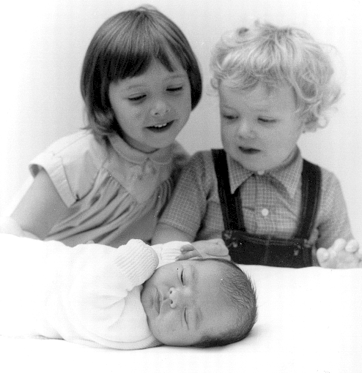
And if we forget?
TASK: think of your most distant childhood memory
Notes:
We do not remember everything. Sometimes this can be a good thing… We have all done some things we are not proud about and we have all seen things we’d rather forget. One of the more mysterious forms of amnesia is called childhood amnesia. To make you understand, try to think of your most distant childhood memory. On this photo, I am around 3.5 years old. I do remember the birth of my little brother, albeit in patchy detail (and more focussed on the sweets we got –Belgian tradition- rather than the baby being born). My middle brother, who was 1.5 years will not remember the event and my baby brother most certainly not.

Slide 9
Childhood amnesia
General inability of people to remember specific events from the early years of their lives
The average age of the earliest memory reported is about 3.5 years old. Yet, women tend to be able to go back a bit further.
Notes:
This type of memory loss is called Childhood amnesia. It is...(boxes)

Slide 10
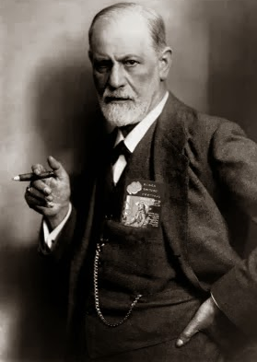
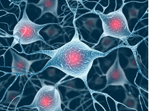
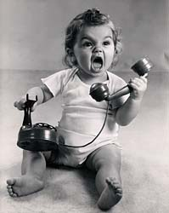
Freud explained childhood amnesia (and almost everything else) by sexual repression
Some theories suggest that children’s brains are not equipped to store memories because there are not enough connections between the brain cells and the memory storage areas are immature.
Some theories suggest that because cognition is influenced by language, we don’t remember this pre-linguistic stage. Maybe the memories are stored in a form we can’t access anymore.
Notes:
There are different theories which explain this childhood amnesia (read boxes).
The theory which suggests that cognition is influenced by language is an interesting one. There is most certainly a connection between language and some kinds of memories, but not all memory is influenced by language. The Chimpanzee memory test in Japan seems to prove that spatial memory is better in primates with a less developed language.

Slide 11
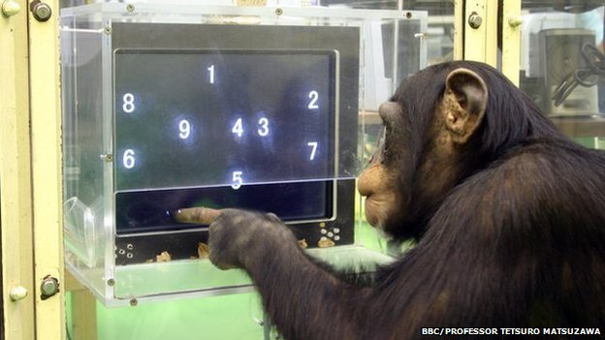
http://www.theguardian.com/science/2013/sep/29/chimp-intelligence-aymu-matsuzawa-kyoto
http://www.youtube.com/watch?v=JkNV0rSndJ0
"We've concluded through the cognitive tests that chimps have extraordinary memories," Matsuzawa says. "They can grasp things at a glance. As a human, you can do things to improve your memory, but you will never be a match for Ayumu."
Notes:
Show the Chimpanzee video: So why is it that the chimpanzees are so much better at these memory tasks?
Their task was to touch the numbers in ascending order. To complicate matters, the game was altered so that as soon as the chimps touched the digit 1, the remaining eight were immediately masked by white squares. To complete the exercise, they had to remember the location of each concealed number and, again, touch them in the correct order.
In an even harder version, five numbers appeared on the screen before turning into white squares. The animals and their human counterparts displayed the same degree of accuracy – about 80% – when the numbers remained visible for seven tenths of a second. But when the time was reduced to four tenths of a second, and then just two tenths, Ayumu maintained the same level of accuracy, while his mother and the human volunteers floundered.
Given that humans share 98.8% of their DNA with chimpanzees, why do the latter have such vastly superior working memories?

Slide 12
The answer lies in evolution, says Matsuzawa. As humans evolved and acquired new skills – notably the ability to use language to communicate and collaborate – they lost others they once shared with their common simian ancestors. "Our ancestors may have also had photographic memories, but we lost that during evolution so that we could acquire new skills," he says. "To get something, we had to lose something.“
For the chimps, the ability to memorise the location of objects is critical to their survival in the wild, where they compete for food with other, often aggressive, ape communities. To thrive, an individual chimp must be able to look up at, say, a sprawling fig tree and quickly note the location of the ripe fruit.
Visual memory versus other types of memory.
DISCUSSION: What is the link between language and memory?
Notes:
The Japanese researcher Matsuzawa claims that language has impaired human being’s ability for short term, spatial memory. Even though there may exist different theories to explain the contrast between the memories of humans and other mammals, it is clear that there is a link between language and memory. This link could be explored further in TOK.
Psychologists make a difference between two types of memory: procedural memory (the knowledge of skills, which is encoded on the subconscious and intuitive level) and declarative memory (the memory of facts and events- either semantic memory, which is based on information or episodic memory, which is based on experiences). Both types of memory are highly important when we consider memory as a Way of Knowing. Each type of memory will raise different Knowledge Questions

Slide 13
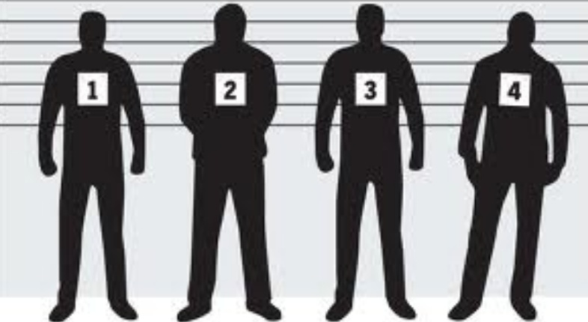
How reliable is our memory?
Notes:
Some people are memory experts (you can find many examples on the internet of these memory magicians), and some feel that their memory fails them. But an important question in TOK terms is: How reliable is our memory? If we rely on memory to store and acquire knowledge, it is important to have a reliable memory. But, this is certainly not always the case. Many of the examples I will use come from a TED talk by psychologist Loftus on the reliability of memory. The reliability of memory is very important in a legal context, where we will use eye witness testimony to decide what has happened.

Slide 14
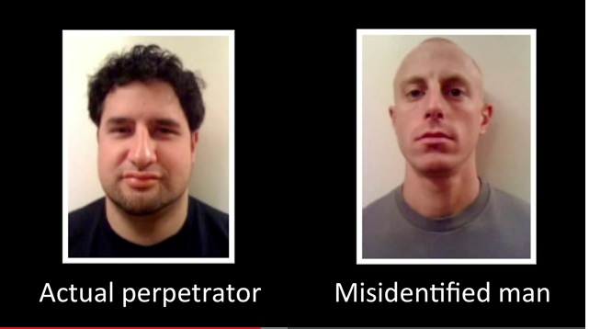
Elizabeth Loftus at TED (the fiction of memory):
Contamination of memory through misinformation
Notes:
Loftus starts off with a case in which a man had been falsely accused of rape (man on the right picture) and he got sentenced based on eye witness testimony. The victim of the rape managed to mistake him for the man on the left hand side, even though the physical resemblance is very poor. According to Loftus, there is a statistically very high incidence of contamination of memory in legal cases which rely on memory and eye witness testimony (even though the man on the right was proven to be innocent and he was legally cleared, his life was ruined and he committed suicide).

Slide 15
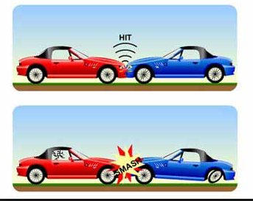
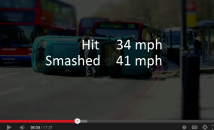
The misinformation effect
Language and memory
“We can change each other’s memory” (Loftus)
Notes:
According to Loftus, we can contaminate and change each other’s memory. Psychological experiments confirm this point.
When people were showed video footage of an accident between two cars and asked (from memory) how fast the car was driving, the answers varied according to the language of the question. The question hit got a lower speed than smashed. When subjects were asked ‘how fast did the car smash into the other’, they also remembered broken glass etc, even though there was no broken glass. This shows how the suggestion of language can change and contaminate someone’s memory.

Slide 16
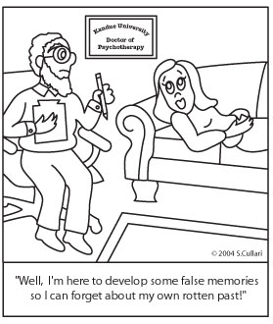
FALSE MEMORIES
DISCUSSION: Have you ever had a false memory (which you are aware of)? Do you think you may have had a false memory planted into your head at some stage?
Notes:
Here’s another psychological joke, about false memories. But, on a serious note: consider the discussion points in the box.

Slide 17
Do you sometimes have a memory of yourself which includes the visual image of yourself as if you were seen by someone else?
Do you reconstruct the memory of your life story?
Facebook: what will it do with your memory?
My own (false) photographic story
Better looking?
more popular?
More exciting?
funnier?
Notes:
(Questions in black box). On a personal level, I feel that I have slightly reconstructed the memories of my childhood, partly on the basis of photographic evidence. I continually reconstructed a story around the photo, though subtly, and I wonder how much of the original facts are still true. It will be interesting to see how new technologies and media such as Facebook will affect your memories of current events.

Slide 18
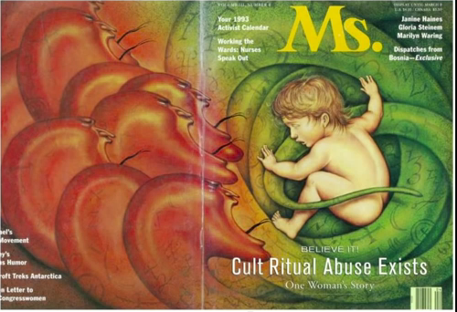
Suggestion in(bad) psychotherapy
False memories were planted by psychiatrist on Cool (1986)
Notes:
Language and photos can alter your memories to some extent. But is it possible to implant completely false memories? In 1986 Nadean Cool, a nurse's aide in Wisconsin, sought therapy from a psychiatrist to help her cope with her reaction to a traumatic event experienced by her daughter. During therapy, the psychiatrist used hypnosis and other suggestive techniques to dig out buried memories of abuse that Cool herself had allegedly experienced. In the process, Cool became convinced that she had repressed memories of having been in a satanic cult, of eating babies, of being raped, of having sex with animals and of being forced to watch the murder of her eight-year-old friend. She came to believe that she had more than 120 personalities-children, adults, angels and even a duck-all because, Cool was told, she had experienced severe childhood sexual and physical abuse. The psychiatrist also performed exorcisms on her, one of which lasted for five hours and included the sprinkling of holy water and screams for Satan to leave Cool's body.
So, what had happened? Cool had been implanted with false memories.

Slide 19
Success rate for planting false memories
Lost in shopping mall: 25 %
Nearly drowned: 50%
Attacked by a dog:50%
You witnessed demonic possession
Notes:
Loftus researched the possibilities of planting false memories in a (ethically rather questionable) psychological experiment. The results were quite amazing.

Slide 20
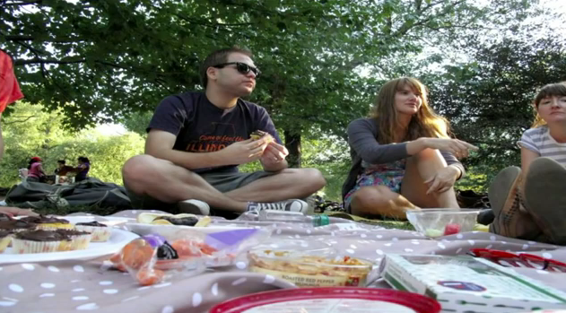
How false memories change your behaviours
Disgust
Or appetite?
Discussion: what are the ethical implications of such memory experiments?
Would you implant false memories in your children to make them eat vegetables?
Is there any situation in which we could justify planting false memories?
Could we justify planting false memories from a utilitarian point of view?
Notes:
Loftus’s research may seem rather controversial from an ethical point of view. She did get into trouble legally because of the type of research she did, as she explains in her TED talk. She does, however, strongly feel that the ethical advantages of the implications outweigh the disadvantages. (DISCUSSIONS)

Slide 21
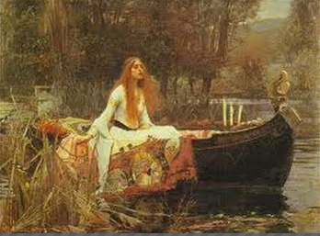
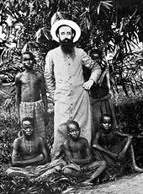
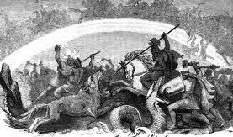
The abuse of memory in the world
Link to AOK
Pre-Raphaelite art
Our memory of colonisation
See Curtis’s ‘The Living Dead’ epsiode 1 (website)
The Aryan Myth
Discussion: can you find other real-life examples where memory is/has been abused around the world?
Notes:
Research on false memories highlights the importance of critically evaluating where memory has been abused and is still abused throughout the world. Many dictatorships, for example, draw on mythical memories which never existed. The Aryan myth with a nostalgia for a past which was never there, is a good example. Propaganda in North Korea creates and glorifies false memories. The colonial history of Belgium, but also the UK and other European nations is often an airbrushed, false memory. Pre-Raphaelite art may just be art, but it had a function to recreate a false medieval memory which heavily influeneced our perception of the past. You can link (false) memories to other areas of knowledge within TOK.

Slide 22
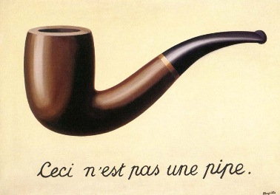
CIA interest in leading ‘memory psychologists’ during the Cold War era.
CASE STUDY: Tabula Rasa therapies by therapist Cameron
For full documentary: See Adam Curtis: The living dead, episode 2, 19.25mins – 23mins.
website: www.sohowdoweknow.weebly.com)
Notes:
An interesting case study is the Tabula Rasa therapies which were used by therapist Cameron. AT the time of the cold war, the CIA was particularly interested in such therapies, as they presented politically powerful tools. (SHOW FRAGMENTS) If you are interested in these episodes, have a look at the website, where they are downloaded.

Slide 23
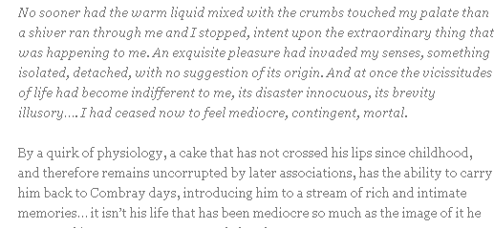
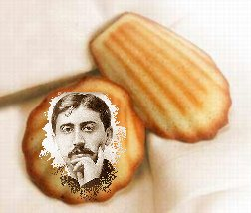
Memory and sense perception (WOK)
Proust: ‘A la recherche du temps perdu.’
Notes:
We can link memory to areas of knowledge, but also to other ways of knowing. Subconscious memory is heavily linked to sense perception and sometimes tastes or smells can bring back memories which we thought we had forgotten about. French author Proust wrote a very famous passage about this phenomenon in his ‘A la recherche du temps perdu.’ The all round sensory experience brings back a much more lively memory of the orginal event. It is as if he could re-live the experience once again.

Slide 24
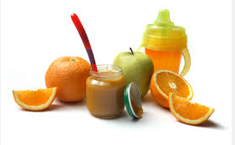
Notes:
There is a scientific explanation for how smells can conjure such vivid memories. But you may not need to be scientist to understand how a smell can bring back a memory. You may just get a general feeling from smelling talcum powder which your grandmother used, you may get happy memories from your youthful camping days when you smell citronella oil. You may be attracted to someone who wears the same perfume as someone you once fancied. Who knows what memories will come back if you eat a food which you have not tasted for ages?

Slide 25
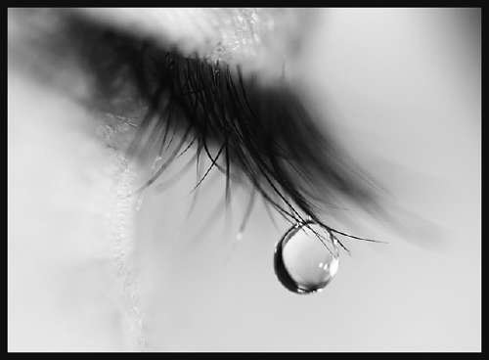
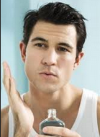
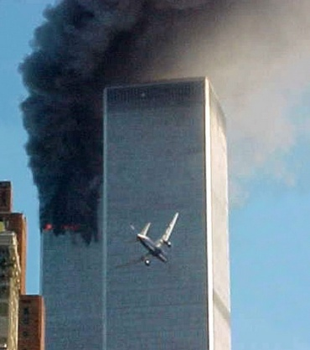
Emotions and memory (WOK)
Emotional events are often memorable
Emotions from the past may influence your judgements today
Flashbulb memories (what you did on 09/11)
Discussion: can you find examples of your own life of such memories?
Notes:
Emotions can be brought back through tastes and smells and their memories which are associated to them. As mentioned you may feel love by smelling the aftershave of person A on person B, or you may fancy men with big noses because the first person you fancied had a big nose. The memory of the nose can arouse this feeling. On the other hand, emotional memories are often more memorable. If you think of a very sad event or a very happy event, this will be easier than thinking about an event which left you completely cold. There is also a concept called ‘flashbulb memories’. If you are old enough, you may remember quite well what happened around you on the emotional, impact day 09/11, apart from 09/11 itself.

Slide 26
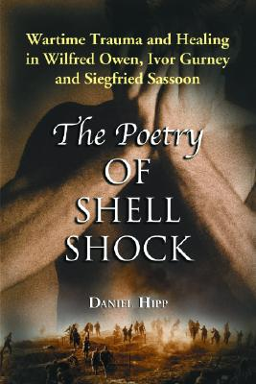
Notes:
In English literature you may have read poems which deal with shell-shock, now called post-traumatic stress disorder. Extreme stress and fear has an effect on the structure of the brains and may cause some kind of memory loss. Even though we have no time to delve deeper into this issue, it is clear that there is a link between emotion (way of knowing) and memory and that scientists, artists and historians will find this issue relevant. It is important to make links between AOK and WOKs in your Theory of Knowledge studies and you may explore this area further.

Slide 27
Science, technology and memory (AOK)
http://www.inference.phy.cam.ac.uk/jmb86/memory.pdf
Neuroscience and psychobiological research on the mechanics of memory
Notes:
Like many neuroscientists, Cedric Williams, a psychobiologist, wants to understand the mechanics of memory—how emotional reactions triggered by a squirt of adrenaline in the body will drastically improve your recollection of any event. For example, say you’re a motorist who passes a place where you once hit a deer.
“When you drive back past that place, even though there’s no deer, you get this funny feeling,” he says. That feeling is because that stretch of road has triggered a reaction in a particular part of the brain—the amygdala, which is the center for the emotional context of memory.
The amygdala hardly works in isolation. When a driver first hits a deer, there is a jolt of adrenaline from glands in the midsection. That jolt courses up the vagus nerve in the spinal column to the brainstem, where it hits a roadblock—the blood-brain barrier. Too big and bulky to pass, the hormone (adrenaline) triggers release of a chemical neurotransmitter (norepinephrine). The “Hey-I-just-hit-a-deer” transmission goes to the hippocampus, a vital part of the brain’s memory pathway that maintains a record of contexts and places. Somewhat like an old-time telephone operator, the amygdala takes incoming information, analyzes it and often channels it elsewhere with a note saying, “This is important.” In this case, which involves an episode (called an episodic memory), the amygdala has a complex task that involves myriad cognitive functions and coordination with various parts of the brain—hippocampus, prefrontal cortex, cerebellum and others.

Slide 28
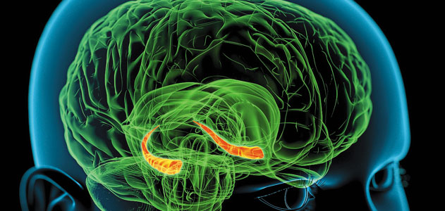
Memory research through technology
The field is a fertile frontier where modern tools—computers and functional magnetic resonance imaging—open new windows. Using fMRI, one group of researchers found that thought patterns used to recall the past are strikingly similar to those used to imagine the future.
In another, researchers scanned the brains of people who had watched short films repeatedly, until the memories were fully encoded, or stored, in the brain. A computer analyzed the scans as the participants recalled the films. Not only could researchers predict which movie was being recalled, but they found that the patterns of brain activity among different participants were “incredibly consistent.” (University of Virginia)
Notes:
Advances in science and technology allow us to research the field of memory much better than once before. In TOK you are encouraged to make links between ways of knowing and areas of knowledge. These links can lead to interesting knowledge issues, which could be the basis for your assessed presentations.

Slide 29
Memory and our sense of self
Memory and identity
Who we are, where we came from
Memory and cultural identity
DISCUSSION TASK: Which knowledge questions could you come up with based on this lecture?
Notes:
“Memory holds a defining place in our identity. It prompts and compels, fascinates and baffles. And like so many aspects of our nature, it serves us well when it functions smoothly but frustrates us mightily when it fails our needs.” (University of Virginia). Yet, we have seen that memory is not perfect and that it does not work in isolation from other WOKs. Which questions about knowledge could you come up with in your TOK sessions? Please prepare some and share them on the TOK forum.

Slide 30
PLENARY
Memory, and particularly habit, has a strong link to procedural knowledge and remembering how to perform actions. In contrast to perception, memory refers to things which are not currently happening. And in contrast to imagination, memory refers to things which we believe really happened. Some would argue that memory is not itself a source of knowledge, but instead is a process which we use to recall knowledge gained in the past.
However, although memory refers to knowledge gained in the past, it can be argued that even new knowledge is dependent on and influenced by memory. For example, how we interpret new situations can be heavily influenced by experience and previous events. In this way, apart from being a “storage unit” for existing knowledge, memory can also be a mechanism that allows us to process new and unique situations.

Slide 31
Many discussions of knowledge tend to focus on how beliefs and knowledge are formed rather than on how they are remembered by the individual. However, most of the knowledge that individuals have is in the form of memory and therefore how we retain information and how past events and experiences are reconstructed is an important aspect of how personal knowledge is formed.

Slide 32
Because so much of our personal knowledge is in the form of memory, issues surrounding the reliability of memory are also crucial.
Memory retrieval is often regarded as unreliable, for example, because it is seen to be subjective or heavily influenced by emotion.
See documentary: ‘The mystery of memory’
(scientific explanation, the effects of emotion on memory)

Slide 33
Memory
Can we know things which are beyond our personal present experience?
Is eyewitness testimony a reliable source of evidence?
Can our beliefs contaminate our memory?
Notes:
I would like to leave you with some knowledge questions about memory. Could you come up with some additional questions about knowledge, which involve memory (and other Ways of Knowing/Areas of Knowledge)? An open-ended questions which evaluates memory as a source of knowledge is the basis of such a knowledge question. You can discuss these questions with your TOK teacher and you should then post them to the online forum on the website. The Powerpoint is published on the website, so you can go through the main points again at any stage. (SHOW FORUM AND EXPLAINS ONLINE SAFETY)

