Slide 1
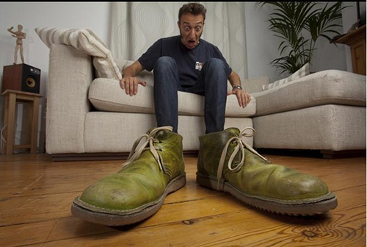
Sense perception
WoK Number 1 – October 2013

Slide 3
Knowledge through the senses
5 senses?
Between 9 and 21 (depending on who’s counting!
Equilibrioception, Proprioception, Thermoception, Nociception

Slide 4
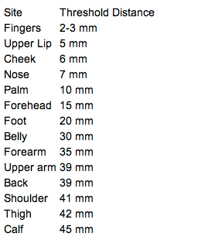
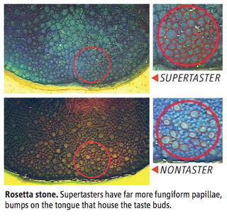
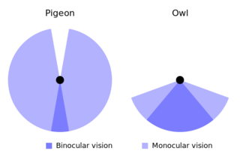
What are the limitations of sensory perception?

Slide 5
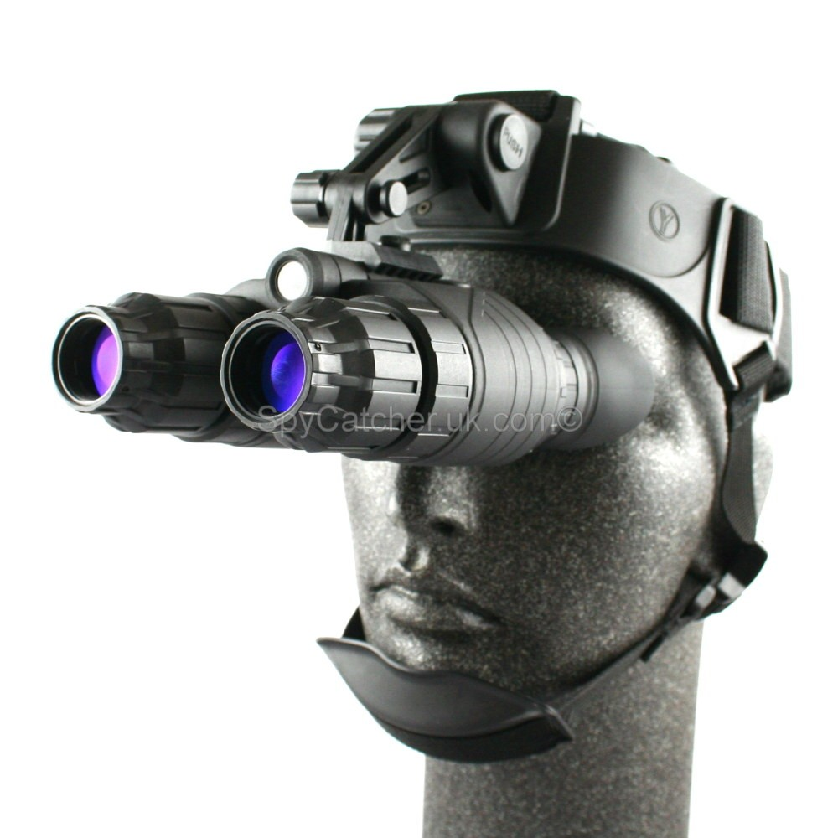
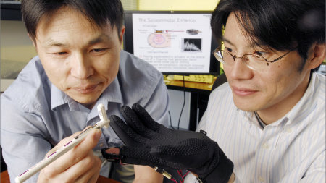
Can technology overcome these?
Does a bat ‘know’ things that we can’t know about?

Slide 6
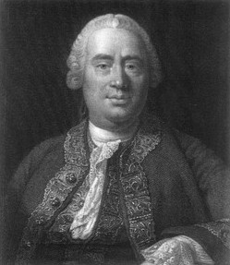
Not entirely...
David Hume (1737)
Can we perceive causality in action?
A pool ball hits another one. The second ball moves.
Does anyone actually see the transfer of force from the cue to the ball? No.

Slide 8
Scepticism vs realism
Do we accept data from the senses?
How and when should we examine our sensory perceptions to check their content?
Definitely enough cause for caution with regard to sensory data...

Slide 9
Other problems... Reliability and validity
Reliability – are our perceptions consistent?
Validity – do our perceptions represent the world as it truly is?

Slide 10
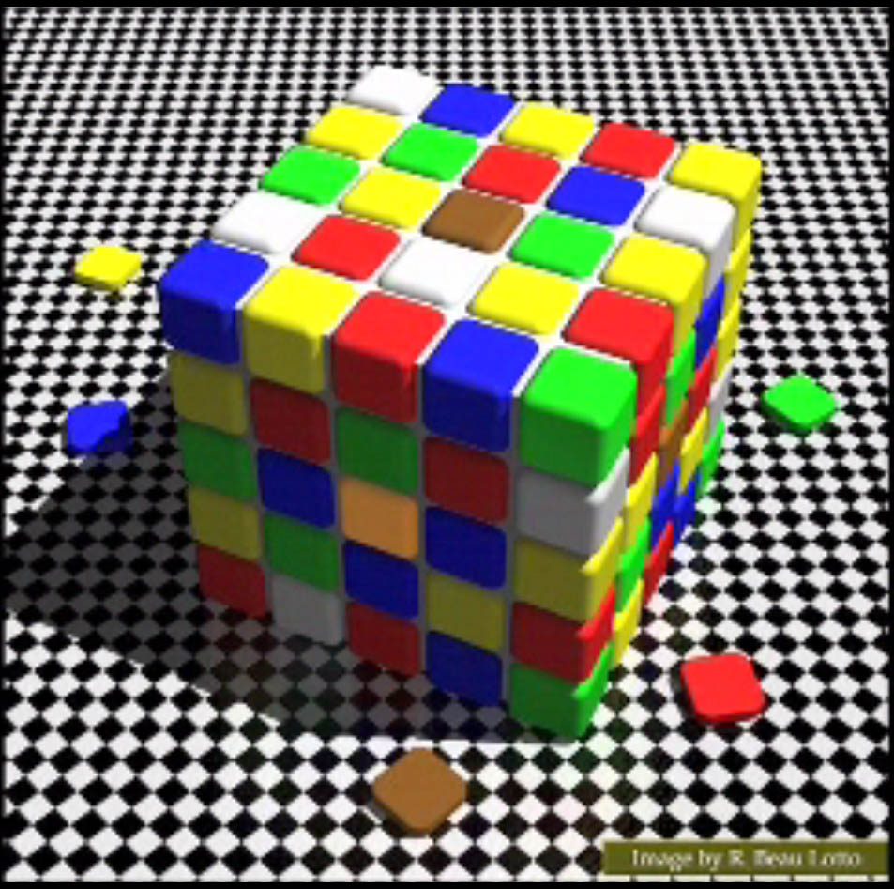
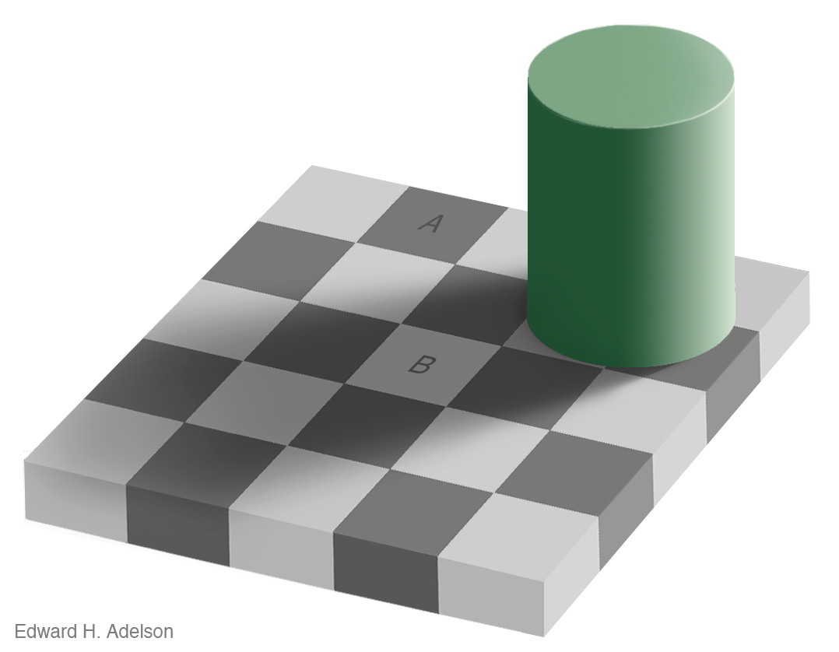
Reliability...

Slide 11
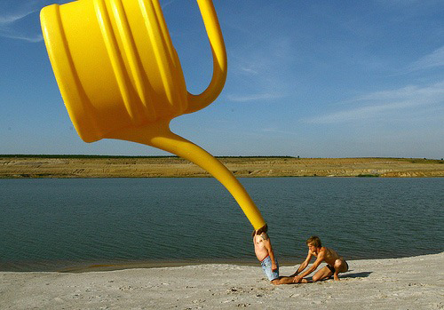
Validity of perceptions
To what extent do our perceptions represent the world as it ‘really’ is?

Slide 12
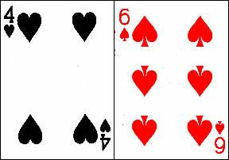
Validity of perceptions
Is all perception ‘theory-laden’...
Tell me what you see...

Slide 13
How is your own perception theory laden?
What beliefs do you have which may bias the way that you perceive the world?
Do knowers have a moral duty to examine their own perceptual filters?

Slide 14
Illusions question both the reliability and validity of perceptions
Where perceived objects differ from objective reality.
http://www.youtube.com/watch?v=jbw_WygD2rc

Slide 15
It’s not just visual perception either!
Vision + Touch...
https://www.youtube.com/watch?v=sxwn1w7MJvk
Vision + hearing... http://www.youtube.com/watch?v=G-lN8vWm3m0

Slide 17
Do we always need sensory perception?
Sometimes our behaviour can be influenced without our perceptual awareness!
E.g. Study subliminal or unconscious influences.
http://www.youtube.com/watch?v=m2xDh2siW_g&feature=related
http://www.youtube.com/watch?v=2Kur8p4yCao&feature=pyv&ad=8033076941&kw=subliminal

Slide 18
An example - Priming
# # # # - mask 500 msec
word 1 - prime 20 msec (typically)
WORD 2 - target 50 msec (typically)
# # # # - mask 500 msec

Slide 19
Priming (slowed down)
Point
# # # #
POINT

Slide 20
(i) (ii)
##### #####
point gravy
POINT POINT
##### #####
P(report of POINT) better in (i) than (ii) - initial presentation of ‘point’ makes it easier to see POINT.
Unconscious processes have influenced our performance.

Slide 21
Disorders of consciousness – performance without awareness!
What can we learn from studying cases where aspects of consciousness have been lost?
Is there still a distinction between performance and awareness?

Slide 22
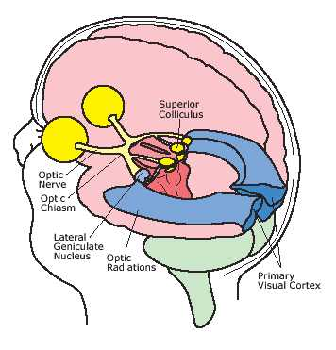
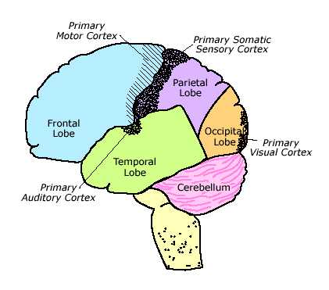
Blindsight

Slide 23
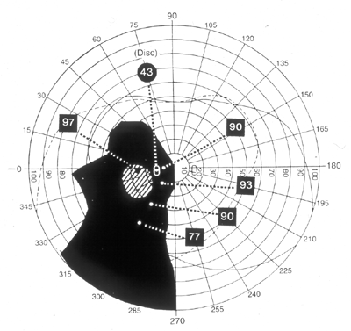
Blindsight

Slide 24
2-AFC
1.
2.
Visual field
Scotoma
Did you see the object? (Y/N)
Was the object in the first or second interval?

Slide 25
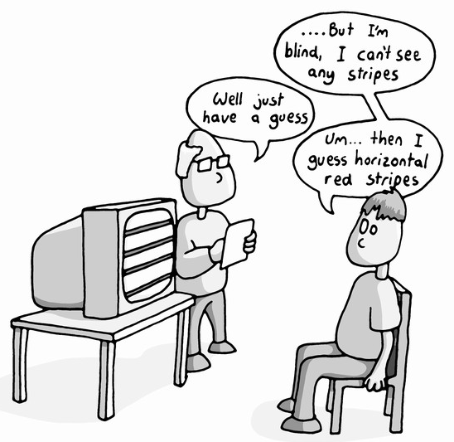

Slide 26
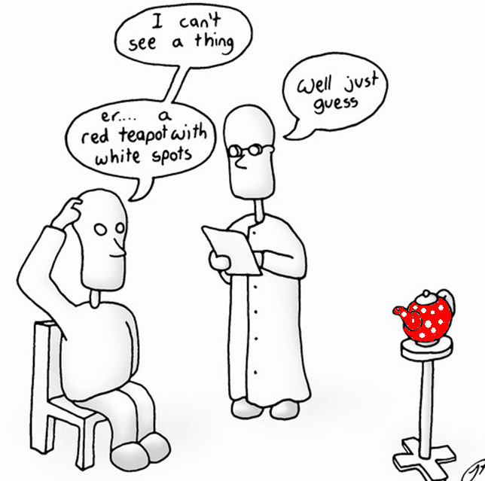

Slide 27
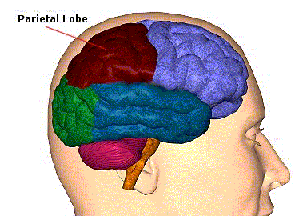
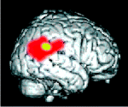
Unilateral neglect

Slide 28
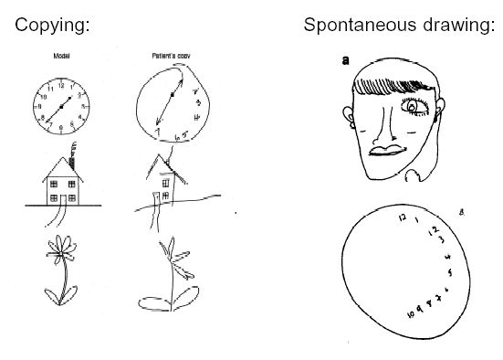
Unilateral neglect

Slide 29
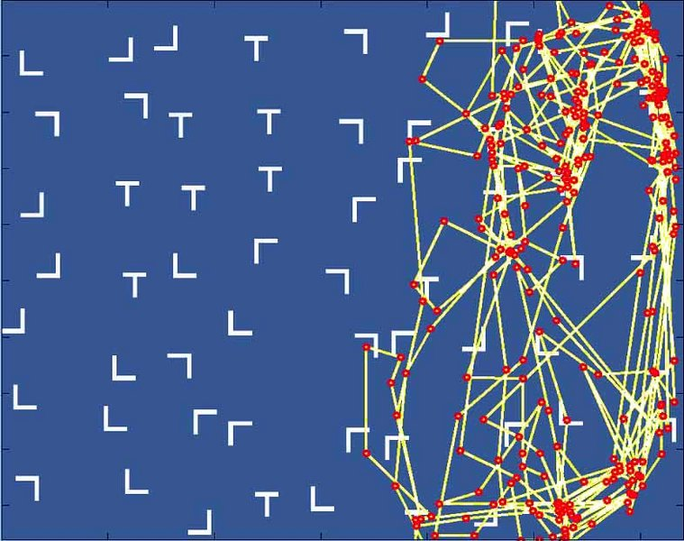

Slide 30
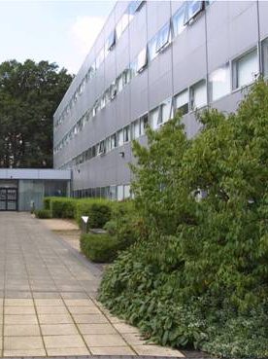
Halligan and Marshall (1993) – Where would you rather live?
1.
2.

Slide 31
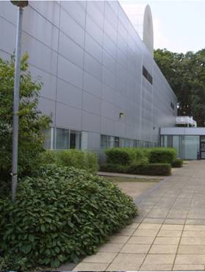
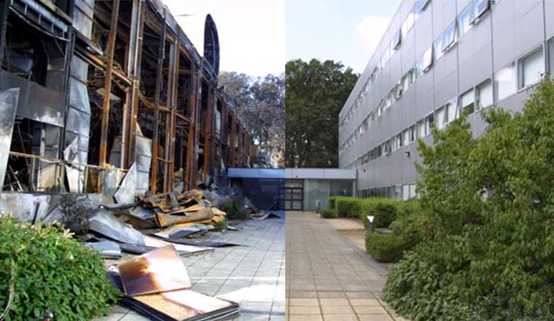
Halligan and Marshall (1993) – Where would you rather live?
1.
2.

Slide 32
Kanizsa figures
Notes:
Vuilleumier and Landis (1998)

Slide 33
But is this all enough to undermine our faith in sensory perception entirely?
Some evidence that an explanation is not perfect does not make it ‘wrong’...

Slide 34
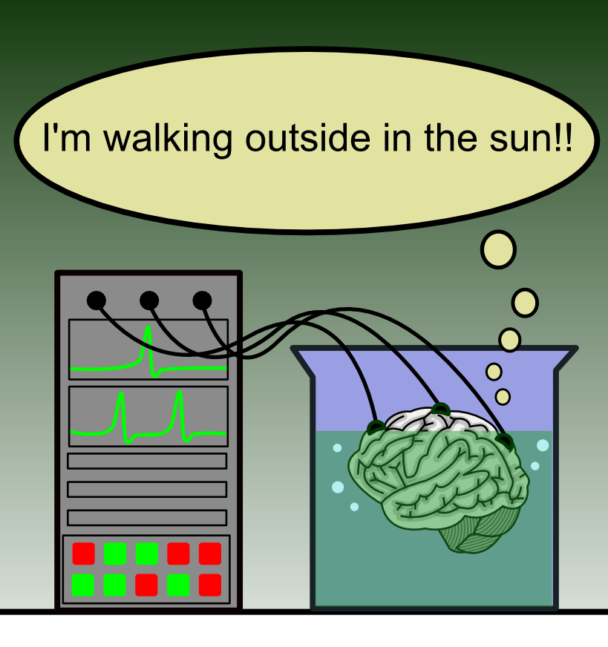
When (and how) can we trust our perceptions?
How do we know we’re not in the matrix?
Very complex philosophical arguments... It’s a difficult one to refute!

Slide 35
A ‘web’ of shared agreement

Slide 36
Wittgenstein’s Private Language argument
The idea of language as a personal ‘private’ construct is ridiculous.
In order for us to communicate with each other, there must be a substantial amount of shared agreement.

Slide 37
Our perceptions would be meaningless unless there was some shared agreement on what they were. The vast majority of the time, this shared agreement is there, and accurately represents the world.

Slide 38
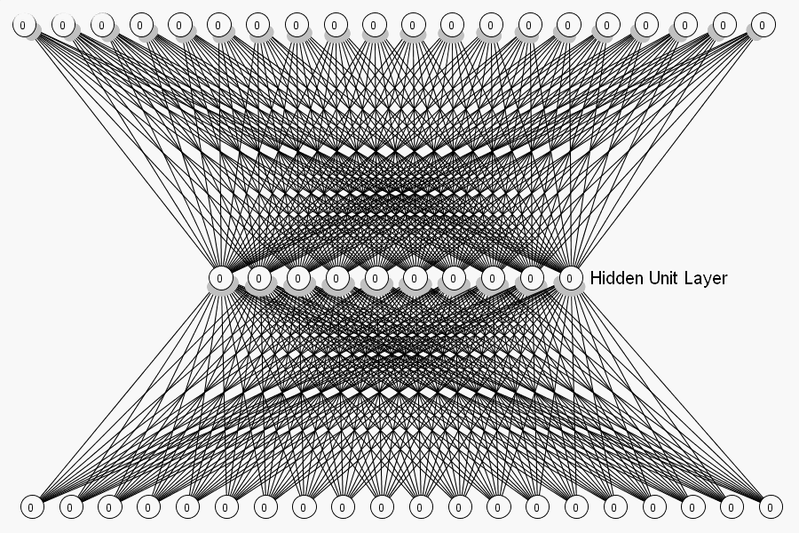

Slide 39
Links...
To language... Sapir-Whorf hypothesis
What is the role of culture and language in the perceptual process?
If you have different language for things, does that mean you see the world differently?

Slide 40
Would this change the way you saw the world?
Chinese – no need to to specify the exact time of an action, as the same verb form can be used for past, present or future actions.
Ancient Greek – no word for blue
Guugu Yimithirr – cardinal directions, rather than egocentric

Slide 41
Links – to AoKs
Do perceptions have different roles in the arts and sciences?
Is it more important in some AoKs than others?

Slide 42
In summary
We surely MUST find a way to trust our sense perceptions...?
Difficult thing to do, but that is your challenge.

Slide 43
Thank you!

Slide 44
Extra...
Perceptions can help us to understand concepts in a new or deeper way...
http://www.toktalk.net/2010/01/24/linking-arts-math-perception-and-emotions/#more-1602

