Slide 1
Ways of knowing: Perception
‘The greatest calamity that can befall people is not that they should be born blind, but rather that they should have eyes and yet fail to see.’
` Helen Keller, 1880-1968

Slide 2
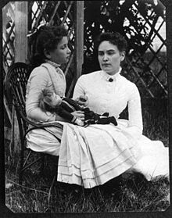
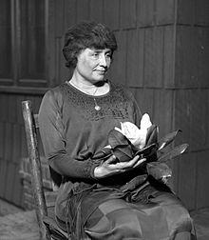
Helen Adams Keller (June 27, 1880 – June 1, 1968) was an American author, political activist and lecturer. She was the first deaf blind person to earn a Bachelor of Arts degree.[The story of how Keller's teacher, Anne Sullivan broke through the isolation imposed by a near complete lack of language, allowing the girl to blossom as she learned to communicate, has become widely known through the dramatic depictions of the play and film The Miracle Worker.

Slide 3
Sense perception through sight, sound, touch, taste and smell allows us to communicate with the outside world.
Keller, who was both deaf and blind, was initially completely isolated from the world. If you, for some reason, had to sacrifice one of your senses, which one would it be?

Slide 4
Anne Sullivan, one of the most inspirational teachers (and Ms Gulinck’s role model), helped Keller made sense of the world by relying on senses other than sight and sound.
Yet, most of us rely heavily on sight to make sense of the world. Many figures of speech and metaphorical expressions evolve around the sense if sight (eg ‘I see what you mean’) or, to a lesser extent, hearing (‘I hear you’). No language which I am aware of uses the expression ‘I smell what you mean’, but you may prove me wrong!

Slide 5
Introductory activities: focus on the less dominant senses
Deaf orchestra
http://www.guardian.co.uk/society/2009/jun/24/deaf-youth-orchestra
Make a list of sounds, smells and tastes which remind you of your childhood. Are they stronger triggers of the subconscious than sight?
Pheromone dating parties
http://www.huffingtonpost.com/2012/06/23/pheromone-parties_n_1621175.html
http://www.youtube.com/watch?v=qLziFMF4DHA
The boy who sees without eyes

Slide 6
Keller’s achievements were truly inspirational. She demonstrated that one can make sense of the world without relying on the dominating senses. She also illustrated the limitations of empiricism.
Empiricism: school of philosophy which claims that ALL knowledge derives from perceptual experience
What are the advantages and limitations of perception as a way of knowing?

Slide 7
Common sense realism: the position that perception is passive and relatively straightforward. The notion that perception gives us an accurate picture of reality.
Do you agree with the notion of common-sense realism?
Is perception and active or passive process?

Slide 8
Perception is a complex process. Our experience of the world is affected by what is out there, but also by the structure of our sense organs and our minds.
PERCEPTION:
SENSATION
INTERPRETATION

Slide 9
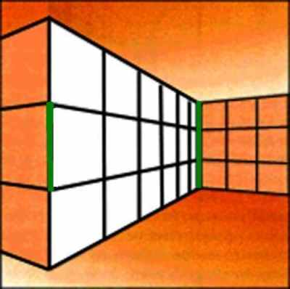
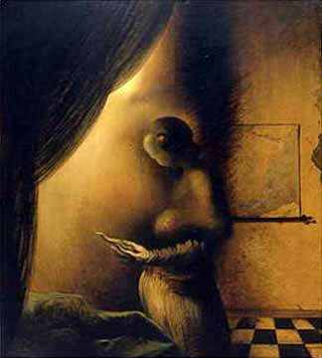
PERCEPTUAL ILLUSIONS:
CONTEXT
FIGURE-GROUND

Slide 10
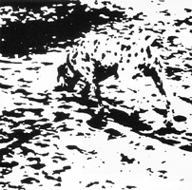
VISUAL GROUPING
EXPECTATIONS
PARIS
IN THE
THE SPRING
Cool visual illusions
http://brainden.com/video-illusions.htm

Slide 11
The role of the UNCONSCIOUS
Spectacle experiment
(see core text)
Visual agnosia
(see reading core text)

Slide 12
The selectivity of perception
Conscious mind treats certain sense perceptions as backgrounds and others as important (foreground)
Subjective factors (such as mood and interest) affect the way your perceive the world through sense perceptions.

Slide 13
How would a tree be perceived by a biologist, a logger, an environmentalists, a native American?
To which extent do you think that the culture you come from affects the way in which you see the world?
In which emotional state do we see the world with the greatest clarity and objectivity? Can you find examples of occasions in which your emotional state has affected your sense perception? (focus on ALL senses)

Slide 14
Seeing is believing?
Or believing is seeing?
Have you ever been so in love that you saw someone as more handsome/pretty than this person was?
What are the possible problems with eye-witness testimonies? What are the legal implications?
How real are you childhood memories? How much is fact and how much reconstruction?
Extension activity: for the psychology students: research real versus perceived trauma.

Slide 15
DISTINGUISHING APPEARANCE FROM REALITY
Problem of misinterpretation of perception
Problem of misremembering
Problem of failure to perceive
It is useful to confirm one sense perception with the evidence of a second sense (eg bent pencil). Secondly, you should check whether your sense perception coherently fits in with your world view (eg Charles Bonnet hallucinations –Ted talkl). Thirdly, it is useful to confirm your perception through the independent testimony of other people.

Slide 16
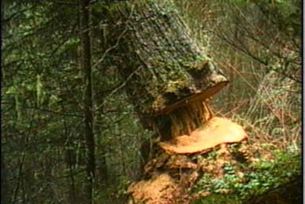
Ultimate reality
To which extent are we limited by our sense perception? To which extent is human perception limited?
How do you KNOW that the light goes out when you close the fridge door?
The tickle is not in the feather. (Galileo)
If a tree falls in a forest and there is no one (or no animal) there to hear it, does it make a sound?

Slide 17
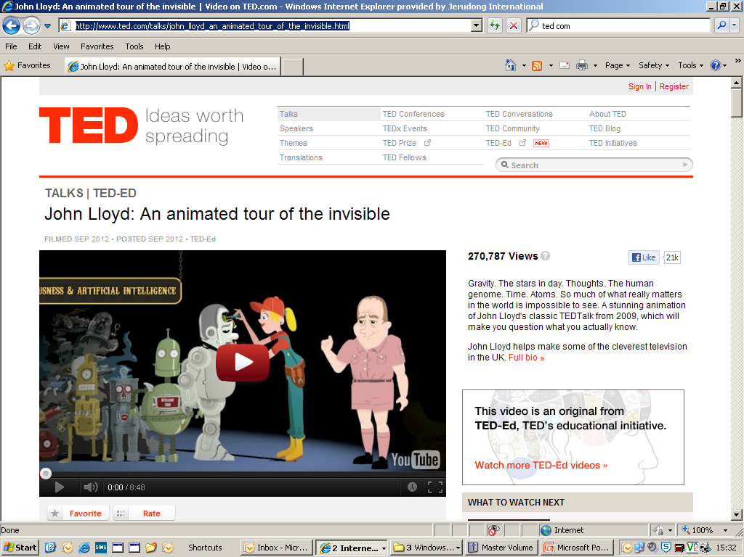
What is really out there?
http://www.ted.com/talks/john_lloyd_an_animated_tour_of_the_invisible.html

Slide 18
Theories of reality
COMMON SENSE REALISM: we perceive the world mirrored as it is. What you see is what is there.
SCIENTIFIC REALISM: the world exists as an independent reality, very different from the way we perceive it.
PHENOMENALISM: a radical form of empiricism: matter is a permanent possibility of sensation. To be is to be perceived.
Which theory do you prefer? What are the limitations of each theory of reality?

