Slide 1
Lost in translation
What is lost in translation from one language to another? Why?
If only translating was this simple...

Slide 2
The trouble with translations
Examples of common translation issues:
But even simple sentences can be tricky to translate.
Why is translating so difficult?
Translation websites
Translating poetry
Metaphors (big head: English vs Italian)
Idioms (‘to die’ in different languages)
Words and nuances that don’t exist in certain languages (weten/kennen– ‘to know’)

Slide 3
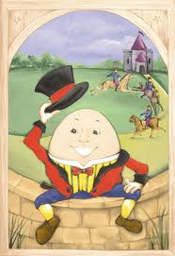

Slide 4
The example of ‘Humpty Dumpty’ (Lera Boroditsky)
Humpty Dumpty …
sat on a wall
In English the verb is marked for tense (sat not sit), in Indonesian not.
In Russian: verb marked for tense, gender (different verb for Mrs Dumpty), and also for the fact if the action (sitting) is completed or not
In Turkish: you include in the verb how you have gathered the information.
The translation of the simple sentence (‘Humpty Dumpty sat on the wall’) becomes more complicated than expected.

Slide 5
The ‘Humpty Dumpty example’
different languages have different grammatical rules
the linguistic focus of different languages varies.
Why?
(is Chomsky’s idea of a ‘universal grammar’ tenable?)
Does the language we speak reflect the way we think?
Does the language we speak shape the way we think and know?
And if we think differently, is it possible to translate?

Slide 6
1) Does the language we speak reflect the way we think?

Slide 7
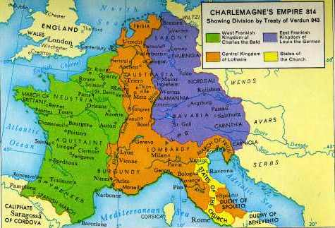
‘To have a second language is to have a second soul’
Charlemagne
Is it possible to translate A to B if we A and B represent different ‘souls’, ‘values’, ‘thoughts’, concepts etc?

Slide 8
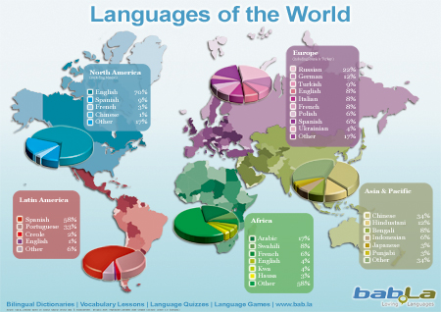
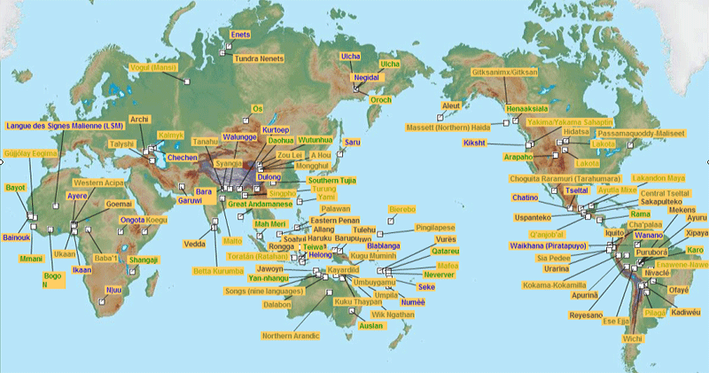
Around 7000 languages in the world: around 7000 different ‘souls”?
Endangered languages
What happens if a language dies?
Does a culture/soul die?

Slide 9
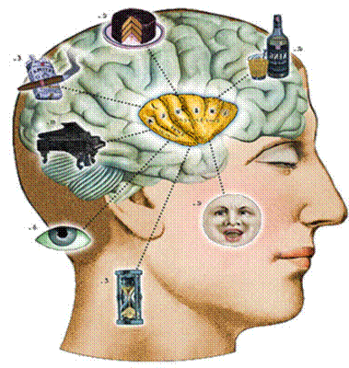
How can we know that people think differently just because they talk differently?
Vs Sapir-Whorf
Contentious issue in field of linguistics
Anthropological and cognitive linguistics
Research in field of cognitive science
New research suggests that people who speak different languages do indeed think differently. These speakers have, for example, different concepts for space, time and causality. Their perception of the concepts can be measured objectively.

Slide 10
Pormpuraaw (remote Aboriginal Community in Australia)
Absolute cardinal directions.
Hello: Where are you going?
1/3 world languages uses absolute directions for space.
Necessity to have excellent sense of orientation.
Space-time: research pictures temporal order. (East to West)

Slide 11
Mandarin
Future can be below
Past can be above
Sense of space/time is influenced by the language you speak.
Will this have an influence on the metaphors you use?
Hebrew: right to left, Aymara (South America: future behind and past in the front)

Slide 12
Japanese
Speakers of Japanese (and Spanish) prefer to express causality without referring to agents.
Memory tests after video footage (accidents): different conclusions.
Subjects of languages who express agents would give harsher punishment to agent.

Slide 13
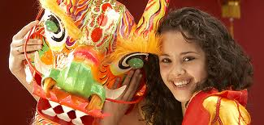
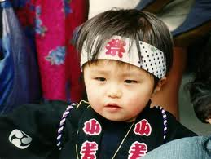
People who speak differently think differently.
Examples of Boroditsky’s cognitive
scientific research
Space (Pormpuraaw)
Time (Mandarin)
Causality (English versus Spanish and Japanese)
People who speak different languages do think differently. This has implications for their way of life and the societies they build. This, in its turn, implies that language shapes their thought.

Slide 14
2) Does the language we speak shape the way we think and know?

Slide 15
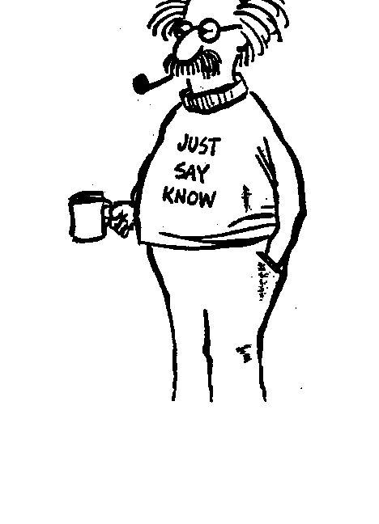
TOK Questions
To what degree might different languages shape in their speakers different concepts of themselves and the world? What are the implications of such differences for knowledge?

Slide 16
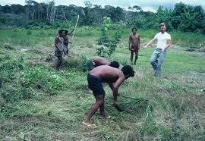
Language can also shape thought.
Russian: extra blue
distinguish blue better
Piraha tribe (Brazil) : can’t remember exact numbers
Causality English→ justice system
What do you think? Can you find more examples in your own language?
Gender bias→ sexism?
Racist expressions→ racism?

Slide 17
TOK style question from article.
Does the language we speak shape our cultural values, or does the influence go the other way, or both?

Slide 18
TOK Questions
What is the role of language in sustaining relationships of authority?
What is the role of language in creating and reinforcing social distinctions, such as class, ethnicity and gender?

Slide 19
Learning another language
Change the way you think?
Are bilingual people more knowledgeable?
TOK Questions
If people speak more than one language, is what they know different in each language?
Does each language provide a different framework for reality?

Slide 20
When learning a new language we learn about human nature
Learning a new language is acquiring a new way of knowing/perceiving the world
My language influences the way I think.
Translations are too complex to be ever fully accurate. Some things get ‘lost in translation’

Slide 21
To go a little further… consider
a) How language can deliberately change thought
b) What happens if we take away language
c) Whether language is uniquely a human gift, given the way language reflects and shapes experience.

Slide 22
a) Can language change thought?
Language and (psycho)therapy
Language and propaganda
Language and religion
Language and manipulation
Language and indoctrination
‘Newspeak’
Language and ‘sales’
‘I can do it’ versus ‘I will fail’

Slide 23
b) What if we take away language?
Can we still think the same way?
Can we experience the world in the same way?
Can we express our thoughts fully in another language if the word we need does not exist?
Are we still as intelligent? Human?

Slide 24
c) Is language a ‘uniquely human gift’?
Will animals ever be able to use language as we know it?

Slide 25
Case-study: the Bonobo apes
‘Ted Talk’ by Susan Savage-Rumbaugh http://www.ted.com/talks/susan_savage_rumbaugh_on_apes_that_write.html
5.30 min-8mins: understanding language, learning new things
10.45-12.30 (14 mins) mins: writing
Implications: if these apes can acquire new language, write and learn concepts, will this change their thought? Will they become much more intelligent/sophisticated given language training?
Planet of the apes scenario?
What makes us ‘human’ compared to these Apes?

Slide 26
Conclusion
Things can get ‘lost in translation’
Literal translations are not always possible, nor desirable
Learning a new language is ‘gaining a new soul’.
The language we speak influences and reflects the way we know
Our experiences shape our language and our language can shape our thoughts.

