Slide 1
Truth and wisdom
“Keep the company of those who seek the truth, and run away from those who have found it”.
Václav Havel

Slide 2
Who’s this dude? Where are his clothes? Why the chains? What’s his bird doing?

Slide 3
What’s happening now?

Slide 4
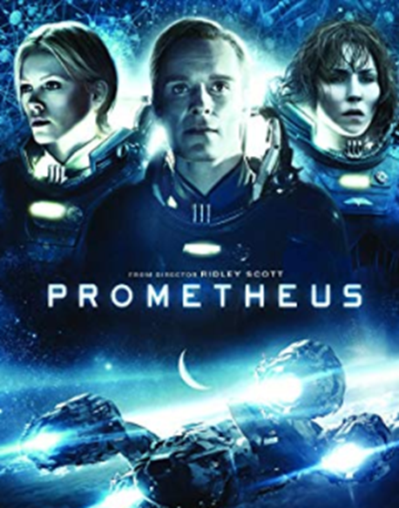
What did he do wrong?

Slide 5
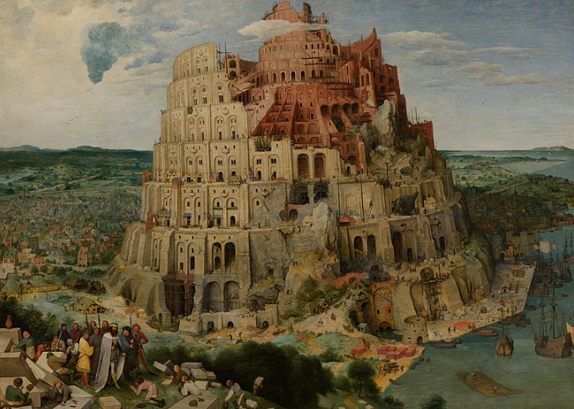
Do you know other myths like this? What do they warn us against?
Do you know some people in the real world who have been punished for getting closer to the truth?

Slide 6
Some quotes on truth and wisdom: Discuss in pairs and feed back to class
Knowledge is an unending adventure at the edge of uncertainty.
Jacob Bronowski
When we believe with every fibre of our being that we have reached the truth, we must know that we believe, and not believe that we know.
Jules Lequier
There are many kinds of eyes… and consequently there are many kinds of ‘truths’, and consequently there is no truth.
Friedrich Nietzsche
We may be learned with another man’s learning, but we can only be wise with wisdom of our own.
Michel de Montaigne
The greatest obstacle to progress is not the absence of knowledge, but the illusion of knowledge.
Daniel Boorstin
Men stumble over the truth from time to time, but most pick themselves up and hurry off as if nothing had happened.
Winston Churchill
Truth is what stands the test of time.
Albert Einstein

Slide 7
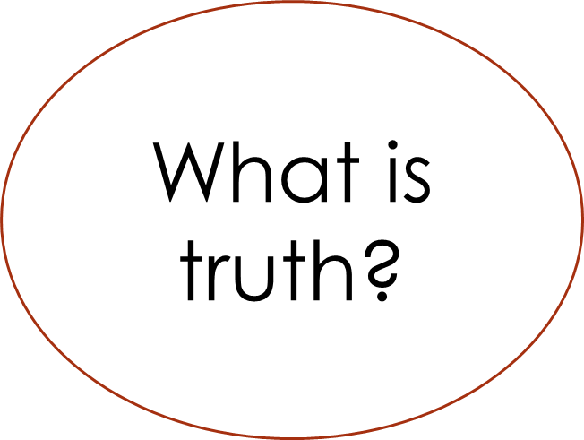
Brainstorm on whiteboard

Slide 8
Is this question more important than ever now that we are so unsure of what is fact/fiction, news/”fake news”?
Is this question still relevant in a post-truth age?
Truth = what corresponds to a fact? What is a fact?
Truth=what fits in our overall set of beliefs?
What is truth?
The more perspectives we have on something, the closer we get to the truth about it, right?
Truth=what is useful or works in practice?
But should we give equal weight to each and every perspective? What if they are inconsistent?
Dogmatism can be dangerous, but so can relativism.
There will always be a gap between our picture of reality (map) and reality itself. Does this mean we should not bother looking for the truth?

Slide 9
1) Truth= what corresponds to a fact?
Correspondence theory
“The grass is green” is true if, and only if:
*grass is green
What’s the point in that?
A statement is true when it corresponds to something in reality, not just because an authority says something.
The correspondence theory was a powerful impetus behind the scientific revolution.

Slide 10
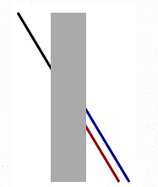
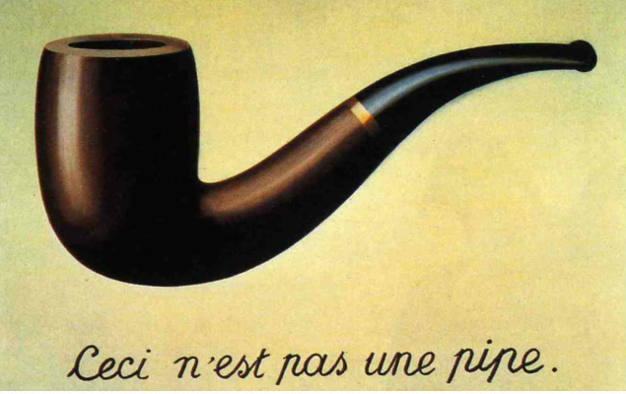
But….
Correspondence is never perfect
What is a fact?
Problems with sense perception to determine truth
How, if at all, do the following propositions correspond to facts?
All metals expand when heated.
Elephants do not have wings.
Random torture is wrong.
The Mona Lisa is a beautiful painting.

Slide 11
2) Truth=a proposition that fits in with our overall set of beliefs. Eg. Someone claims to have seen a Shark in Lake Geneva, does not fit in with current beliefs that Sharks live in salt water.
Coherence theory
Sounds good, no?
BUT
Coherence is not sufficient for truth.

Slide 12
Coherence cannot exclude crazy beliefs!
In groups, devise absurd but coherent explanations for each of the following:
The movement of the sun across the sky
The price of stocks and shares
Global warming
The variety of species on the planet

Slide 13
3) Truth=what is useful/works in practice?
Pragmatic theory
Cool, finally something down to earth!
BUT
A statement can be useful but not true
Or
True but not useful

Slide 14
Classify the statements in groups. Are they… -true and useful -true but not useful -useful but not true -not useful and not true?
See next slide. Cut out one set per pair/group.

Slide 15
Eating carrots makes you see in the dark. | Santa Claus is watching you to see if you are good or bad.
If a French noun ends with the suffix –ion, it is feminine. | I’m a good looing genius.
I am a very sociable person with a good sense of humour. | Human beings have free will.
John Smith has exactly 113,574 hairs on his head. | If you take Cocaine your teeth will fall out.
After we are dead we will soon be forgotten. | We are fighting a just war and we have God on our side.
You should never talk to strangers. | “Fake news!”. (Trump, 2018)
1+2=3 | Anyone can be successful if they work hard enough.

Slide 16
What does this say about the pragmatic theory of truth? Do you think some areas of knowledge are more pragmatic in nature than others?

Slide 17
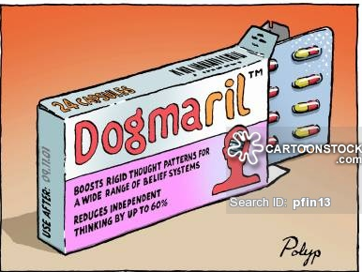
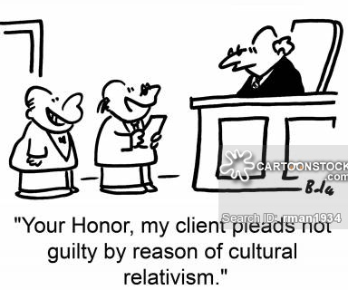
No theory of truth is perfect and there are issues with both dogma and relativism.

Slide 18
Brilliant. So what am I to make of all this? Please put me out of my misery!!
Maybe we can never reach the truth, but this does not need that we should give up trying to reach it. If we include a range of different (but not inconsistent) perspectives, we can get closer to the truth about something. This can be called the “cubist theory” of the truth. It is different from relativism in the sense that the different perspectives aim to reach towards the same underlying truth (a bit like looking at the Mount Everest from different angles). The error of dogmatism is to mistake a half-truth for the whole truth, and the error of relativism is to think that, since the truth varies with your perspective, there is no truth at all. The cubist theory of truth likes to embrace perspectives in order to get close to the truth.
See Lagemaat textbook chapter Truth & Wisdom

Slide 19
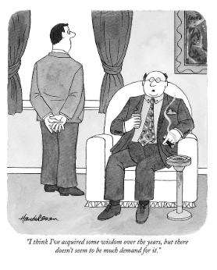
Where is the wisdom we have lost in knowledge?

