Slide 1
Indigenous Knowledge
A cross-curricular lesson on a new AOK

Slide 2
Aims of the lesson:
Understand the notions of indigenous knowledge and culture.
See the relevance of studying Indigenous Knowledge in IB.
Develop links between areas of knowledge and ways of knowing in the context of indigenous knowledge.
Revise what has been covered throughout the year by showing examples of how previous learning can be applied to Indigenous Knowledge as an Area of Knowledge.
Do independent research into real life situations which can be developed into knowledge questions (preparation for presentations).

Slide 3
Why do we study indigenous knowledge?
Recognising perspectives.
Be caring and considerate.
Internationalism.
Implications of ‘one language’/‘one culture’.
Understanding links between AOKs (holistic approach to knowledge).

Slide 4
What does it mean to be indigenous?
UNESCO definition 2004:
“Indigenous communities, peoples and nations are those which, having a historical continuity with pre-invasion and pre-colonial societies that developed on their territories, consider themselves distinct from other sectors of the societies now prevailing on those territories, or parts of them. They form at present non-dominant sectors of society and are determined to preserve, develop and transmit to future generations their ancestral territories, and their ethnic identity as the basis of their continued existence as peoples, in accordance with their own cultural patterns, social institutions and legal system.”
What are the implications for these peoples of living on the edges of society?
Why bother preserving ethnic identity?

Slide 5
Wade Davis at TED
‘The world in which we live does not exist in some absolute sense, but is just one model of reality, the consequence of one particular set of adaptive choices that our lineage made, albeit successfully, many generations ago.’
Notes:
Wade Davis: we all share the same adaptive imperatives. We're all born. We all bring our children into the world. We go through initiation rites. We have to deal with the inexorable separation of death, so it shouldn't surprise us that we all sing, we all dance, we all have art. [...] But what's interesting is the unique cadence of the song, the rhythm of the dance in every culture. [...] All of these peoples teach us that there are other ways of being, other ways of thinking, other ways of orienting yourself in the Earth. [...] When each of you in this room were born, there were 6,000 languages spoken on the planet. Now, a language is not just a body of vocabulary or a set of grammatical rules.A language is a flash of the human spirit. It's a vehicle through which the soul of each particular culture comes into the material world. Every language is an old-growth forest of the mind, a watershed, a thought, an ecosystem of spiritual possibilities. And of those 6,000 languages, as we sit here today in Monterey, fully half are no longer being whispered into the ears of children. They're no longer being taught to babies, which means, effectively, unless something changes, they're already dead.What could be more lonely than to be enveloped in silence, to be the last of your people to speak your language, to have no way to pass on the wisdom of the ancestors or anticipate the promise of the children? And yet, that dreadful fate is indeed the plight of somebody somewhere on Earth roughly every two weeks,because every two weeks, some elder dies and carries with him into the grave the last syllables of an ancient tongue.[...] And I know there's some of you who say, "Well, wouldn't it be better, wouldn't the world be a better place if we all just spoke one language?" And I say, "Great, let's make that language Yoruba. Let's make it Cantonese. Let's make it Kogi." And you'll suddenly discover what it would be like to be unable to speak your own language.’ (TED)

Slide 6
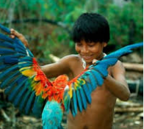
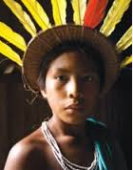
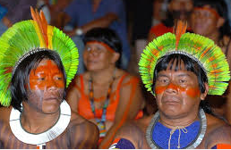
Barasana (Northwest Amazon)
Notes:
Take, for example, this child of a Barasana in the Northwest Amazon, the people of the anaconda who believe that mythologically they came up the milk river from the east in the belly of sacred snakes. Now, this is a people who cognitively do not distinguish the color blue from the color green because the canopy of the heavens is equated to the canopy of the forest upon which the people depend. (Wade Davis, TED)

Slide 7
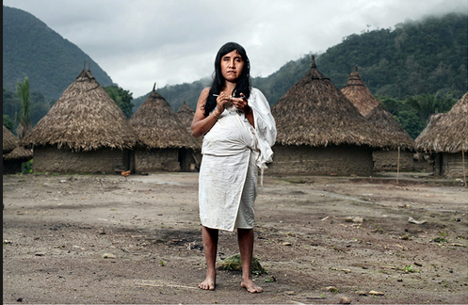
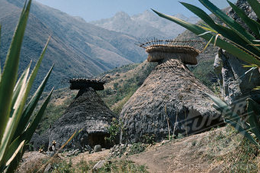
Kogi people (Sierra Nevada Northern Colombia)
Notes:
Kogi of the Sierra Nevada de Santa Marta in northern Colombia. Descendants of the ancient Tairona civilization which once carpeted the Caribbean coastal plain of Colombia, in the wake of the conquest, these people retreated into an isolated volcanic massif that soars above the Caribbean coastal plain. In a bloodstained continent, these people alone were never conquered by the Spanish. To this day, they remain ruled by a ritual priesthood but the training for the priesthood is rather extraordinary. The young acolytes are taken away from their families at the age of three and four, sequestered in a shadowy world of darkness in stone huts at the base of glaciers for 18 years: two nine-year periods deliberately chosen to mimic the nine months of gestation they spend in their natural mother's womb; now they are metaphorically in the womb of the great mother. And for this entire time, they are inculturated into the values of their society, values that maintain the proposition that their prayers and their prayers alone maintain the cosmic -- or we might say the ecological -- balance. And at the end of this amazing initiation, one day they're suddenly taken out and for the first time in their lives, at the age of 18, they see a sunrise.

Slide 8
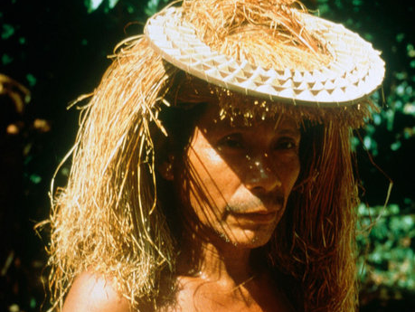
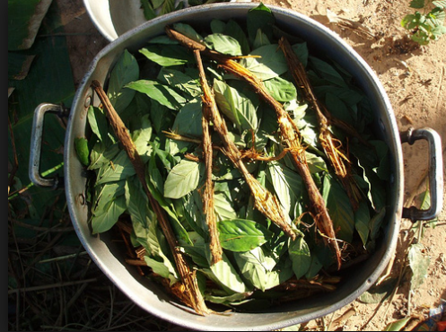
Ayahuasca: How do you know your plants?
Notes:
his is ayahuasca, which many of you have heard about, the most powerful psychoactive preparation of the shaman's repertoire. What makes ayahuasca fascinating is not the sheer pharmacological potential of this preparation, but the elaboration of it. It's made really of two different sources: on the one hand, this woody liana which has in it a series of beta-carbolines, harmine, harmaline, mildly hallucinogenic -- to take the vine alone is rather to have sort of blue hazy smoke drift across your consciousness -- but it's mixed with the leaves of a shrub in the coffee family called Psychotria viridis. This plant had in it some very powerful tryptamines, very close to brain serotonin, dimethyltryptamine, 5-methoxydimethyltryptamine. [...] the thing about tryptamines is they cannot be taken orally because they're denatured by an enzyme found naturally in the human gut called monoamine oxidase.They can only be taken orally if taken in conjunction with some other chemical that denatures the MAO. Now, the fascinating things are that the beta-carbolines found within that liana are MAO inhibitors of the precise sort necessary to potentiate the tryptamine. So you ask yourself a question. How, in a flora of 80,000 species of vascular plants, do these people find these two morphologically unrelated plants that when combined in this way, created a kind of biochemical version of the whole being greater than the sum of the parts? [...] Well, we use that great euphemism, "trial and error," which is exposed to be meaningless. But you ask the Indians, and they say, "The plants talk to us." [...] Well, what does that mean? This tribe, the Cofan, has 17 varieties of ayahuasca, all of which they distinguish a great distance in the forest, all of which are referable to our eye as one species. And then you ask them how they establish their taxonomy and they say, "I thought you knew something about plants. I mean, don't you know anything?" And I said, "No." Well, it turns out you take each of the 17 varieties in the night of a full moon, and it sings to you in a different key. Now, that's not going to get you a Ph.D. at Harvard, but it's a lot more interesting than counting stamens.

Slide 9
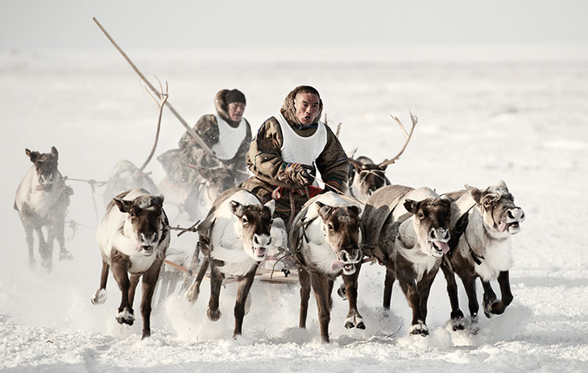
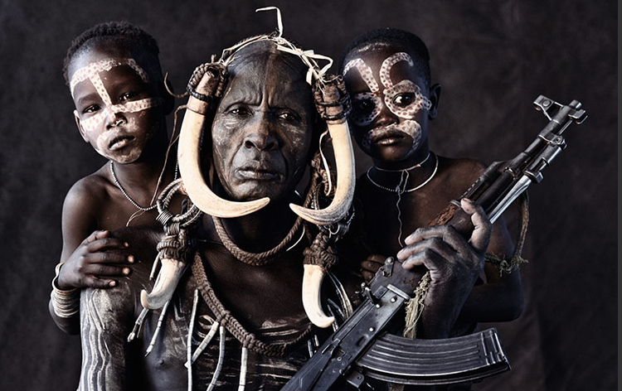
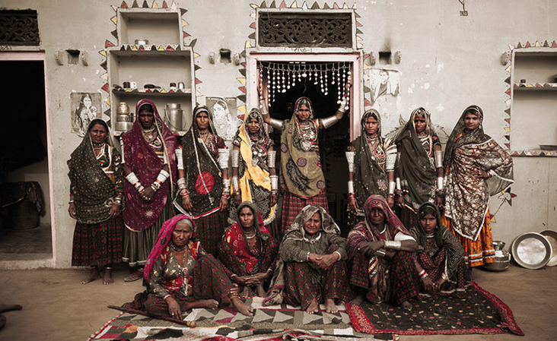
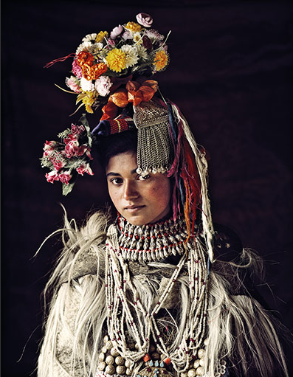
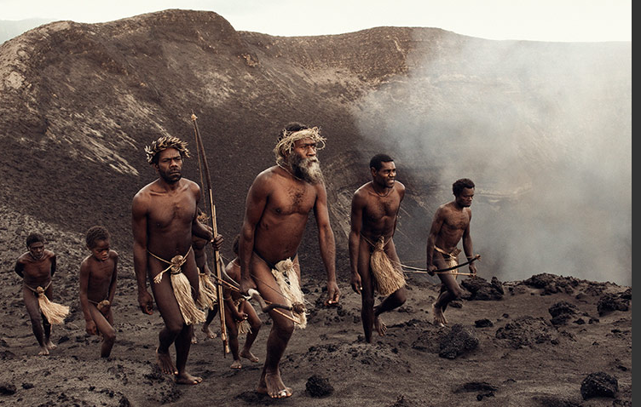
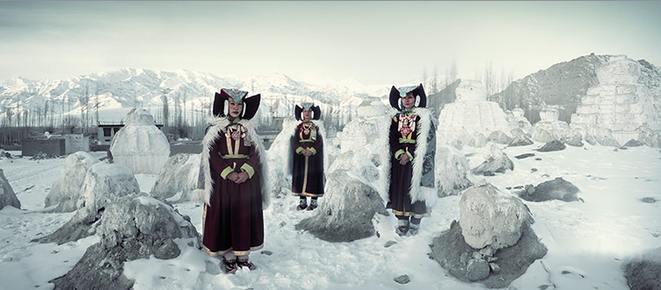
Disappearing lives (Jimmy Nelson)
Notes:
Nenets, Russia: The Nenets of the Siberian arctic are a nomadic tribe of reindeer herders. Migrating across the Yamal peninsula, where the Ob river and Ural mountains meet the Arctic coast, the Nenets have thrived for more than a millennium in one of the most inhospitable places on earth, with temperatures that dip to –50C in winter and soar to 35C in summer. On their annual migration of over 1,000 km, these people move huge herds of reindeer from summer pastures in the north to winter pastures just south of the Arctic Circle. Today, more than 10,000 nomads herd 300,000 domestic reindeer. Mursi, Ethiopia: The Mursi tribe lives in the lower Omo Valley, situated in Africa’s Great Rift Valley in south-west Ethiopia. The Mursi, who number about 4,000, are a nomadic tribe of herdsmen who, over the past few decades have encountered growing threats to their livelihood. Extreme drought has made it more and more difficult for many Mursi families to feed themselves by means of their traditional activities, such as cultivation and cattle herding. Furthermore, the establishment of national parks with fences and roads has seriously restricted the access of local tribes and threatened their natural resources.Rabari, India: For almost 1,000 years, the people of the Rabari tribe have roamed the deserts and plains of what is today western India. Now found largely in Gujarat and Rajasthan, it is believed that they migrated from the Iranian plateau more than a millennium ago. Their name means ‘outsider’ and traditionally they were camel herders, crossing desert areas that were off-limits to other tribal groups. Although only about one to two per cent still practises an entirely nomadic lifestyle, the main sources of Rabari income comes through livestock. Women usually wear long black headscarves (lobadi) and distinctive heavy brass earrings, and tattoo magical symbols on their necks, breasts and arms. Drokpa, India/Pakistan: Around 2,500 Drokpas live in three villages in the Dha-Hanu valley of Ladakh, which is situated in Jammu and Kashmir, a disputed territory between India and Pakistan. The Drokpas are completely different from the Tibeto-Burman inhabitants of most of Ladakh – tall and fair, with big, lightly coloured eyes, full lips and distinctive noses and eyebrows. Historians have identified the Drokpa people as the only authentic descendants of the Aryans left in India. For centuries, the Drokpas have been indulging in public kissing and wife-swapping without any inhibitions or consideration for marital relationships. Since the practice was banned by the authorities, the Drokpas now only conduct this passionate display in the absence of outsiders.Ni-Vanuatu, Vanuatu: The Ni-Vanuatu are the Melanesian people who make up the population of the Republic of Vanuatu. This chain of 83 islands in the south-west Pacific Ocean, formerly the New Hebrides, gained independence from Britain and France in 1980. Espiritu Santo is the largest island. Nowadays, all the inhabited islands have their own languages (over 100 distinct languages are spoken) and their own customs and traditions.Ladakhi, India: The people of Ladakh (meaning land of the passes) live in very high mountain valleys between the Himalaya and Karakoram ranges in the northern Indian state of Jammu and Kashmir. Well-to-do Ladakhi women have a striking and opulent appearance. Their gonchas are made of heavy Chinese silk and they wear impressive jewellery, with baroque pearls, turquoises, coral and amber bedecking their necks and ears. The gonchas of the less fortunate are made of coarse, home-spun, woollen cloth.

Slide 10
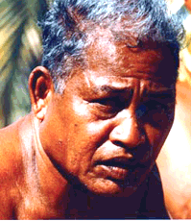
Culture specific knowledge
http://www.emlii.com/e977d5bf/Have-a-Last-Good-Look-At-Them-Before-They-Pass-Away
Notes:
A tribal person in New Guinea can still identify 70 species of birds by their songs; a shaman in the Amazon can identify hundreds of species of plants and which preparations will enhance their chemical potency in he human body; a traditional Polynesian navigator can detect an island miles beyond the horizon by a pattern in the waves and the behaviour of birds. This kind of knowledge seems almost supernatural to a modern person stumbling noisily through the forest.; but it’s not supernatural. It is human intelligence honed over millennia, through unimaginably vast numbers of individual observations, experiments, reflections, intuitions, refinements of art and experience and communication. (Carol Black.13 January 2012. Occupy your Brain. On Power, Knowledge, and the Re-Occupation of Common Sense.)

Slide 11
What does it mean to be indigenous?
How do we know?
Dominant paradigm
Western science
Scientific method
Evidence/explanation in physical world
Understanding how
Education at school/formal
Media
Written tradition
Part to whole
Hypothesis/ falsification
Skepticism
Indigenous/native knowledge
Education through life
Language (metaphor)
Nature/ecology
Oral history/stories (generally not documented)
Tradition and inherited wisdom
Holistic
Locally bound
Closely related to survival
Culture and context specific
Non-formal
Practical applications
Physical and metaphysical world
Or should we not think in opposite pairs?
Notes:
How does the scientific method influence your understanding of the world?
What are the implications of thinking in binary oppositions?

Slide 12
Non-formal, orally transmitted
language
songs
stories
dance
rituals
demonstrations
shared work
Remember the ‘lost in translation’ lesson?
What are the implications of the last speaker of a language dying?

Slide 13
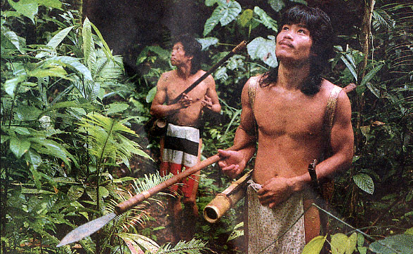
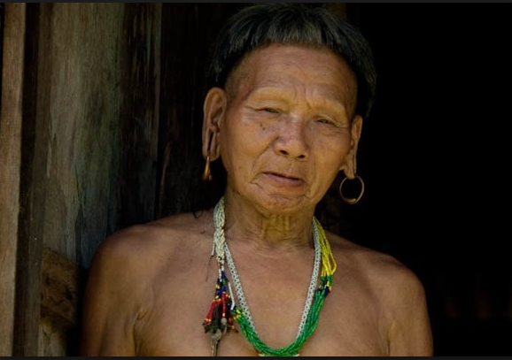
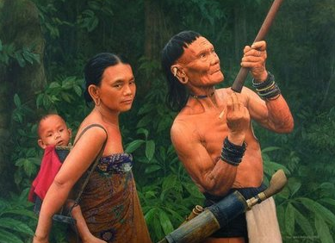
Case study: The Penan (Malaysia)
Real life situation: Copy of the Penan dictionary
(only 7 in existence)
Culture specific/Non-formal, orally transmitted/holistic/dynamic and adaptive, closely related to survival/importance of ecology and the natural environment/the metaphysical.
Real life situation: Copy of the Penan dictionary
(only 7 in existence)
Notes:
Examples from Rasyidah’s Extended Essay: talk about traditional knowledge, ecology, policy of taking no more than needed and the imposing of the Malay language rather than the Penan language. Talk about the Borneo project (see link website and earth day) regarding the preservation of the Penan ecology and lifestyle. Read the passage of the Penan man (their voice).

