Slide 1
Theory of Knowledge
What is it? And why do we study it?
‘The greatest obstacle to progress is not the absence of knowledge but the illusion of knowledge.’
Daniel Boorstin, 1914-2004

Slide 2
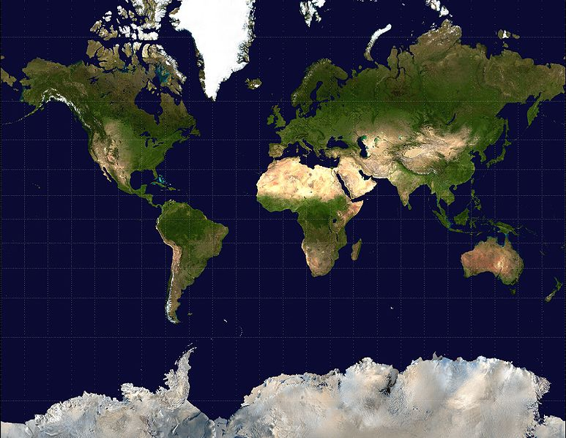
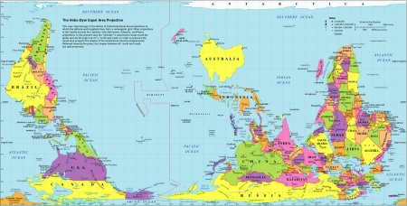
How do you view your world? Why?
How do we know what we know?
Ted Talk Derek Sivers

Slide 3
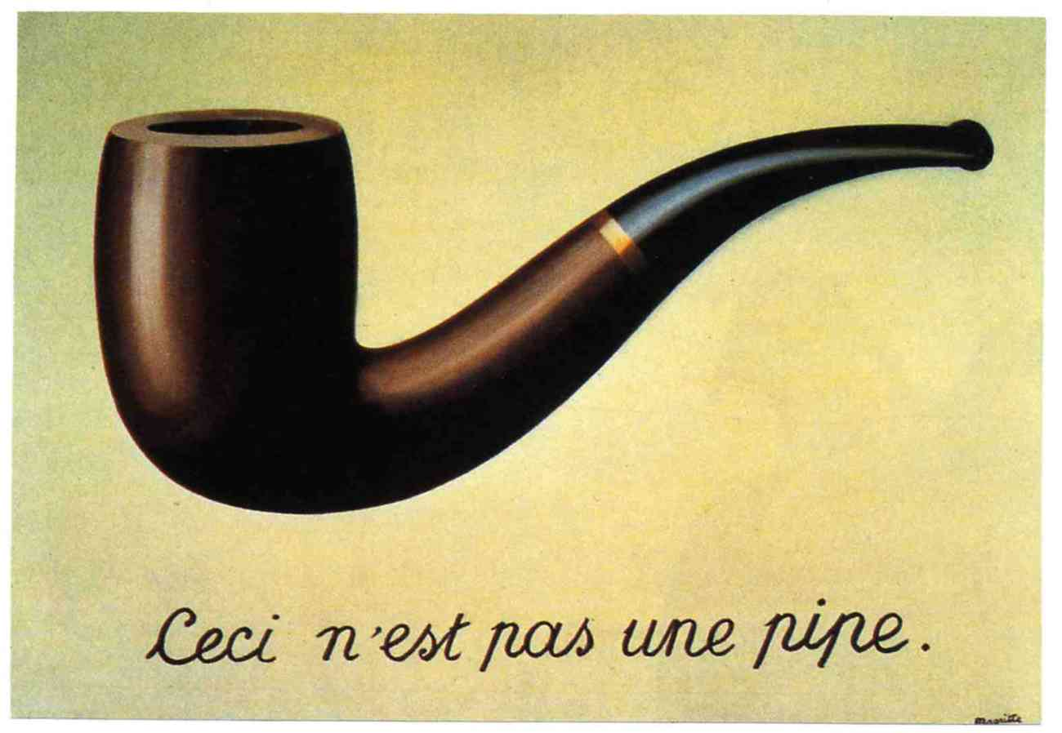
Representation is not reality

Slide 4
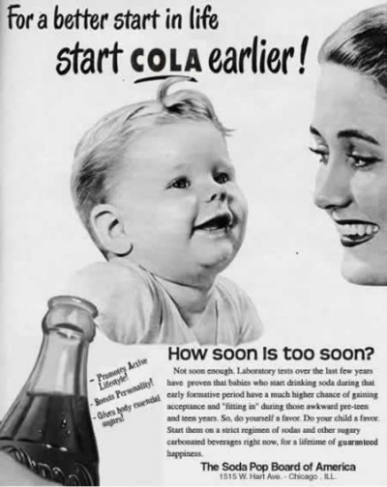
Why do we study Theory of Knowledge?
We are surrounded by Knowledge Claims in our daily lives.

Slide 5
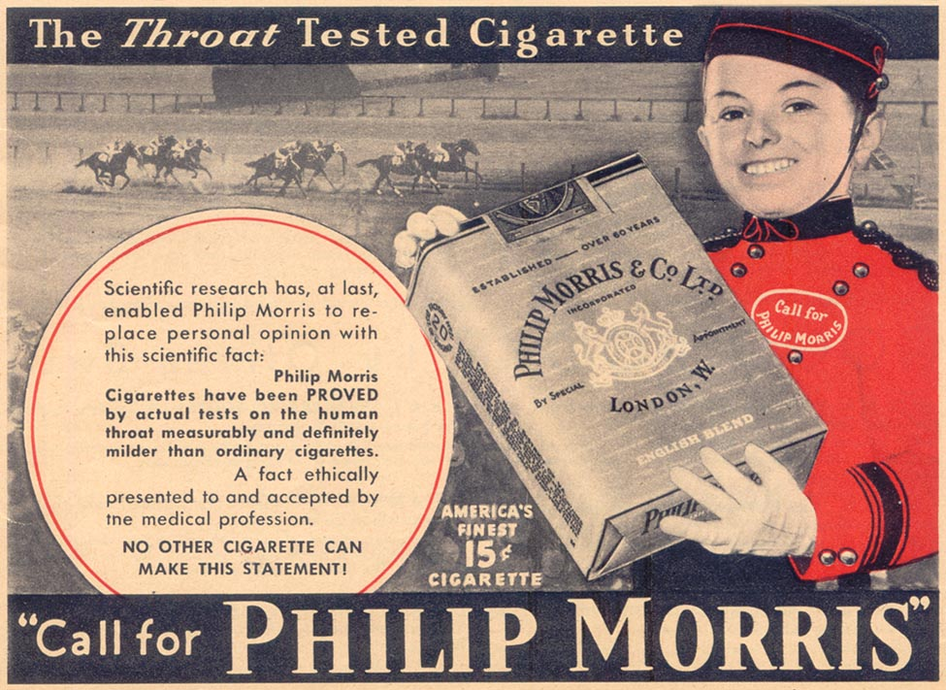
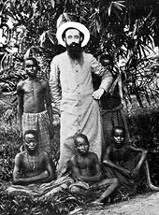
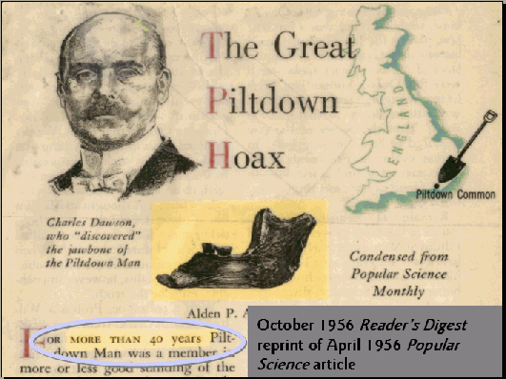
Many Knowledge Claims are misguided and some are even dangerous.
Ted talk: why people believe weird things

Slide 6
What will you do in Theory of Knowledge lessons?
Look at real life situations
Analyse how you know what you know
Discover a range of perspectives
Make links between aspects of the course and subjects you study

Slide 7
We make sense of the world through various ‘ways of knowing’.
Language
Reason
Emotion
Sense perception
Memory
Faith
Imagination
Intuition
You will analyse how you know through these Ways of Knowing in TOK classes.
STUDENT TASK: optical illusions

Slide 8
Task plenary
What does the after image (girl) tell you about the limitations of sense perception as a way of knowing?
How do you know which line continues the first (Poggendorf illusion)?
How do you know you really don’t have a hole in your hand (toilet roll)?
What does the changing face illusion say about sense perception and knowledge? Can our sense fool us?
What did you see first: the girl or the man? Why? Does this have implications for sense perceptions as a way of knowing? Do we see what is there or what we want to see?

Slide 9
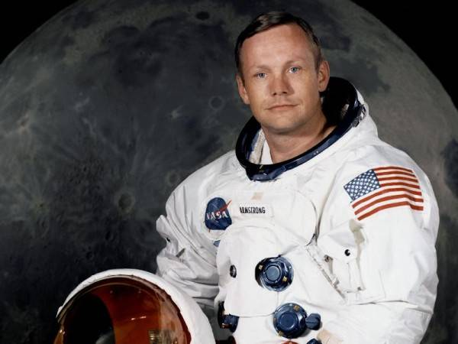
The ways of knowing in theory of knowledge classes:
Language: How do you know that Neil Armstrong landed on the moon in 1969?
Lots of knowledge is ‘second hand’.

Slide 10
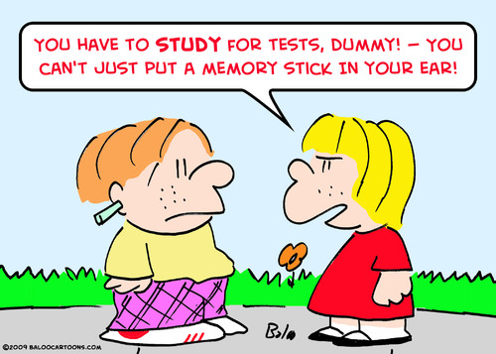
We make links between various ways of knowing and areas of knowledge.
MEMORY
Can our beliefs contaminate our memory?

Slide 11
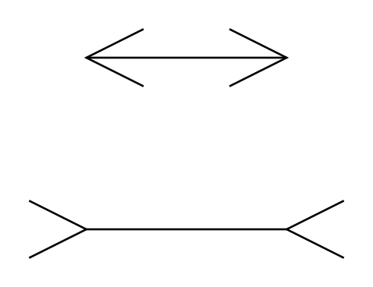
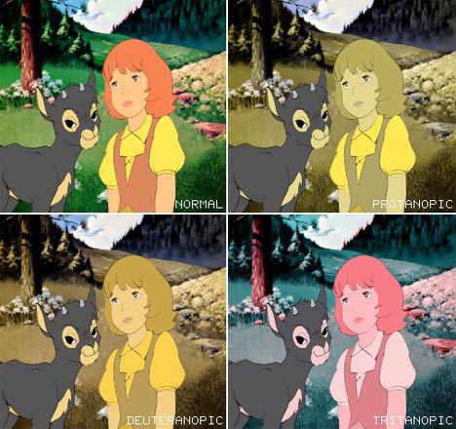
Sense Perception: How do you know which line is longest?
Colour blindness: not everyone perceives the world in the same way.

Slide 12
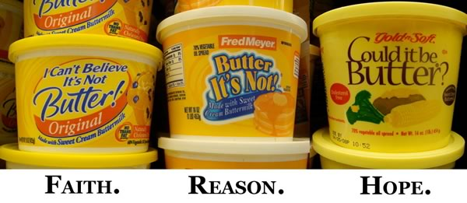
Faith
Does faith meet a psychological need?
We make links in TOK

Slide 13
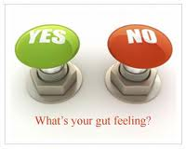
Intuition
Should you trust your intuition?
We analyse strengths and weaknesses of ways of knowing.

Slide 14
Watch out for logical fallacies!
I fit into my pyjamas, my pyjamas fit into my suitcase, so why don’t I fit in my suitcase?
Reason:
How do we know if (wrong) reasoning leads us to reasonable knowledge claims?

Slide 15
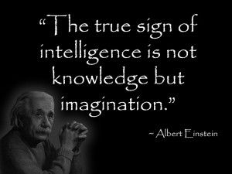
Imagination:
Can imagination reveal truths that reality hides?

Slide 16
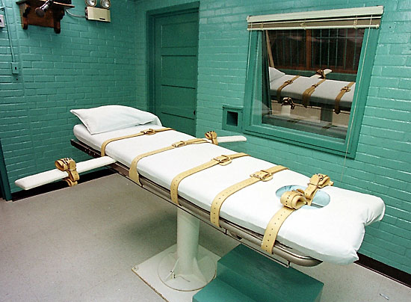
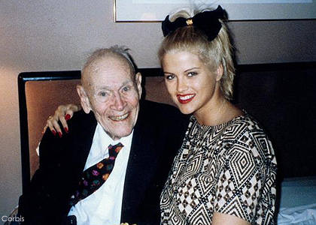
Emotion: How do you know what is right or wrong? Can you feel it?

