Slide 1
Ethics
Thanks to Richard van de Lagemaat,
Theory of Knowledge for the IB Diploma,
Cambridge University Press
‘Ethical axioms are found and tested not very differently from the axioms of science. Truth is what stands the test of experience.’
Albert Einstein

Slide 2
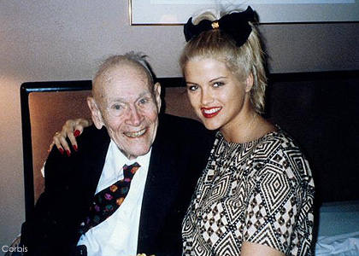
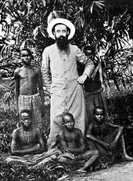
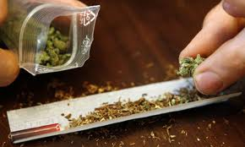
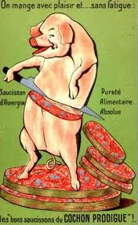
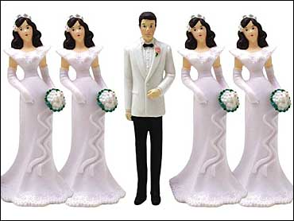
How do we know what’s right or wrong?

Slide 3
How do we know what’s right or wrong?
Is abortion ever justified?
Should drugs be legalised?
Are there limits to free speech?
Should Euthanasia be legalised?
What is the ethical age difference between (sexual) partners?
Is homosexuality wrong?
Is incest wrong?
Which way of knowing do you resort to when making your moral judgment? Are you affected by the knowledge community you belong to?

Slide 4
How can we justify our moral judgement?
Moral taste?
Emotions and moral judgment.
moral reasoning
(value judgments)
http://www.ted.com/talks/david_pizarro_the_strange_politics_of_disgust.html
Based on assumptions?
Is their such thing as moral knowledge?

Slide 5
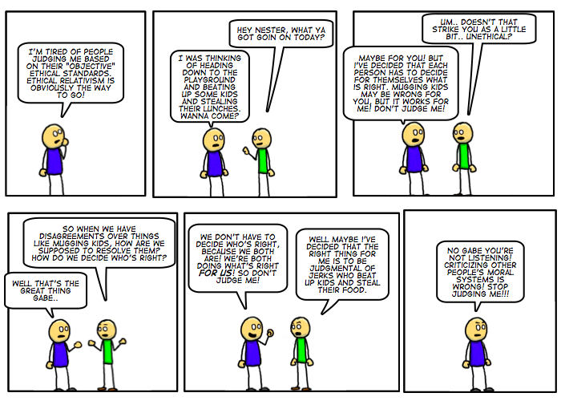
Moral relativism?

Slide 6
Theories of ethics
Religious ethics
Duty ethics
Kant’s approach to ethics
Utilitarianism

Slide 7
Key points and terms
Justification of moral principles
Moral relativism versus universal core values
Altruism
Moral values and religion (versus Plato and atheist points of view)
Kant’s notion of duty
Kant’s limitations of solving moral dilemmas
Utilitarianism: the greatest happiness for the greatest number
Objections and limitations of utilitarianism
Good judgement

