Slide 1
The Milgram Experiment
Another inconvenient truth
Are YOU capable of cold blooded murder?
Notes:
So, you’re all here wanting to find out the answer to the big question (.’Are you capable of cold blooded murder’) Did you know that statistically: 1 in 100 people has psychopathic tendencies? So, there’s a good chance that one of us here today is a psychopath, statistically... It could well be the person sitting next to you right now. But this lecture is not so much about psychopathic murderers.
Today I will tell you a bit about the Milgram experiment and how this social psychological experiment may reveal quite an uncomfortable truth about us all. To explain what the Milgram experiment is all about, we need to go back to the aftermath of WW2

Slide 2
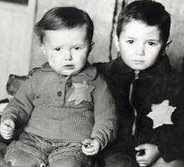
1. The setting
Are YOU capable of murdering innocent people?
Notes:
Your are all familiar with the atrocities of the holocaust, the genocide and systematic murdering of approximately 6 million innocent Jewish people. I want you to have a good look at the picture: would you be capable of murdering these innocent children? Surely murdering innocent children like these= the work of psychopaths?

Slide 3
Notes:
If this is true, is the holocaust the work of psychopaths on a very large scale?
Was Nazi Germany a nation with a huge proportion of psychopaths?
Or were ‘ordinary people’ involved? To answer this question we need to look at Eichman’s trial.

Slide 4
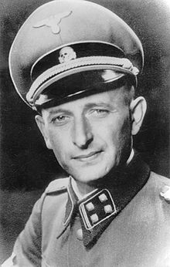
Eichmann’s trial
"I never did anything, great or small, without obtaining in advance express instructions from Adolf Hitler or any of my superiors."
“I was only following orders.”
He explicitly declared that he had abdicated his conscience in order to follow the Führerprinzip.
Notes:
Eichmann was one of the major organizers of the Holocaust. He sorted out the logistics of mass deportation of Jews to ghettos and extermination camps. After the war, he fled to Argentina ^{5]} where he lived under a false identity, working for Mercedes-Benz until 1960 when He was found out in and taken to Israel to face trial in an Israeli court on 15 criminal charges, including crimes against humanity and war crimes. He was found guilty and executed by hanging in 1962, but the interesting thing is not so much his punishment as the trial as such. During his trial he mentioned that he was just following orders, even if these orders clashed with his personal conscience.

Slide 5
Israeli psychiaters concluded that Eichmann was ‘normal’
.
Eichmann= the embodiment of the banality of Evil
(Hannah Arendt)
Notes:
Eichmann appeared at his trial to have an ordinary and common personality, displaying neither guilt nor hatred and Israeli psychiaters concluded that he was ‘normal’. Hannah Arendt, a political theorist, suggested that this most strikingly discredits the idea that the Nazi criminals were manifestly psychopathic and different from ordinary people. Eichmann himself said he joined the SS not because he agreed with its ethos, but to build a career. According to Hannah Arendt, Eichmann was the embodiment of the ‘banality of evil’. This does not mean that evil is banal, but that evil is something which could be present in ordinary people.

Slide 6
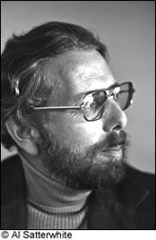
What does this mean for us?
The Milgram Experiment,
1961
Notes:
To which extent would ordinary people like you or me have been willing to follow Hitler’s orders? How likely would you or me have committed war crimes? This is where Stanley Milgram comes in.

Slide 7
2. The experiment
Social psychological experiment
Conducted by Stanley Milgram
Yale University- 1961
Measured to which extent people are willing to obey a figure of authority who asks them to do something
which conflicts with their personal conscience
Notes:
The experiment was conducted three months after Eichmann’s trial. On ordinary American (not German) citizens.
Conflicts with conscience, just as Eichman claimed he obeyed orders which conflicted with his conscience

Slide 8
Notes:
People were told they could take part in a memory study by either playing the role of the teacher of the student. The memory experiment would check whether students would learn better if they were punished when they got answers wrong. In this case the punishment would be the delivery of electric shocks (imagine I could do this each time you got a poor mark on your French vocab tests, you’d all be studying like hell?). The volunteers who answered the above add were led to believe that ‘chance’ would determine their role in the memory experiment. But, in fact, all volunteers ended up with the role of the ‘teacher’ and all the student roles and ‘memory expert roles’ were played by actors.

Slide 9
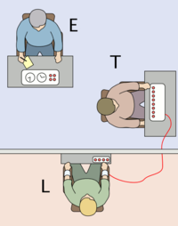
How?
Electric shock generator (fake) from 15 Volt to 450 Volt (deadly)
Teacher
(real subject of the experiment)
Experimenter
(authority figure-actor)
Wall through which can be communicated (sounds only)
Learner (actor)
Notes:
The volunteers, who got the role of the teachers, were in fact the real subject of the Milgram experiment. The Milgram experiment wanted to find out to which extent ordinary people were willing to do something they would find morally wrong (In this case it was ‘distributing electric shocks’). just because an authority figure told them to do so. The shocks were fake, but the ‘teacher’ did not know this. The teacher could not see the student, but they could hear the sounds and screams through the wall, and they really believed that they were delivering these electric shocks.

Slide 10
Video Milgram’s Obedience experiment
03.00 – 5.40 mins
Notes:
To illustrate the experiment, I will now show you a short clip with authentic footage of the Milgram experiment.

Slide 11
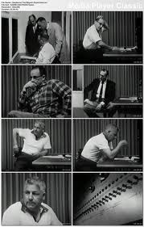
Please continue.
The experiment requires that you continue.
It is absolutely essential that you continue.
You have no other choice, you must go on.
Notes:
As you have seen Stanley Milgram exaplain himself the shocks delivered through the ‘electroshockmachine’ started from a mild 15 volt, but went all the way up to the deadly 450 volt. Many volunteers did not feel comfortable delivering these shocks and when they hesitated the authority figure encouraged the teachers to continue through the use of the following verbal prods. The teachers were also told that the experimenters would take full responsibility for the experiment.

Slide 12
The predicted outcome
Poll before the experiment asked senior psychology students at Yale to estimate the outcome of the experiment:
About 1.2 % of participants would be prepared to inflict the maximum (deadly) voltage
Notes:
Before the experiment senior psychology students at Yale university were asked to estimate the outcome of the experiment. They thought that...

Slide 13
The actual outcome
About 65% of participants were willing to inflict the maximum DEADLY voltage.
(even though many did not enjoy doing this)
Notes:
This contrasts sharply with the actual outcome of the experiment, whereby .....

Slide 14
http://www.youtube.com/watch?v=GHuI2JIPylk&feature=related (till 2.30 seconds)
Notes:
If this is all getting a bit much, a bit deep, have a look at this short and slightly simplified animated version about the Milgram experiment.

Slide 15
Conclusion of the experiment
Obedience=dangerous
‘Ordinary people, simply doing their jobs, and without any particular hostility on their part, can become agents in a terrible destructive process. Moreover, even when the destructive effects of their work become patently clear, and they are asked to carry out actions incompatible with fundamental standards of morality, relatively few people have the resources needed to resist authority.’
Milgram. The Perils of Obedience, 1974.
Notes:
As you’ve just heard, the results of the Milgram experiment truly shocked the world (no pun intended). After WW2 many people wanted to believe that the evils of the holocaust were the work of psychopaths, or people who were very different from you or me. Some people also wanted to believe that German nationals were particularly suited to the evils of the holocaust, a belief which is still present in current stereotypes today. The Milgram experiment, however, showed that, as Stanley Milgram described in ‘The Perils of Obedience’..................................... It is safe to say that blind obedience can be quite dangerous.

Slide 16
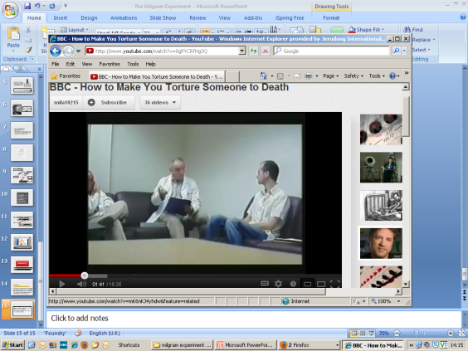
3. Modern day applications
The BBC remake
Other social experiments.
Modern genocides and unethical regimes.
http://www.youtube.com/watch?v=0gPYCRfHg3Q
Notes:
You may think that all this happened so long ago and that the experiment may not be relevant to your own life. That the world has changed, that we are better educated etc. But the recent BBC remake (check out youtube) comes up with the same results (by the way, young people seem to be much more willing to obey authority). Some people may feel that the experiment was flawed for some reason, but many similar other social experiments on authority led to the same outcome as the Milgram experiment. Finally, it’s worth remembering that since the holocaust there have been many other instances of genocides, which would not have been able to happen without the obedience of ordinary citizens.

Slide 17
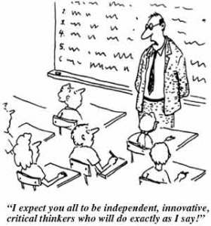
Plenary-Your own life
Would you have administered the maximum voltage?
How likely are you to challenge (unethical) authority ?
How sound is your moral judgement?
Have you ever done something unethical due to the pressure of your environment?
Notes:
We’re coming to the end of the lecture and as a plenary I would like you to apply the conclusions of the Milgram experiment to your own life by glancing over the following questions. Today, by explaining what the Milgram experiment is all about I hope you have gained an understanding of the dangers associated with blind obedience and authority worship. I also hope you will think twice before doing something you know is unethical just because someone else told you to. Finally, I also hope that by understanding the evil potential in all of us you may be less quick to judge others and take more responsibility for your own actions.

