Slide 1
Personal knowledge…
Over to you!

Slide 2
Two real world examples, where natural science and Psychology overlap…
Prosopagnosia

Slide 3
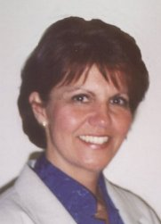
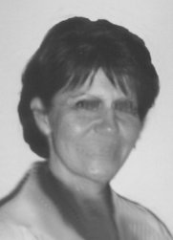
Prosopagnosia

Slide 4
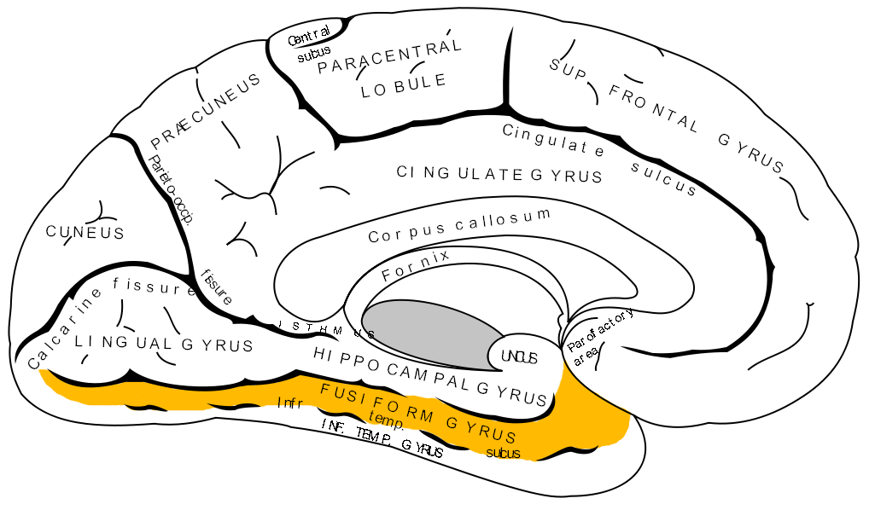
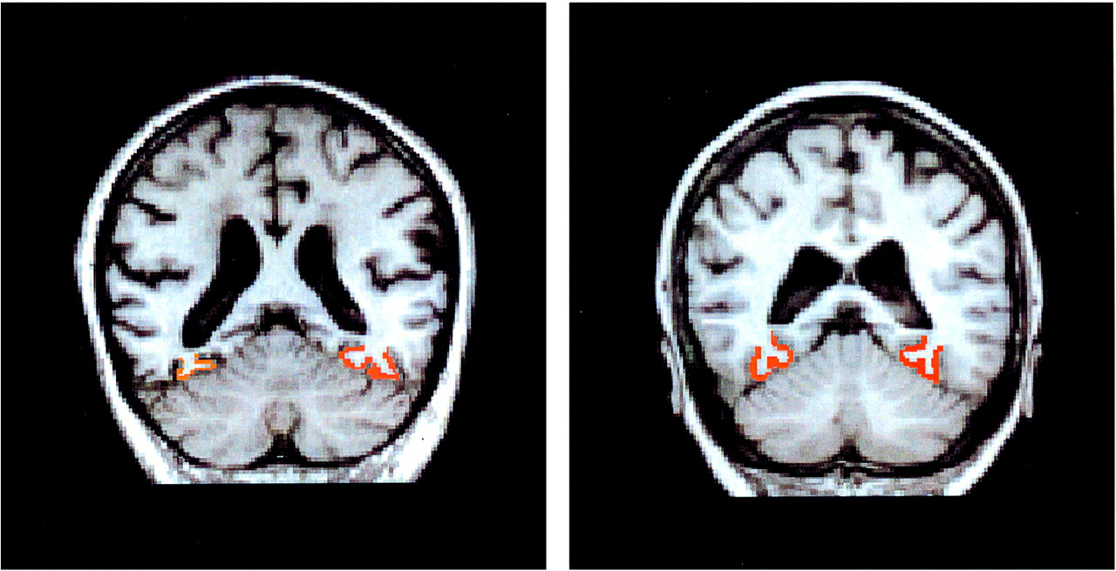
Prosopagnosia
http://www.youtube.com/watch?v=wlFi6IV42Ag&feature=related

Slide 5
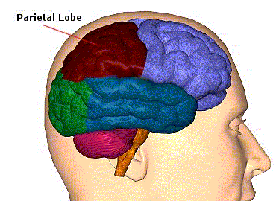
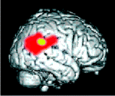
2. Hemispatial neglect

Slide 6
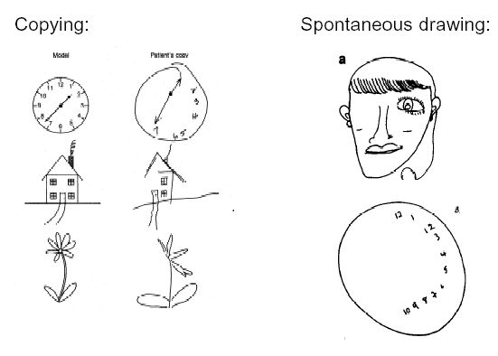
Hemispatial neglect
http://www.guardian.co.uk/science/blog/2012/nov/23/man-brain-ignores-half-world

Slide 7
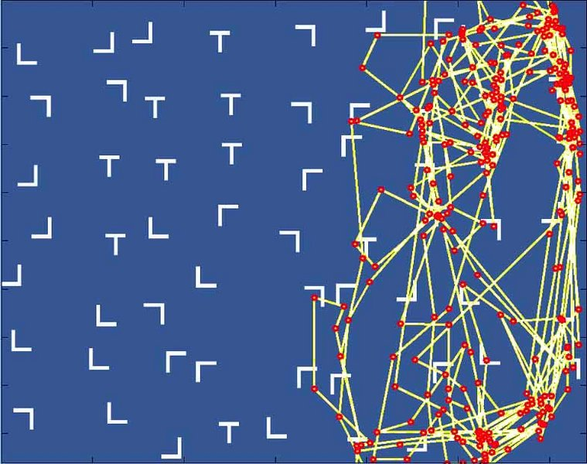

Slide 8
Blindsight
Charles-Bonnet syndrome
Apperceptive agnosia
Anosognosia
The Capgras delusion
Science funding
Researcher bias
Experimenter ethics

Slide 9
Ideas for KQs
Anosognosia – How can you convince someone that reality doesn’t not match their strongly held sense perceptions?
Beauty and arts – Does investigating something scientifically make it less mysterious or beautiful?
Ethics (e.g. Andrew Wakefield) – Should scientists who publish misleading or inaccurate findings be imprisoned?
Reason and reliability – How many times should scientific findings have to be replicated if we are to accept them?

Slide 10
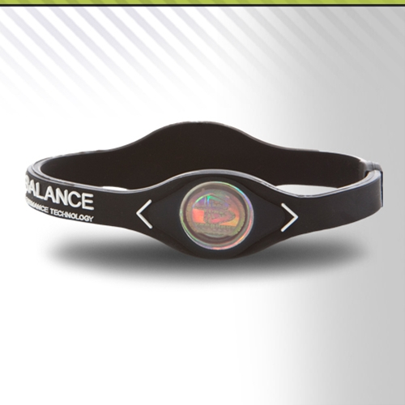
Science, pseudo-science and non-science
Do Powerbalance tests?

Slide 11
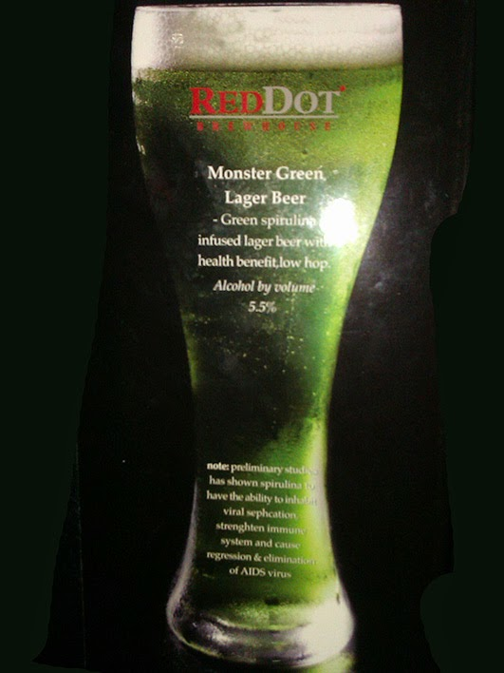

Slide 12
